Slide 1
Pulmonary Rehabilitation Impact Model on Exacerbation (PRIME) tool
England

Slide 2
Background
The PRIME tool was commissioned by the CSP through the Physiotherapy Works programme. The work was undertaken by Imperial College London, with input from an expert steering group, and the model was launched in April 2017.
Aim
The PRIME tool aims to use available evidence and data to model the impact of pulmonary rehabilitation (PR) on exacerbations of chronic obstructive pulmonary disease (COPD).
Format
The PRIME tool is an excel spreadsheet embedded in the CSP website.
Assumption
The key assumption is that exacerbations are reduced by 36.4% when PR is completed by eligible patients with COPD.
It is freely available to anyone, members and non-members alike.

Slide 3
How the PRIME tool can be used?
See the list of practices within a given CCG, and how many there are
Use the recommendations to help inform service improvement
Compare your area’s performance against a specific benchmark area (e.g. CCG to CCG, CCG to national average)
Compare your area’s current performance against its future forecast performance.
This benchmark and forecast information can be used to:
o make a business case for service improvement in your area
o break down costs to support business case
o demonstrate the quality of your service

Slide 4
How to access the model
When opening the model* you may need to enable macros by clicking the button in the task bar at the top of the screen.
If the banner doesn’t automatically pop up, you can check that macros are enabled by doing the following:
*We recommend that you download the model and save it to your desktop. The model is not suitable for use on Mac devices or mobile devices.
Click the Microsoft Office Button or the File Tab and then click Excel Options.
Click Trust Centre, click Trust Centre Settings, and then click Macro Settings.
Click on Enable all macros.

Slide 5
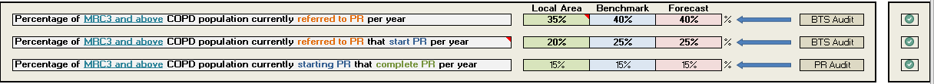
How to get your local data: User input page
If these boxes are ticked, the values you entered have been updated and all calculations will be based on your local data.
If you have local data available, you are advised to input these into the green boxes throughout the User Input page, so the results you get are as accurate for your local situation as possible.
It is not advisable to alter the benchmark or forecast values as they have been set to national average values.
These boxes indicate where the data has come from, and clicking on the text will lead to further information on how the data has been derived.
Scroll to the top of the page and click the ‘calculate’ button to update the values.

Slide 6
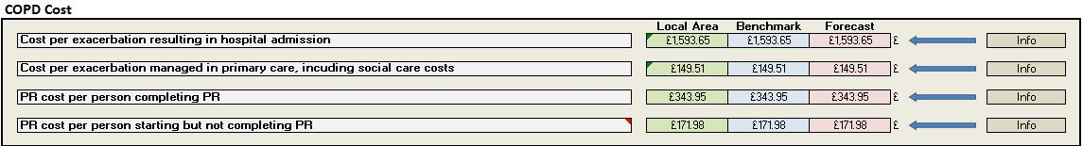
How to get your local data: User input page
If you have local data available on the costs of PR or the costs of exacerbations in your area, you can enter these into the COPD Cost table green boxes
You can find out how these benchmark figures have been calculated on the Exacerbation & PR Costs sheet.

Slide 7
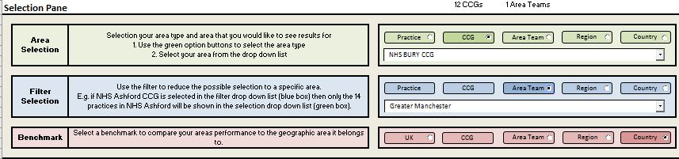
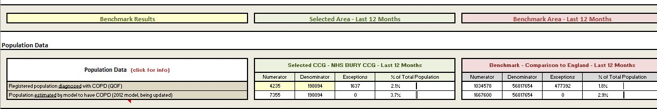
How to get your local data: Benchmarking (Results page)
To narrow down the practice or CCG options available, use this blue box to add a filter
In this example, NHS Bury CCG is being compared to England
The benchmarking results show NHS Bury has a slightly higher percentage of the population diagnosed with COPD and higher estimation of undiagnosed COPD patients than England as a whole. When you scroll down the Results page, you will also find tables comparing your selected areas’ costs and rates of exacerbations (both hospital and primary).

Slide 8
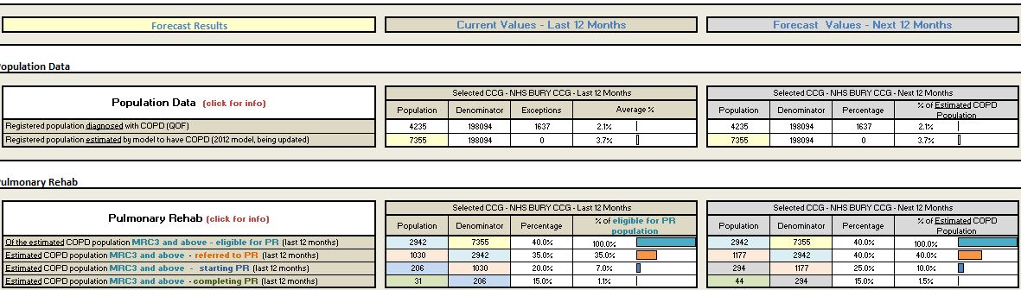
How to get your local data: Forecasting (Results page)
If the “Forecast Results” option is selected at the top of the Results page, you will see figures for your chosen area for the last 12 months and the forecast for the next 12 months.

Slide 9
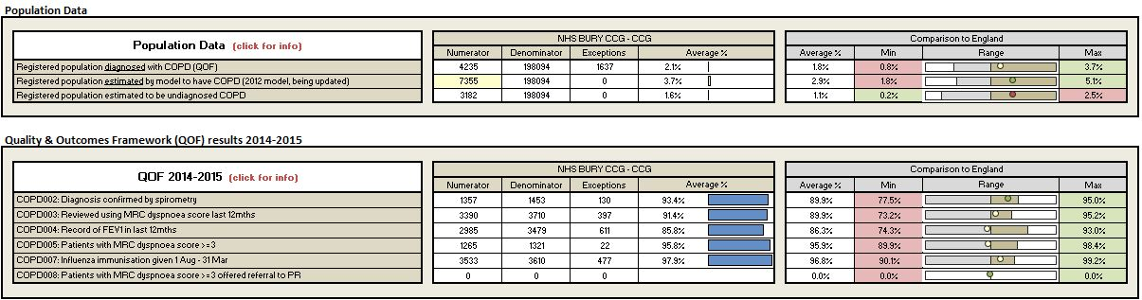
How to get your local data: QOF (Results page)
At the top of the Results page you can choose to look at QOF results for your chosen area. This will give you the QOF 2014-15 figures for the area chosen (in the below this is NHS Bury CCG) and also give a comparison to the area chosen (in this case the comparison is to England)

Slide 10
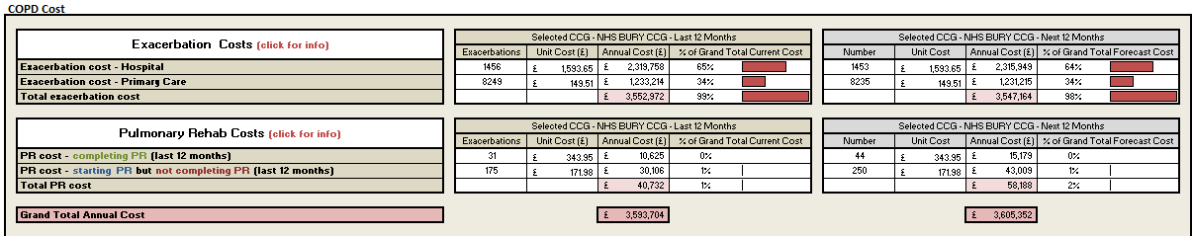
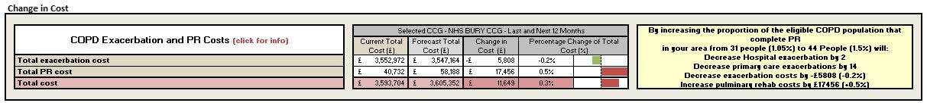
How to get your local data: Forecasting (Results page)
When you scroll down the Results page you will also find tables forecasting costs of both Exacerbation and Pulmonary Rehab for your chosen area, in the last 12 months and for the next 12 months.
At the bottom of the Forecasting results you’ll see potential results for the area selected in increasing the percentage of the eligible COPD population to complete PR.
This table shows you potential decreases in exacerbations and costs through extending PR

