Slide 1



The Value of Physiotherapy in Community Urgent Care
Sophie Wallington
Advanced Physiotherapist Practitioner

Slide 2

Hello!
My name is Sophie Wallington
Advanced Physiotherapist Practitioner

Slide 3
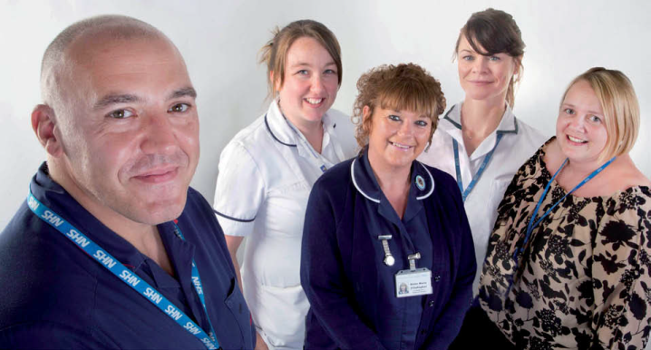
Crisis Response Service
Community Assessment and Support Service (CASS)
North Manchester Community Services
Urgent Community Care 72 Hour Service
Integrated Health and Social Care delivery model
1-2 hour response
7-day service
Credible alternative to A&E
Direct referrals from:
      Urgent Care
      Ambulance Service
      GP’s
      Health and social care professionals in the community
      Community Alarms

Slide 4

Skills
Role
Impact
Notes:
Learning outcomes:
The core and extended skills both clinical and non-clinical
Protecting roles through leadership and accountability in the context of a changing workforce. Thinking differently about extending the scope of Physiotherapists’ skills within an urgent community care setting
What Physiotherapy can offer Intermediate Care and Community Urgent Care

Slide 5


Skills
Push the boundaries of traditional Physiotherapy practice

Slide 6
Patient advocacy
Venepuncture
Skin and Continence Assessments
Dysphagia Assessment
Moving and Handling risk assessment
Point of Care Testing
Non-medical Prescribing
Commissioning Social Care Packages
Equipment Assessment
Acute Respiratory Exacerbations
Mental Capacity and DOLS
Advanced Care Planning
Pain Management
Cognitive Assessments
Neuro Assessment
Self-Care Facilitation
Motivational Interviewing
Interpreting diagnostics
Community risk assessment
Case Management Co-ordination
Notes:
Think about your role and your service, and make changes to close any gaps there might be? Delays in care / screening not specialist assessment to accurately stream demand to specialist services and assessment

Slide 7

The Physiotherapy Offer
Linking physiology and function
Holistic
Impact on daily living rather than purely medical or physiological presentation
Systematic
Assessment skills – Hands on
Level and depth of training
Clinical autonomy – work outside of a hierarchical system
Clinically competent diagnosticians
The Advanced Practice Role can act as a vehicle for allowing Physiotherapists access to the correct advanced medical knowledge and skills to competently sit at the front of this pathway – with adherence to strong clinical governance.

Slide 8

Traditionally Physiotherapy assessment and intervention is applied at the end of a care pathway, with a focus on rehabilitation, more specialised diagnosis and reversibility

Slide 9
Using a Physiotherapists’ skills right at the start of an assessment from A&E, Urgent Care, Urgent Community care clinical assessment – these very scientific, diagnostic, holistic skills are applied concurrently to the management of medical, nursing and social care issues.
It can often add a different perspective to management and it can aid a speedy recovery as some of the self care elements of Physiotherapy intervention are instilled early on.
This is not a replacement of the traditional role of rehabilitation – more assists in streaming the appropriate patients down the right therapy pathway, and kick starts the process early.

Slide 10
Roles
👧
Protect changing roles through leadership and accountability. Extend scope appropriately to improve care, not careers

Slide 11
Extending the roles of individual team members and role blurring
Leads
The most appropriate assessor for the patient
Ability to troubleshoot unknown issues through extended skill base
Delegation and direction
Clinical Governance
Assistant Practitioner Competencies

Slide 12
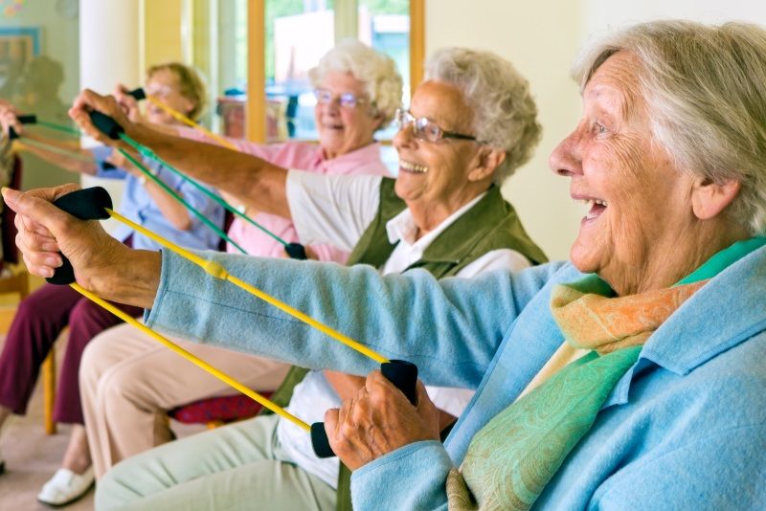
Benefits and Impact
.

Slide 13

Acute hospitals focus on treating those requiring specialist or more complex treatment
Rapid access to information, advice and treatment
Better use of highly trained clinicians’ skills and expertise. Offers patients access to the most appropriately trained professional
Enhances workforce capacity in community services and supports delivery of more care outside hospital, closer to home
Enable GPs to maximise the use of their medical training and skills in dealing with complex clinical work. Shared care with the GP, with clinical confidence and credibility

Slide 14

£921.81
Ambulance (£213.81), A&E Assessment (£104), Less than 24 Hours (£604)

Slide 15
£1800.00
Flat rate tariff for non-elective hospital admission

Slide 16
£435.00
1 Week in Residential Care. Manchester Local authority Rate

Slide 17
£23.50
1 Hour Senior Physiotherapist Contact Time in Patients’ Home

Slide 18
Be Proud
Think Differently
Make an Impact

Slide 19

Thanks!
Any questions?

Slide 20
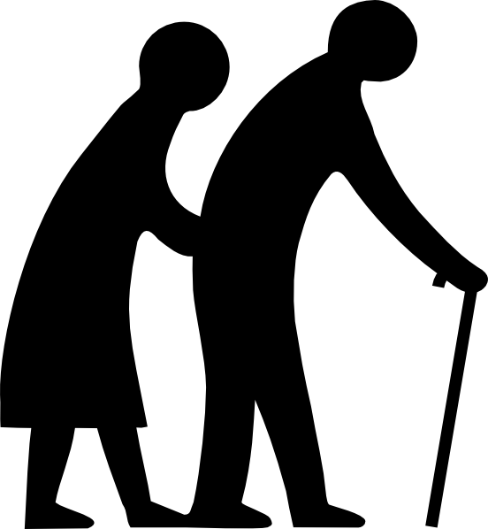
Frailty
A complex problem requiring a complex solution

Slide 21

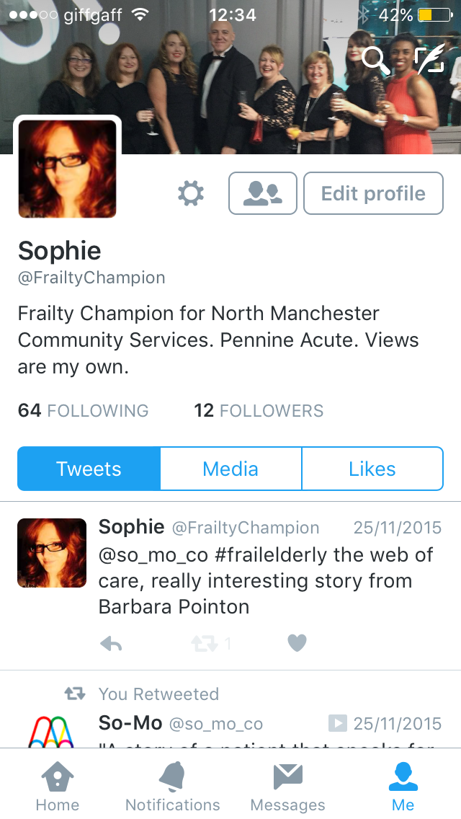
@FrailtyChampion
Build a network and enhance opportunities to share learning, ideas and increase knowledge of local and national initiatives in the field
Sophie.Wallington@NHS.Net
Place your screenshot here

