Slide 1


Twitter – the basics
Twitter.com or app on smart phone / tablet
Select a picture and write a bio
@theCSP
Following – people you find interesting!
Followers – people find you interesting!
Writing a tweet
Reply, Retweet, Quote retweet
#localinfluence #CSPARC2018
Search feature

Slide 2

Profile page
Profile picture and bio
Write a tweet
Following
Followers
Notifications
News feed
Search feature

Slide 3
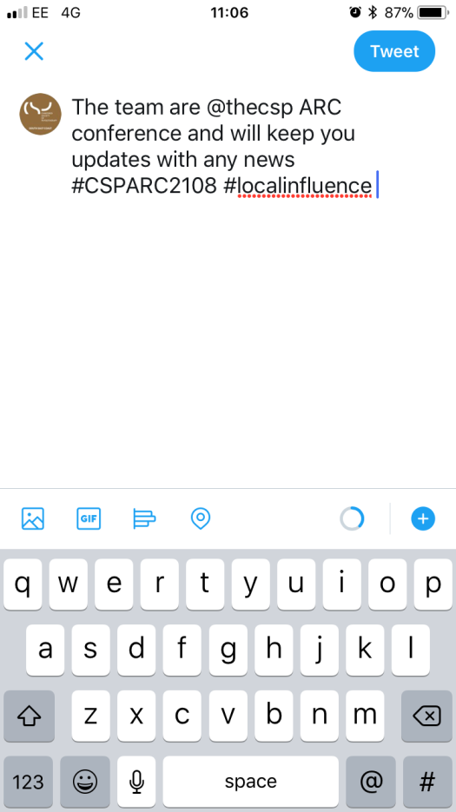

Write a tweet / Retweet!
#hashtags
Add pictures
Reply
Retweet
Like

