Slide 1
AHPs Supporting Unscheduled Care and Improving Patient Flow
Caroline Poole
Deputy Clinical Director Allied Health Professions (AHPs)
@carolineNhs
caroline.poole4@nhs.net

Slide 2
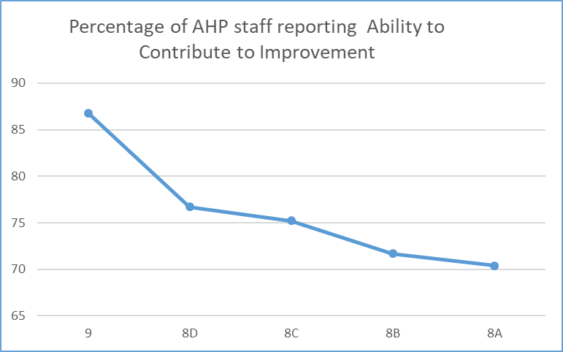


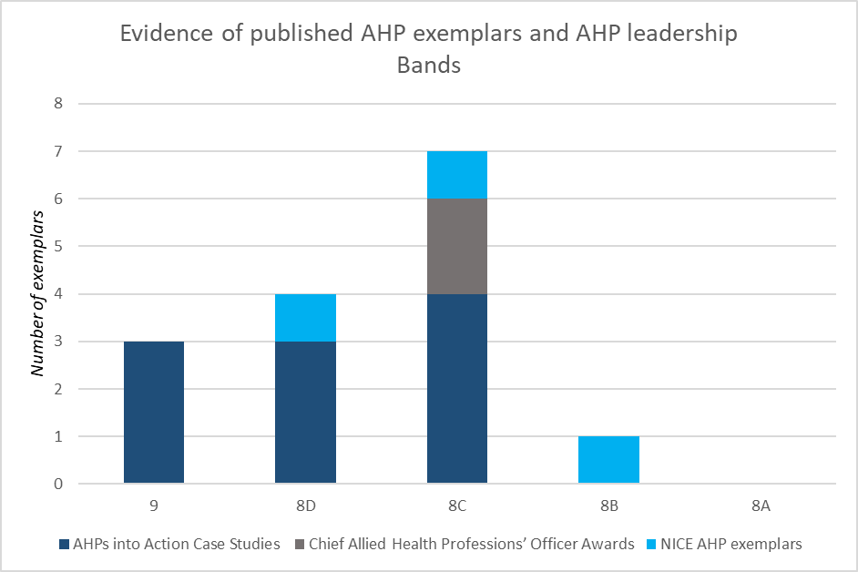
Visibility & Influence
Contribution to QI activity
Notes:
And this is why it matters.
We know that leadership for improvement is critical

Slide 3
Staying in hospital is bad for patients – acute or community it leads to deconditioning and harm and for many patients never returning to their homes after their hospital admission #Homefirst
20 – 25 % admissions do not need to have come into hospital and 50% of bed days are not required for clinical reasons could be managed in a lower level of care preferably at home
50% of people could have been discharged on lower level pathway
At least 50% of the reasons for not needing to be in hospital are in the direct control of the hospital
350000 patients spend over three weeks in hospital each year
Notes:
A few facts and figures to start off setting the scene
Waste…..inappropriate care……patient experience……impact on system resilience

Slide 4
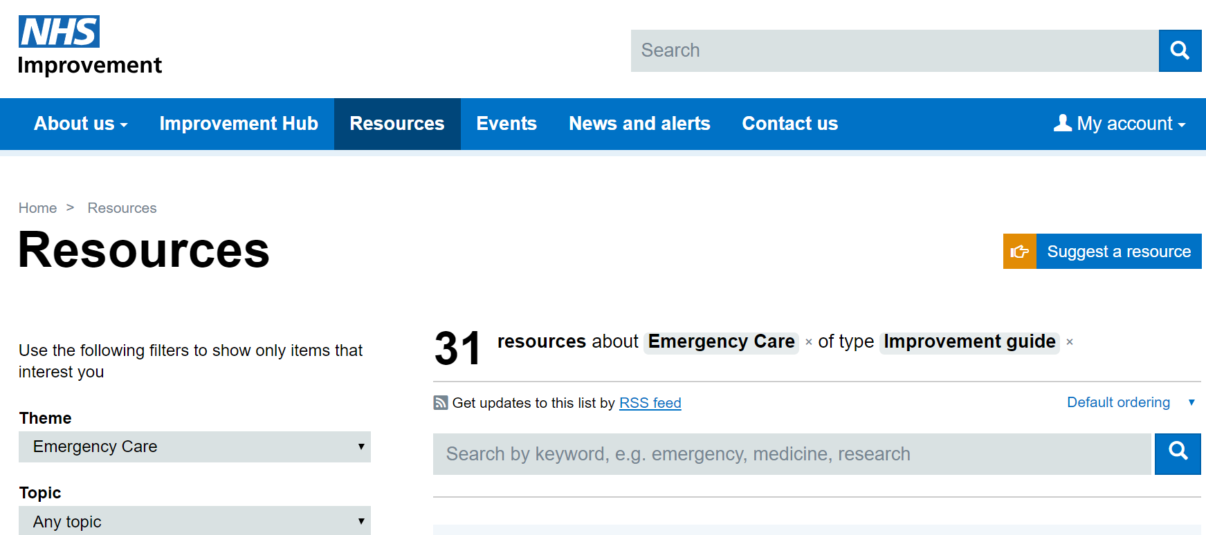

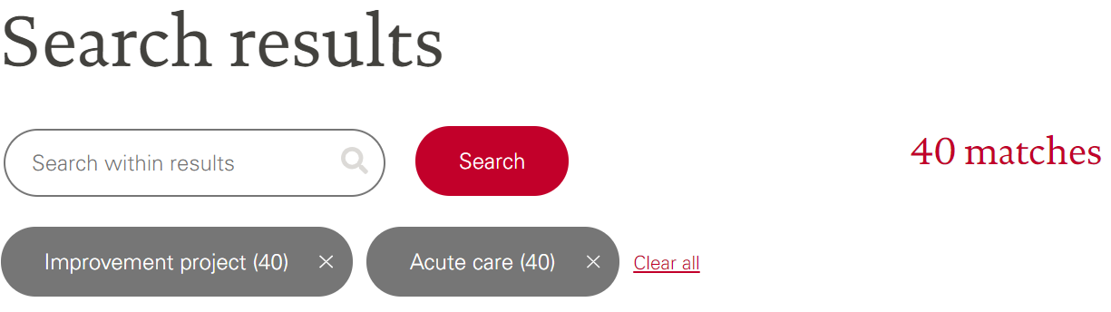
Lots of ideas already published….

Slide 5

AHPs CAN support patient flow
15 case studies with evidenced impact
Notes:
AHPs into action
We can have an impact on urgent and emergency care
This document published April 2018 demonstrating some of the areas we were delivering real impact and system change

Slide 6


Slide 7
The collaborative: high demand
44 trusts and their system partners completed the programme
Competing priorities and lack of AHP leadership were cited by some trusts as the reason why they could not participate at this time, despite their desire to do so
Collaborative delivery from NHS Improvement between Emergency Care Intensive Support Team and the AHP Team
Notes:
We decided to support the system – to provide an opportunity for leaders to step forward

Slide 8
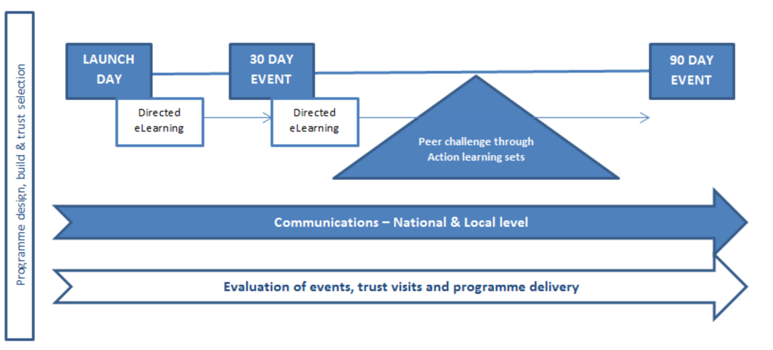
The collaborative structure
Blended approach, 90 days rapid improvement cycle using Model for Improvement
Notes:
We used the methodology of an improvement collaborative –
3 face to face events and a set of peer-to-peer learning opportunities through action learning sets
Supplemented by e-learning
2 aims:
To reduce longer lengths of stay
To develop improvement capability that is transferrable to other projects and pathways

Slide 9
Reducing longer lengths of stay following emergency admission
- Local opportunity
- Not prescriptive

Slide 10
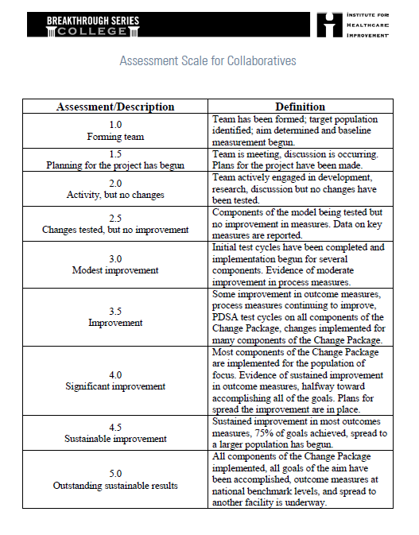
Measurement: two key tools
Notes:
We wanted to be able to demonstrate SHIFT from the baseline – recognising that some teams were already actively engage in their change work – whereas others may not have met before day 1 as a team

Slide 11
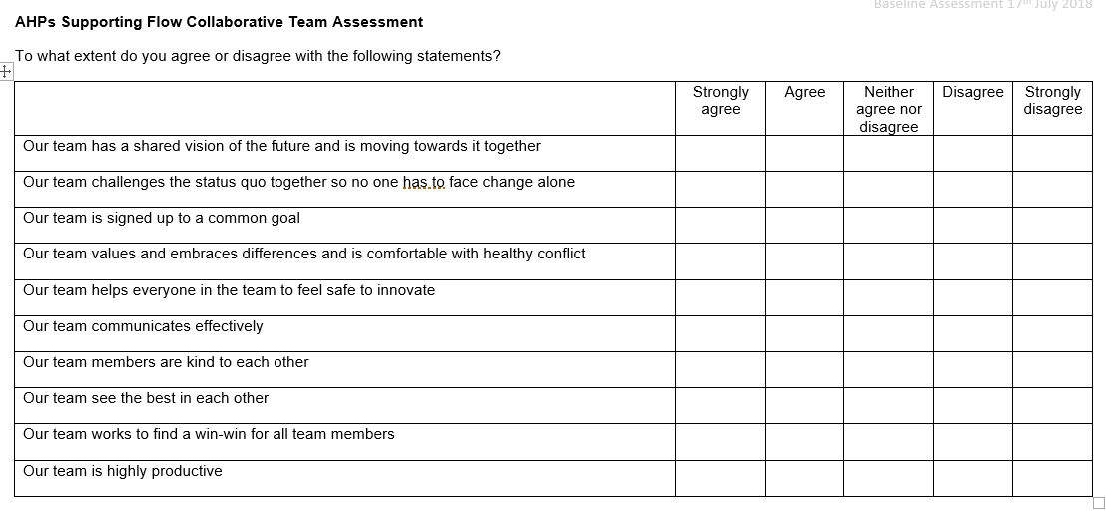
Capturing shift in team behaviours: bespoke tool
Notes:
We also wanted to capture the impact of the collaborative on team working across disciplines and organisations – again recognising the variation in baseline and building reasonable expectations for the 90 days.
Also wanted to be able to articulate the shift in cohesive team behaviours as we know that is a good predictor of healthy collaborative working which is so important

Slide 12
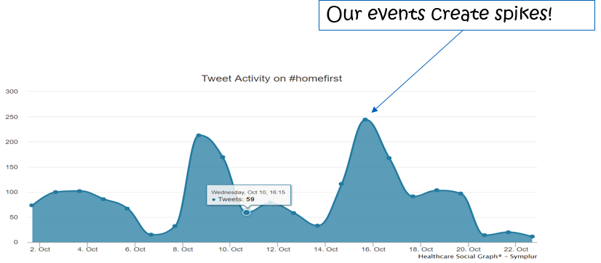
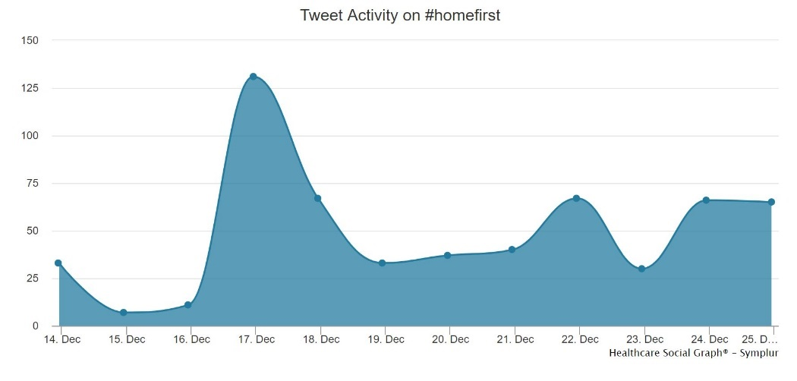
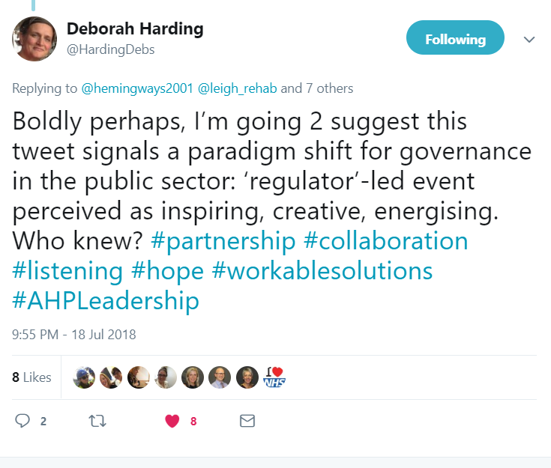
Engagement Measures
Twitter via #HomeFirst
“The energy & drive of everyone involved”
“Feeling empowered to make suggestions toward a larger collaborative goal”
“I was really quite blown away with the enthusiasm and innovation in the group – it’s really made me think about how we could develop a bit more passion and ‘blue sky thinking’ […] I think we’ve got so bogged down operationally over time we’ve forgotten how to get excited […] and the impact we can have! Thanks for the motivation”

Slide 13
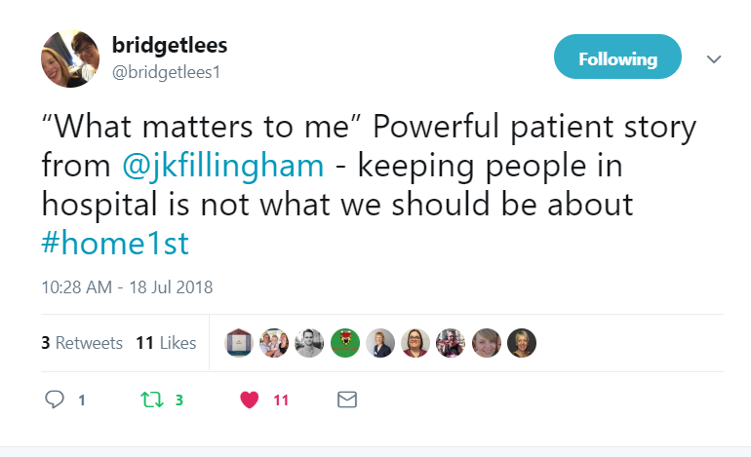
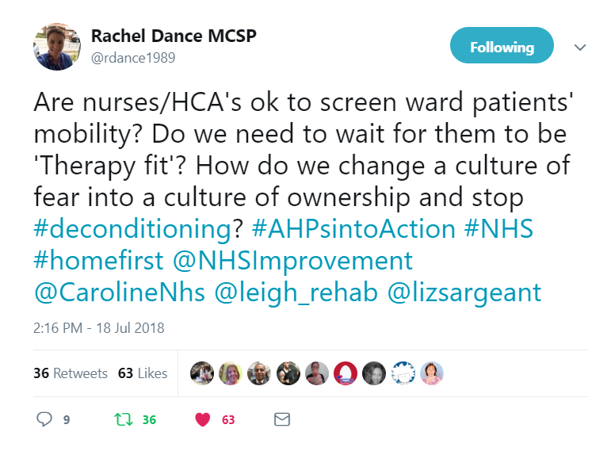
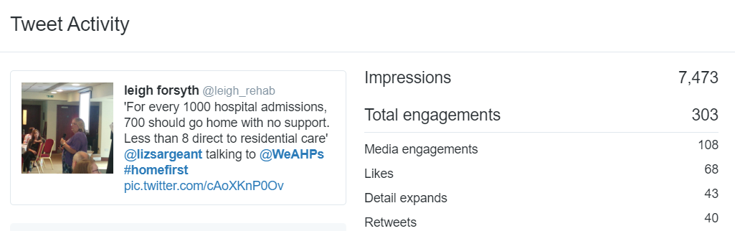
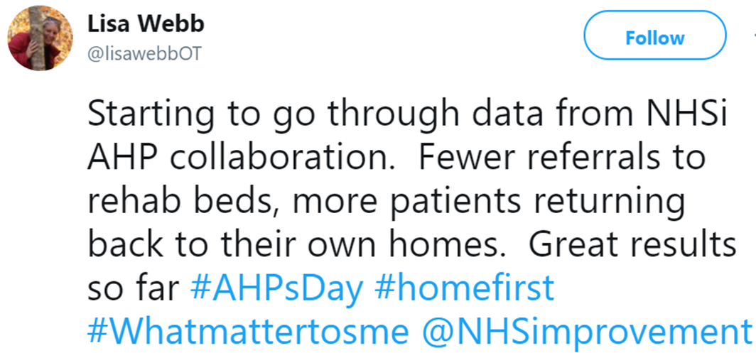
The power of twitter

Slide 14
Improved Team Cohesion (Behaviour)
Project Teams were asked to reflect on the status of their team’s cohesion at each touch point
The team working assessment tool was created bespoke for this collaborative and is based on assessing the recognising behaviours demonstrated by high performing teams
This illustrates a significant shift towards positive team culture that we anticipate will provide longer term benefit for both sustainability and a wider effect for the organisations participating.
The participating trusts submitted >84% of all ‘homework’ tasks on time, indicating a high level of engagement with the content.

Slide 15
Improvements Achieved (Results)
% of Trusts reporting improvements to varying degrees:
Cohort 1: 19 out of the 27 trusts (70%)
Cohort 2: 10 out of the 17 trusts (59%)

Slide 16
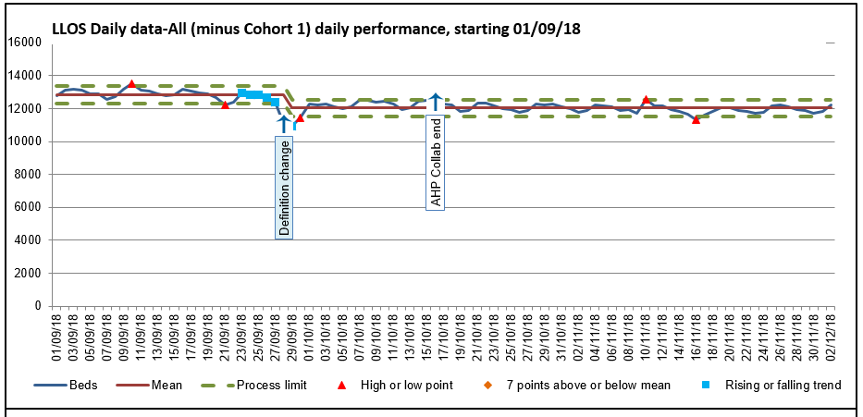
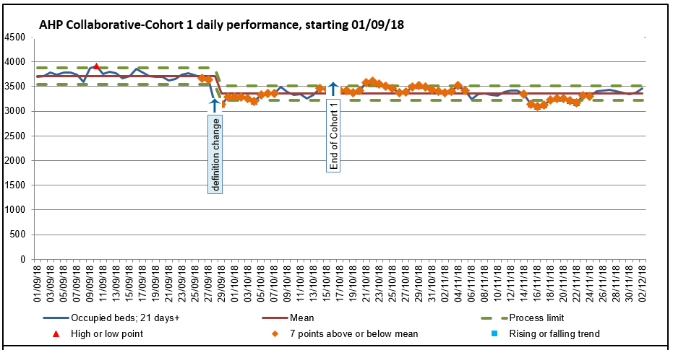
Long Length of Stay (Daily sit rep)
2.21% decrease in LLOS (National)
9.45% decrease in trusts in AHP collaborative
* we have been unable to pull the objective data from Cohort 2 into this report to cover the same period of time yet.

Slide 17
Site Feedback
“The best bit about this project is the way the team have just seen an opportunity and developed the model. The MDT approach of the team and the can do attitude has been great to witness. The results we are seeing are fantastic, but behind the numbers are our patients who are receiving more timely care, in the correct environment and being supported back home.
We have extended the scheme until end of March by which time a business case will have been developed. I’m very proud of the team and what has been achieved in a very short time.”
Chief Operating Officer
“It addresses the social issues that, previously we’ve simply not been set up to deal with”
Consultant
“Sometimes the easy way out is to admit; this has shown us a different way of thinking and working.”
Consultant

Slide 18
Delivering system and culture change, e.g.
Embed Homefirst culture
Increase number of patients discharged home rather than intermediate care
Increase number of patient discharged within 24 hours of being medically optimised
Implement radiographer-led discharge from emergency department
Identify nutrition and hydration risks in the emergency department
AHPs in handover from ambulance trust to support rapid discharge

Slide 19
Our learning
Time out as a team
Permission and authority to focus
Hidden and untapped talent
Energy and commitment
Making opportunities for your AHPs to demonstrate their leadership adds value
Short term collaboration energises and mobilises…
Notes:
This is our learning through this process

Slide 20


Slide 21
A call to action…
Can you describe the impact of your service in terms that your decision-makers recognise as important?
Can you clearly articulate the AHP contribution to your trust’s strategic priorities?
Who is your “go to” AHP lead; are you connected?
Notes:
These are the questions to ask yourselves

Slide 22

Any questions?
@carolineNhs

