Slide 1
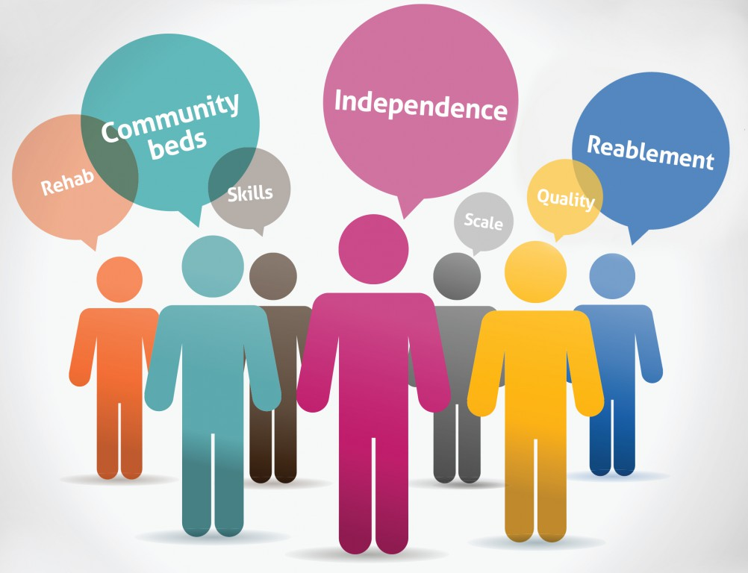

Commissioning For Intermediate Care
Victoria Tomlinson
Lancashire County Council
Senior Policy, Information and Commissioning Manager and Occupational Therapist

Slide 2


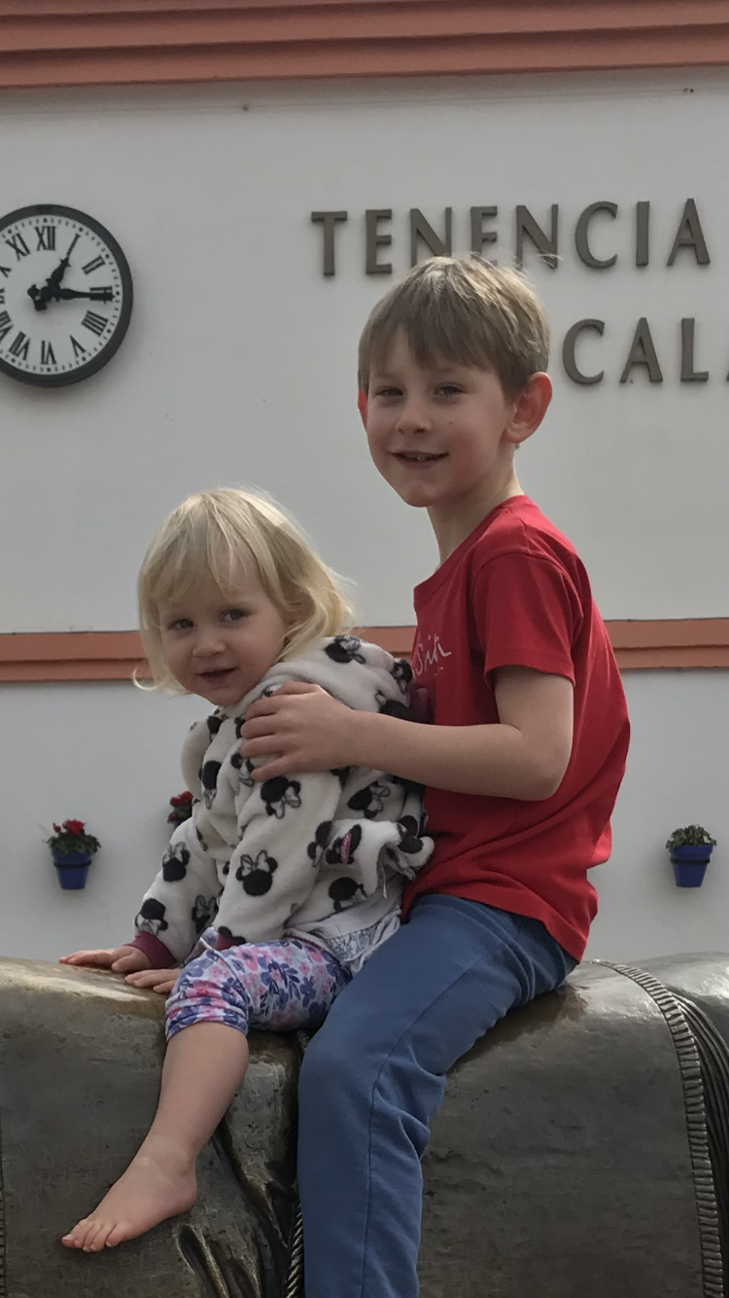


Who am I?
- Mum of 2
- HCPC registered Occupational Therapist
- Avid reader, Twitter and Facebook user
- Over 10 years experience working in the NHS before moving into Social Care Commissioning
- Exercise and Diet avoider
- Daughter to aging parents
- Wife of another Occupational Therapist

Slide 3
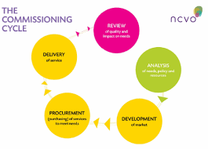
What is commissioning and how does it impact on my service?
“We ‘commission’ in order to achieve outcomes for our citizens, communities and society as a whole; based on knowing their needs, wants, aspirations and experience.”
(Integrated Commissioning for Better Outcomes 2018)
The Commissioning cycle is comparable to the AHP's Assessment, Treatment and Review of provision
Notes:
Commissioning is about more than procuring services, it is about a wide variety of activities which improve the outcomes and the lives for people, places and populations.
Good commissioning is increasingly building on the assets, strengths and skills of local communities and people to reduce the need for care and health support from the statutory agencies, and to improve outcomes

Slide 4
Shaping Provision and Market Shaping
Under the Care Act (2014), CCG and Local Authority commisioners are responsible for
“the efficient and effective operation of a market in services for meeting care and support needs with a view to ensuring that any person wishing to access services in the market:
• Has a variety of providers to choose from who (taken together) provide a range of services
• Has a variety of high quality services to choose from
• Has sufficient information to make an informed decision about how to meet the needs in question.”
https://youtu.be/3YdlV1DsK54

Slide 5
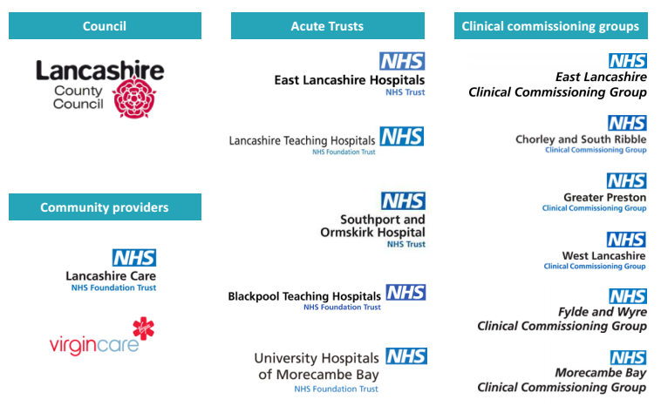
Intermediate Care in Lancashire
NICE states that intermediate care practice should be person-centred throughout the care pathway. This means that people should be involved in the planning of their own care and setting of goals. Eligibility should be considered on a case by case basis.
Contracting and monitoring processes must be flexible to facilitate this way of delivering care (NICE 2017).
Notes:
Person-centred approaches have also been found to support interdisciplinary collaboration: a qualitative study in Norway (Birkeland et al. 2017) found that reablement was more effective when goals were defined by the patient, and that the plan could become a unifying objective between professionals with different disciplinary approaches and priorities.

Slide 6
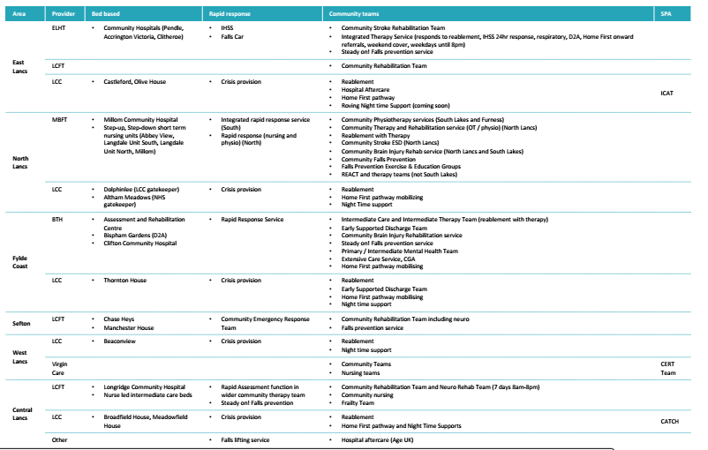
Intermediate Care in Lancashire

Slide 7
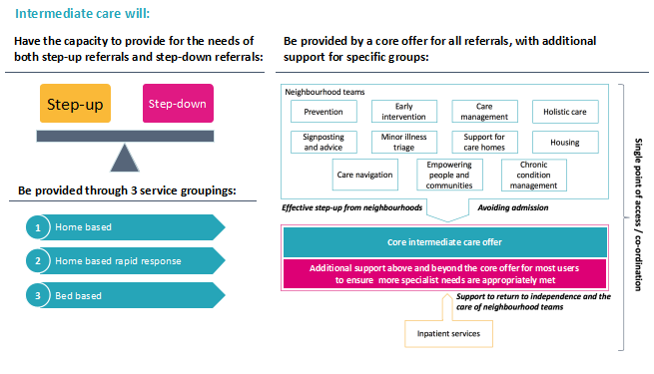
Intermediate Care in Lancashire

Slide 8
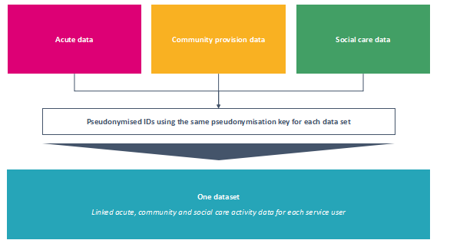
Intermediate Care in Lancashire
Alongside interviews and discussions with
- Providers
- Staff
- Residents currently using the service
- Carers
- Managers across health and social care
- Hospitals
- GPs

Slide 9
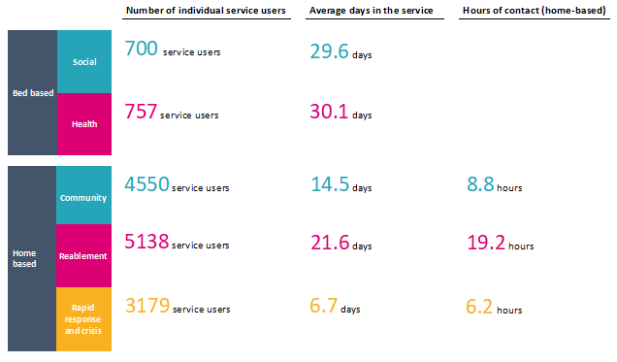
Intermediate Care in Lancashire

Slide 10
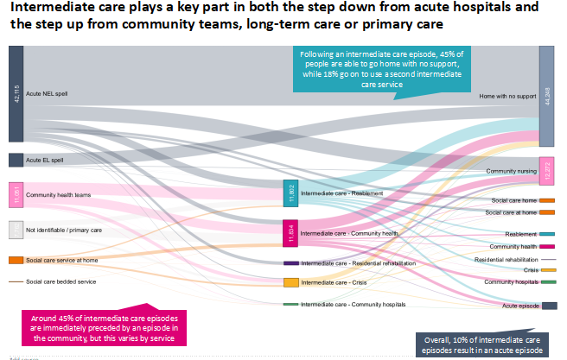

Slide 11
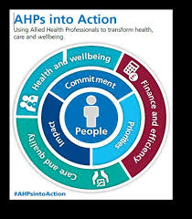
What are commissioners expecting from AHPs?
Meaningful Outcomes for people (not just numbers or flow)
Long-Term Benefits for the Individual are more important than short term gains
Support to the other health and care services through positive risk management, joint working and strong case management
Get to know, trust and use other services which are available in your area.
Build relationships with other services to make the system as a whole operate better
Notes:
A strong focus on outcomes for people, communities and the wider population
Designing and agreeing outcomes metrics is hard. Toby Lowe, a researcher in social change
with a commitment to new forms of measurement, identifies a set of classic problems facing outcome based performance management systems. He particularly outlines the large range of factors that influence outcomes, reflecting the complexity of people's lives, which are not easy to contain in measures.
The complexity and challenge of outcomes metrics can be helped by the use of national outcomes frameworks. These can give a degree of clarity and they “describe the outcomes but do not prescribe how they should be achieved
locally”.
National outcomes frameworks are generally stronger when applied to measuring health outcomes for larger populations rather than communities or individuals. The Public Health Outcomes Framework takes a ‘holistic’ approach to measuring outcomes; to quote the PHE website:
“The outcomes reflect a focus not only on how long people live, but on how well they live at all stages of life.”
Really understanding people’s lives and motivations and developing inclusive empowered communities and people is not a short-term endeavour, and knowing how to measure this across time is complex. Those working in the community sector point to the long-term nature of their work to change communities, the use of
the National Voices ‘I Statements’as a clear and credible base for measurement in a personalised, outcome based system is strongly recommended.
Commissioners who understand that outcomes are created by the way in which people experience their lives, with care and support from professionals, will build trusting relationships with people to improve understanding of what matters most to them, rather than what matters to the professionals. The emphasis should be on shared learning for improvement. Developing outcomes metrics consistent with the values of coproduction is a serious test of the commitment to trying to understand what truly matters to people.

