Slide 1

The Long Term Plan and its Opportunities for Community Rehabilitation
Alex MacKenzie
Chair of Council
The Chartered Society of Physiotherapy

Slide 2

Background to the Long Term Plan (LTP)
Previous criticism of ‘short termism’ in NHS planning and funding
Long term challenges identified including increasing demand, aging population and workforce shortages
Desire to increase and sustain, prevention, personalisation, care closer to home and the integration agenda
Increased access and innovation with digital solutions
Long term funding plan provided as a recognition of the 70th anniversary of the NHS

Slide 3
NHS Long term plan (key themes)
Life course programmes
prevention and personal responsibility
healthy childhood and maternal health
integrated and personalised care for people with long-term conditions and the frail elderly (including dementia)
Clinical priorities
cancer
cardiovascular and respiratory
learning disability and autism
mental health
Enablers
workforce, training and leadership
digital and technology
primary care
research and innovation
clinical review of standards
engagement
funding and financial architecture
capital and infrastructure
efficiency and productivity
local and national system architecture

Slide 4

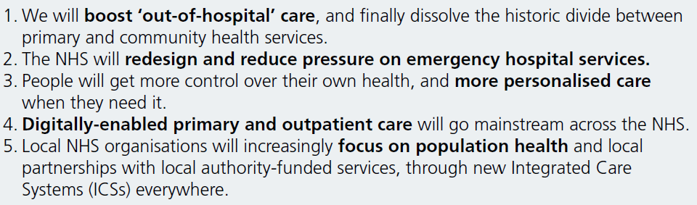
NHS Long Term Plan (LTP)
^{Copy}
^{Copy}
^{Copy}

Slide 5
Read the whole NHS Long Term Plan with your team.
Find and create opportunities from it…..

Slide 6
But if you are going to look for the ‘name checks’….
Community MDT services including crisis response
AHPs as part of the primary care team
Addressing AHP workforce shortages and skill development
AHP role in supporting patient flow
Highlighting AHPs into Action
Highlighting role of AHPs in mental health
Cardiac Rehab, Pulmonary Rehab, Stroke Rehab, post-natal support, CYP services
20 commitments that explicitly reference AHP services, and many more of direct relevance

Slide 7
Looking beyond LTP ‘name checks’
Increasing service user resilience
Developing new skills, roles and care models
Expediting patient care
Working across organisational boundaries
Sharing skills & collaboration
Shared decision making & personalised care
Prevention & social prescribing
Leadership and system change
Innovation and digital maturity

Slide 8
CSP – Strategic Objectives
SO1: We'll position physiotherapy at the leading edge of transforming the delivery of health and social care throughout the UK
SO2: We'll champion the development and use of the evidence that physiotherapy is both clinically and cost effective in the planning or commissioning, and delivery, of health and social care
Community Rehabilitation is a priority area for the CSP.

Slide 9
How are we doing this?
AIMS
To determine the current state of community rehabilitation services across the UK for benchmarking and future evaluation
To explore the various workforce, finance and organisational models and structures that contribute to the delivery of good community rehabilitation
To gain insights and examples of what ‘good’ look like
To influence and shape national work streams for Community Rehabilitation
ACTIVITIES
Service visits
Gaining a sound understanding what is happening in practice
Creation of consensus statement and principles of good rehabilitation
Development of a data base of examples of good practice
Links with RightCare community rehab pathway
Links with community services data set and community currencies work

Slide 10
So far….
Visited a variety of services
Launched iCSP community rehabilitation network
Developing a member resource to support service delivery
Linking with other professional bodies and third sector organisations to build a consensus of what needs to change
Linked with NHSE RightCare work

Slide 11
SWOT Analysis
Strengths | Weaknesses
Time with patients- build relationships Maintain skills in all areas Access to MDT Multiagency collaboration Rewarding area of work Evidence based and cost effective | Lack of clear post grad development pathways Capacity- volume of work Infrastructure Waiting lists Travel time Access to specialists i.e. in acute setting
Opportunities | Threats
Workforce development Admission prevention- In Reach Supported discharge- In Reach FCP- falls, frailty, COPD Cost savings to health economy Public Health engagement Access to Telehealth | Lack of data Unwarranted variation in service Poor profile “Generalist vs Specialist” Lack of opportunity for advanced roles 5 day service 9-5 Isolated staff- poor supervision arrangements for Skill mix

Slide 12
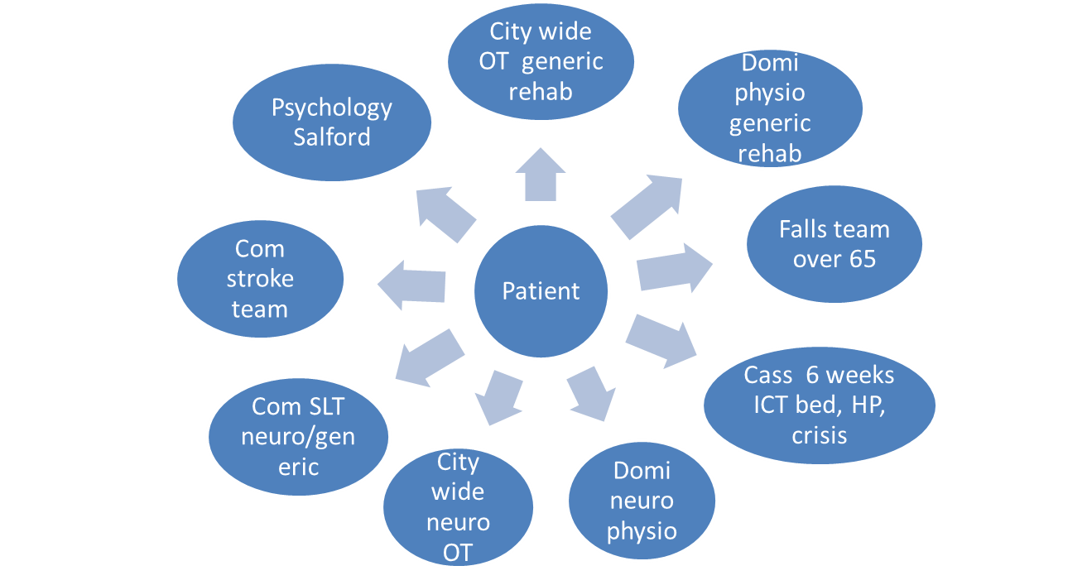
Service example – patient centered?

Slide 13


Slide 14
Redesign - outcome
One Team
One referral system / Reduced referrer confusion
One triage and response time for all patients based on need
One assessment for patient
Fewer complicated processes
Increase in clinical time as clinicians efficient
Pathways smooth and timely
Reduction in wait from up to 3 months to 1-2 weeks
AHP leadership and team profile raised = more funding

Slide 15
Next Steps….
Resource to ensure all services can clearly define their service and its impact
Ensure sharing of models of care and redesign
Sharing of CSP position statement and principles of good rehabilitation
New campaign: Right to Rehab
CSP support to members to deliver LTP

