Slide 1


Small Scale Test for Change;
Grass roots approach.
Rebecca Emmott
Senior Physiotherapist.
Laura Fahy.
Assistant Practitioner.
Notes:
Grass roots- change from bottom up.

Slide 2
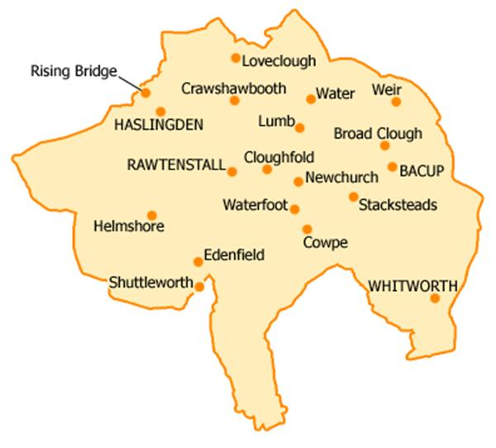


Who we are:
Notes:
Small scale change building on the learning in a structured way before spread across localities/ trust.

Slide 3
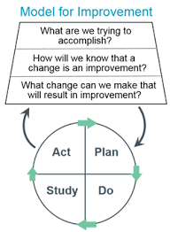


Test of change overview.
Notes:
Small scale change building on the learning in a structured way before spread across localities/ trust.

Slide 4
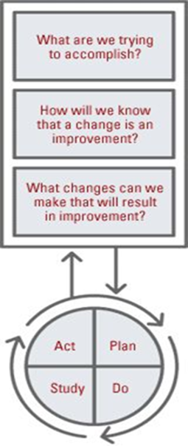
Plan, Do, Study, Act (PDSA) cycle.
Framework key questions:
Model for Improvement
What are we tying to accomplish?
How do we know if the change is an improvement?
What changes can we make that will result in improvement.
Notes:
Use plan, do, study, act (PDSA) cycles to test an idea by trialling a change on a small scale and asses its impact, building upon the learning from previous cycles in a structured way before wholesale implementation.
1. What are we trying to accomplish? (The aims statement).
2. How will we know if the change is an improvement? What measures of success will we
use?
3. What changes can we make that will result in improvement? (The change concepts to
be tested).

Slide 5
Reablement with Therapy (RWT)
Overview.
A short and intensive therapy service delivered within the patients home.
Offered to patients who are frail or recovering from illness or injury – often to support safe hospital discharge.
Commissioned by Lancashire County Council.
Available for up to 6 weeks with maximum 4 visits per day.

Slide 6
Current pathway.
S75 referral received from Lancashire County council.
Referral triaged for Assistant Practitioner (AP) urgent.
Referral placed on locality waiting list
Patient seen by AP to complete initial assessment & set goals . Documentation entered onto EMIS & LAS - no home notes generated.
Appointment made by admin team as appointment available.
Patient reviewed weekly by AP
(one hour slot)
Patient reviewed over the next 6 weeks.
Patient deemed not AP appropriate/ not meeting goals / requiring autonomous practitioner
Patient assessed by B6 physiotherapist and reviewed as needed.
All goals met – Patient discharged.
(RWT complete)
Ongoing therapy need – Patient referred to ITT.
(RWT complete)

Slide 7
Is there a problem?
Most RWT patients on waiting list breaching key performance indicator (KPI) of 5 working days.
High wait time for all patients waiting to be seen by Rossendale Integrated therapy team.
Most RWT patients outside of Therapy Assistant Practitioner (AP) scope of practice and requiring input from qualified physiotherapist.

Slide 8
Is there a problem?
Inconsistent levels of communication between social and health sectors.
Inconsistent levels of care between RWT patients.
No standardised patient documentation.
Therapy led service?

Slide 9
Primary aim.
To ensure 100% of RWT Patients do not breech against the KPI by March 2019.

Slide 10
Secondary aims.
To improve communication between social and health sectors.
Improve satisfaction/outcomes for RWT patients.
Improve effectiveness of support staff input by reducing waiting lists for support staff.
Increase cost effectiveness.
Notes:
Cost effectiveness- would need to look at how current RWT pathway

Slide 11
Method and approach.
STRENGTHS Open to change. Aware of the issues surrounding RWT. Motivated. Experienced. Good Communicators. Have links within the trust. | WEAKNESSES. Lack of contacts within social care. Other work / educational commitments. Lack of knowledge of pathways/processes.
OPPORTUNITIES. Shift in culture within NHS to actively promote change. Improved awareness around quality improvement processes. Willingness from Social Services to be involved in change. Well placed as an AHP to work across organisational boundaries. Numerous changes to staffing within team. | THREATS. Numerous changes to staffing within team. Resistance from team / managers to implement change. Time limits. Staff annual leave. Staff sickness.

Slide 12
Who is involved?
Single point of access (SPOA)
Physio/ TAP
Social
services
Integrated therapy team
Private home care company
Patient
Operational managers
Quality Improvement team
Band 7 Clinical lead

Slide 13
Resources needed for test of change.
Time.
Clinical lead guidance.
Knowledge of existing pathways.
Patients & their families.
Access to health & social services computer systems.
Staff - Therapy staff
- Admin
- SPOA staff

Slide 14
Barriers to test of change.
Time (again)!
Resistance towards change.
Multiple staff within therapy SPOA.
Communication barriers between social and health sectors.
Other work commitments.
Notes:
How will you overcome them?
Meetings
Sharing info

Slide 15
Method and approach.
Identification of need for RWT day 1x weekly.
Identification of need for paperwork and goal sheets to be left in patients homes.
Created new triage inbox for RWT patients.
Meetings - Single point of access (SPOA)
- Admin
- Social Services
- CRG ( Care provider)
- Senior Team leads/ Operational managers
- Quality improvement team for therapies
- Rossendale Integrated therapy team (ITT)

Slide 16
Current pathway.
S75 referral received from Lancashire County council.
Referral triaged for Assistant Practitioner (AP) urgent.
Referral placed on AP waiting list
Patient seen by AP to complete initial assessment & set goals . Documentation entered onto EMIS & LAS no home notes generated.
Appointment made by admin team when appointment available.
Patient reviewed weekly by AP
(one hour slot)
Patient reviewed over the next 6 weeks.
Patient deemed not AP appropriate/ not meeting goals / requiring autonomous practitioner
Patient assessed by B6 physiotherapist and reviewed as needed.
All goals met – Patient discharged.
(RWT complete)
Ongoing therapy need – Patient referred to ITT.
(RWT complete)

Slide 17
New pathway.
S75 referral received from Lancashire County council.
Referral added to new RWT waiting list.
Clinician contacts patient to arrange appointment .
Patient reviewed twice in six weeks (determined by clinical need) care visits amended as required.
All RWT patients seen on same day to assess and set goals. Documentation entered onto EMIS & LAS – Home notes left with patient.
Improved & regular communication between health clinicians and Social Services
All goals met – Patient discharged.
(RWT complete)
Ongoing therapy need – Patient referred to ITT.
(RWT complete)

Slide 18
Outcomes.

Slide 19
Breech times during Test of Change:
Before:
Patient | Breech time against KPI | Total wait time (Not including weekends)
Patient 1 | 4 days | 9 days
Patient 2 | 5 days | 10 days
Patient 3 | 8 days | 13 days
Patient 4 | 6 days | 11 days
Patient 5 | 11 days | 16 day
After:
Patient | Breech time against KPI | Total wait time from referral received in SPOA (Not including weekends)
Patient 1 | No breech | 3 days
Patient 2 | No breech | 3 days
Patient 3 | No breech | 3 days
Patient 4 | No breech | 1 day
Patient 5 | No breech | 2 days

Slide 20
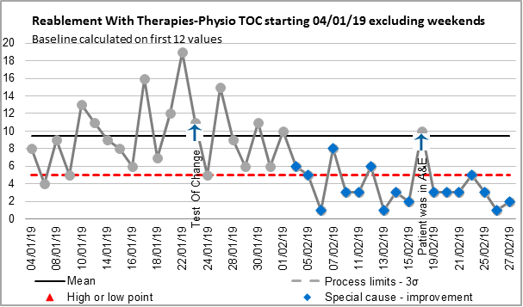
Outcome measure.
Notes:
Data Analysis for Rebecca Emmott
We collected a sample of 19 patients prior to our Test of Change starting. On this graph the mean is 9.5days (in black) the UCL is 23 and the KPI (in red) is 5days.
There are 15.78% of patients being seen within the current KPI which is 5 working days (excluding weekends). The process is uncontrolled and wait times are variable within control limits.
From when the test of change started there is a significant decrease (over 7 data points) in the RTT time with 17 data points falling below the mean line. There is a decline in the length of RTT from the beginning of the Test of Change and the last 7 data points’ show that the KPI is being met 100% of the time.
There is one point on the 19/02 where the wait was 10days but the patient was unable to be seen due to being admitted through A&E.

Slide 21
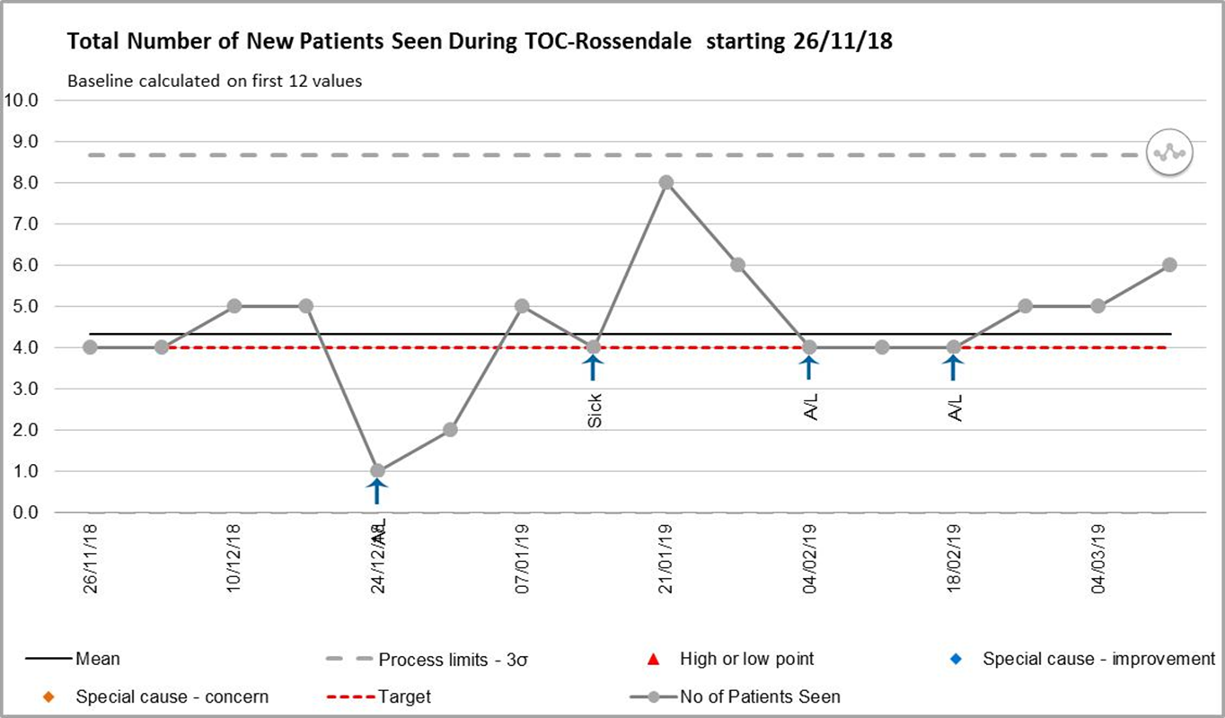
Process Measure.

Slide 22
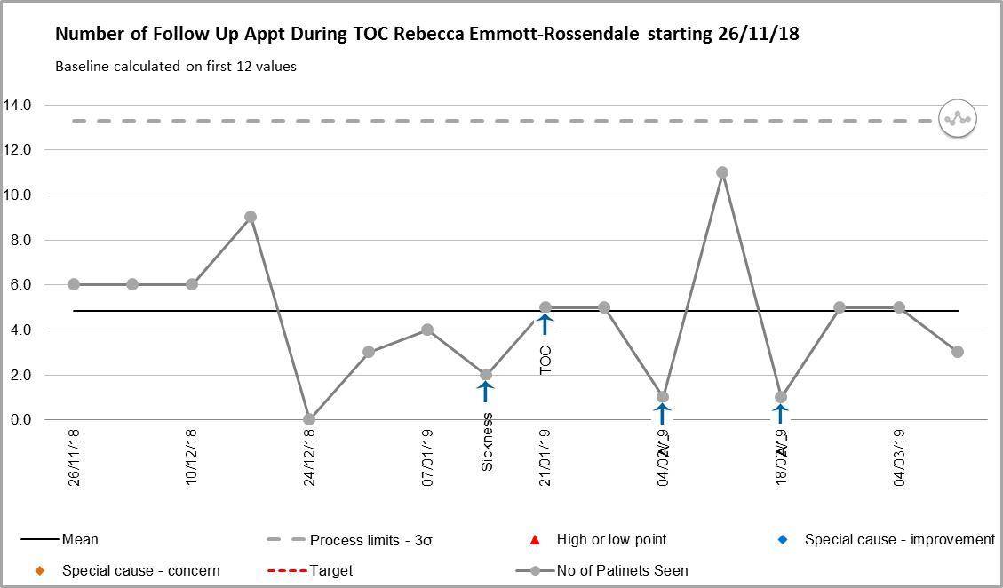
Balancing measure.

Slide 23
Secondary aims.
To improve communication between social and health sectors.
Improve satisfaction/outcomes for RWT patients.
Improve effectiveness of support staff input by reducing waiting lists for support staff.
Increase cost effectiveness.
Notes:
Cost effectiveness- would need to look at how current RWT pathway

Slide 24

£10,975.

Slide 25
Any Questions?

