Slide 1
First Contact Practitioner Physiotherapist
Craig Greenwood

Slide 2
Current Work Load
14 hours in Liverpool GP practice
    1 day per practice base
19 hours in MSK clinical triage service in a University Hospital Aintree
8 hours in North Cheshire GP practice

Slide 3
Set up Liverpool
Framework set up by GP practice, using current guidelines including the CSP and national to see Musculoskeletal (MSK) workload
Sub-contracted from the local acute trust, with interview process.
GP mentor.
Information for team prior to start-up, for scope of work and direction on which patients

Slide 4
Specialist Physiotherapist Role
Guidance for receptionists and patients
The Specialist Physiotherapist:
Is a highly experienced physiotherapist who assesses patients with a new presentation or recurrence of strains, sprains, joint or muscle pain or stiffness.
Is more experienced than a GP in managing orthopaedic problems
Provides rapid access to the most appropriate clinician for the patient’s problem

Slide 5
Yes | No
First presentation or recurrence of; Neck pain Back pain Shoulder pain Elbow pain Hand and wrist pain Hip and groin pain Knee pain Foot and ankle pain Sprains and strains Sports injuries Road traffic accident injuries Nerve problems Provides a comprehensive assessment Organises investigations (x-rays, blood tests, scans) if appropriate Provides a management plan Refers to physiotherapy, consultants, podiatry, appliances (splints and orthotics) Provides joint injections Organises prescriptions (via a GP or pharmacist) | Longstanding bone joint or muscle problems Patients already under a hospital clinic for the same problem Children (under 16) Patients with active cancer, before GP review Problems related to conditions other than muscle, ligament, bone, joints or nerves Does not prescribe (but can organise prescription via GP or pharmacist) Does not provide fit note (Med3) but can organise via GP

Slide 6
Referral in (Aintree Group Practice)
77% self referred initially, +6% GP triage
87% at one year, +3% GP triage
At one year, 90% true first contact patients
Ave 53yo
Female= Male

Slide 8
Outcome of consultation/ management:
 | At 3 months (n.326) | At 12 months (n.150) | Overall
Self-care, advice and/ or exercise programme | 63% | 70% | 65.2%
Referred MCAS/Physio | 23% | 13% | 19.8%
Joint/ soft tissue injection | 7% | 14% | 9.2%
Referred Orthopaedics | 3% | 1% | 2.4%
Referred Rheumatology | 1% | 0% | 0.7%
Refer GP | 1% | 1% | 1.0%
Refer Appliances | 3% | 1% | 2.4%
Refer Podiatry | 1% | 0% | 0.7%
Follow-up | 3% | 3% | 3%

Slide 9
X-ray- 2.3%
Blood tests- 1.3%
MRI- 0.7%
Med3 request- 1.7%
Prescription request- 1.7%

Slide 10
GP follow-up within 4 weeks- 9%
No. of patients 43
Analgesia 9
Referral on MSK/ physio 15
Injection 1
X-ray 1
Depression 1
Rheumatology 2
Reassured/ no change 14
                433/ 476 no GP contact

Slide 11
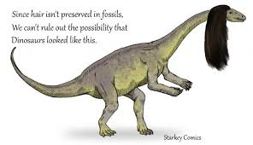


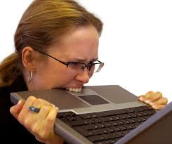
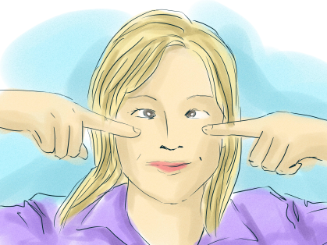
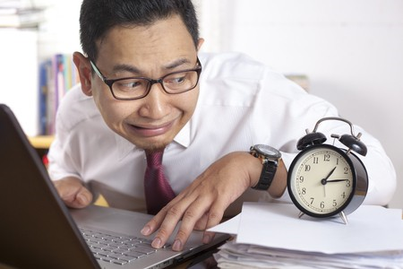
Barriers and tips
Prove you exist
Know the role of the team- be a part
Mentor
Computer system
Local systems
Early Orders
Experience and personality
20 minutes- you’re worth it

Slide 12

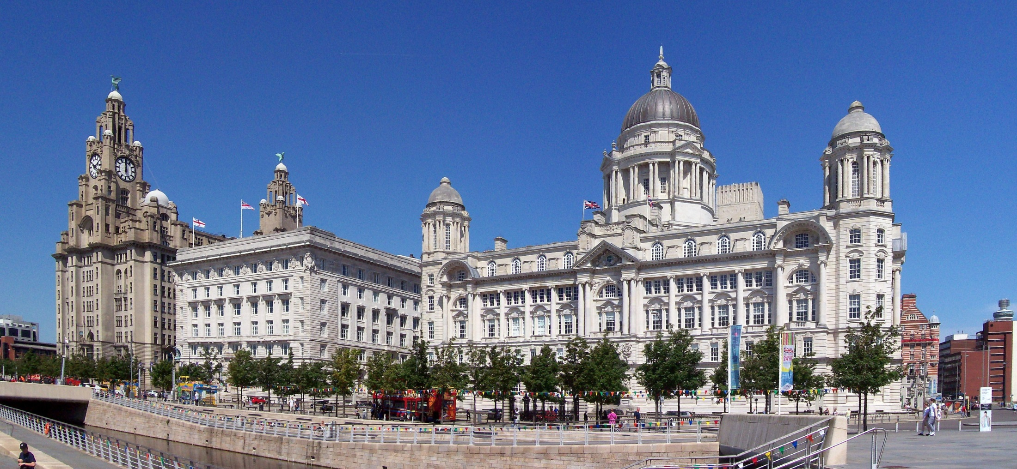
Thank You

