Slide 1



Upskilling the AHP workforce for FCP Roles
Gillian Rawlinson
Principal Lecturer, UCLAN
Advanced Physiotherapy Practitioner
@GillRPhysio

Slide 2
Outline…
FCP and level of practice; what are the frameworks ?
FCP and ACP; what does it all mean?
Education routes
-experiential
-taught module
-Elearning
How can education sector support FCP growth and SAFE service delivery
Next steps…

Slide 3

What are the frameworks/ guidance ?

Slide 4

Background
Drivers
  Clinical professionals
  Professional bodies
  Royal Colleges
  NHS England
  Health Education England
  Policy makers (e.g. National Clinical Director)
  New Care Models (to support FYFV)
Commissioned by HEE and NHS England
Building on work by ARMA in partnership with
  NHS England Long Term Conditions Unit
  National Clinical Director for MSK

Slide 5

MSK Core Capabilities Framework ; Purpose
Support transformation of services
Skilled MSK practitioners earlier in patient pathways
Support enhanced delivery of care
Inform job role configuration
Notes:
support the better use of knowledge, skills and behaviours within multi disciplinary teams;
support skill mix review, by increasing transparency and confidence in different professions' and individual practitioner’s capabilities;
inform job role (re-)configuration to achieve enhanced service delivery and patient care;
support the enhanced delivery of care across patient pathways, including through new models of care;

Slide 6

Who is the MSK Core Capability framework for?
Service users
Individuals and teams
Commissioners of services
Commissioners of education and training
Employers and training hubs
Education providers
Notes:
Service users – sets out clear expectations re what MSK FPoC practitioners are able to do, leading to imp confidence, informed choices, shared decision making.
Individuals and teams – clear expectations re role requirements, ID training needs, plan education/training, support CPD/career progression
Commissioners of services – specify minimum standards of clinical care at FPoC
Commissioners of education and training – capabilities required to from staff in these roles
Employers and training hubs – enable managers to demonstrate that staff meet requirements (or have development plans in place), help design of training
Education providers – inform design of curricula

Slide 7
Notes:
Mention wider online consultation survey (90 participants)

Slide 8

Steering group
Royal College of Nursing
College of Occupational Therapists
The College of Podiatry
National Rheumatoid Arthritis Society
Arthritis Care
Primary Care Rheumatology Society
National Osteoporosis Society
National Voices
The College of Paramedics
The British Association of Prothotists and Orthotists
Skills for Health
Skills for Care
The British Society for Rheumatology
The British Orthopaedic Association
The Chartered Society of Physiotherapy
Royal Pharmaceutical Society
Arthritis and Musculoskeletal Alliance
National Clinical Director (for MSK)
British Health Professionals in Rheumatology
National Health Service England
Health Education England
Public Health England

Slide 9
Structure of the Framework
Domains | Capabilities
A - Person-Centred Approaches | Communication Person-centred care
B - Assessment, Investigations and Diagnosis | History-taking Physical assessment Investigations and diagnosis
C - Condition Management, Interventions and Prevention | Prevention and lifestyle interventions Self-management and behaviour change Pharmacotherapy Injection therapy Surgical interventions Rehabilitative interventions Interventions and care planning Referrals and collaborative working
D - Service and Professional Development | Evidence-based practice and service development
Capabilities underpinned by:
  Professional values and behaviours
  MSK knowledge and skills

Slide 10

Advanced Clinical Practice Framework (2017)
Four Pillars
Clinical Practice
Leadership & Management
Education
Research

Slide 12


Advanced Clinical Practice
National Academy for Advanced Practice

Slide 13
National Academy for Advanced Practice
What the NAAP intends to do
Assure Safety and Public/Peer Confidence in the ACP Brand by;
Maintain Lists/Directories/Registers that are open to view
Provide a consistently applied definition of ACP & Consultant
Agree Educational Standards of Training for ACP programmes
Accredited programmes that use the ACP Framework and that provide an award that has ACP in the title
Provide Portfolio and Equivalence pathways to demonstrate that practitioners meet the ACP Framework requirements
Quality Assure the processes
Link with statutory regulator

Slide 14

Two routes to Academy ‘Accreditation’
Educational
Standards of Education and training (SETS)
Recognition of
ACP degree programmes
And previous graduates?
Equivalency
Meet Standards of equivalency
Challenging and in development

Slide 15
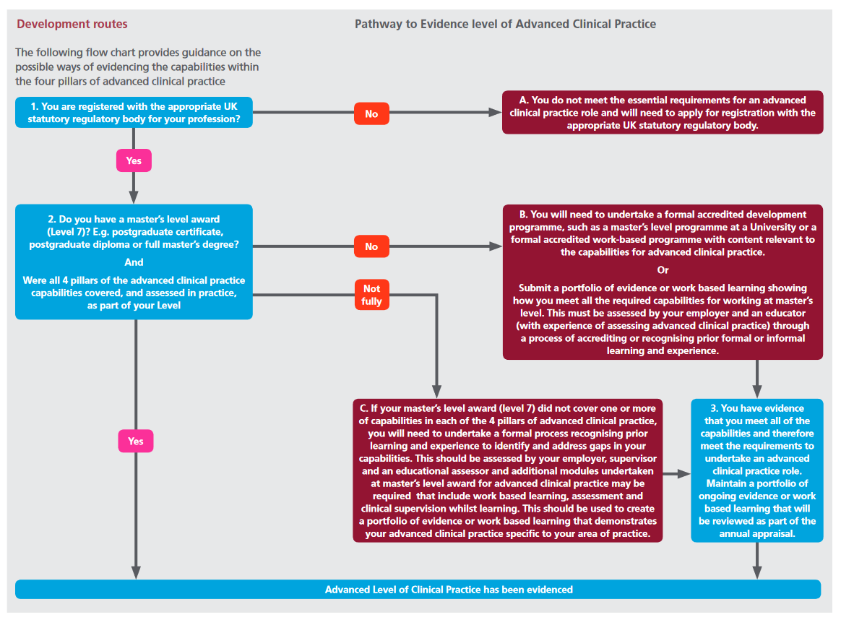

Slide 16
What knowledge, skills and capabilities do we need as FCP’s ?
Scope of practice
Generic
Specialist

Slide 17

So what do we need to learn for FCP roles?

Slide 18
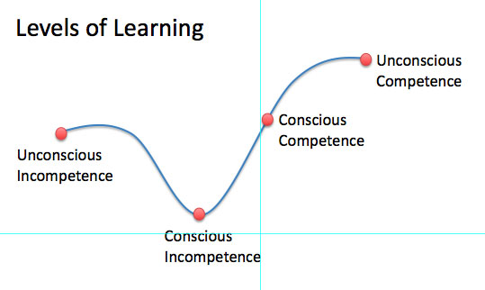
“You don’t know what you don’t know”

Slide 19
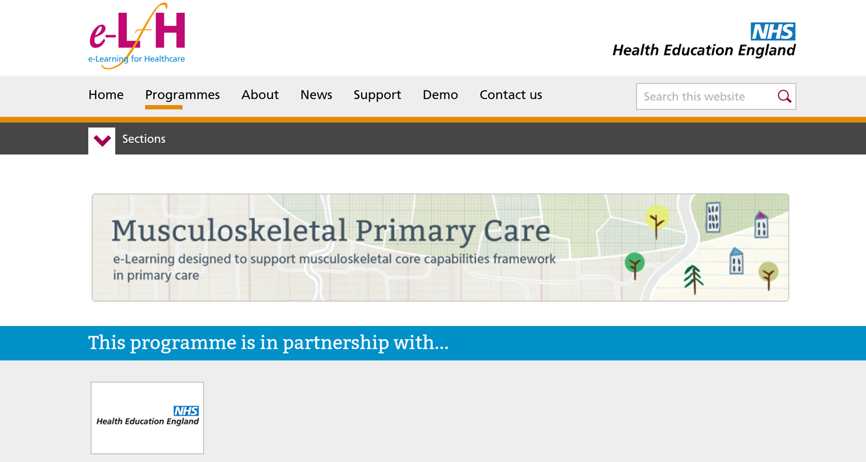
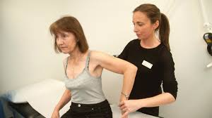

Current Educational options ?...
Elearning ?
Portfolio
Taught module @UCLan ?
Mentorship ?
On the job /experiential ?

Slide 20


Slide 21
FCP Capabilities –Module Learning Outcomes
Knowledge of primary care setting
Decision making
PDP planning
AHP FCP’s
Whole person care
Wider determinants of health
Innovation , evaluation & data
Notes:
Demand
How many people need these services
Number of referrals / footfall…
Is this the full picture ?....consider hard to reach groups who may need services but aren’t aware or don t know how to access? E.g. mental health, breast screening
Self referral
New patient: Follow up ratios– is there variation?
Capacity
Does service capacity meet demand for effective delivery of interventions
Eg Time limited therapy is this a useful model?
Do we need to develop new models of care and do things differently to improve capacity to meet demand
Skills and workforce e.g. prescribing skills
Embrace technology and digital transformation to improve capacity
Eg teleswallowing , telecare, SMS, patient decision aids.
Can we systematically and nationally measure and compare capacity?

Slide 22


UCLAN FCP Module Outline
30 credits level 7 (masters level)
AHP multi-professional (tutor and student)
Blended learning approach (5 taught dys)
Core skills with self-directed application (specialist v generic)
Clinical Mentor in Primary care (GP)
Strong focus on Personal development planning
Supports innovation and measurement of impact, value and outcomes
Multi-assessment methods

Slide 23
Uclan MSc ACP/ Apprenticeship Structure: An Overview
Year 1
Semester 1 | Semester 2 | Semester 3
Advanced Consultation, Examination and Clinical Decision Making (40 credits)
Designing Quality Improvement (20 credits) | Evidence for Practice (20 credits) | Option (20 credits)
Portfolio

Slide 24
Year 2 Structure:
Year 2
Semester 1 | Semester 2 | Semester 3
Leading Quality Improvement (20 credits) | Option (20 credits) | Option (20 credits)
 | Transition to Advanced Clinical Practice (20 credits)
Portfolio

Slide 25
Year 1
Semester 1 | Semester 2 | Semester 3
Advanced Consultation, Examination and Clinical Decision Making (40 credits)
Aim The aim of the module is to enable the practitioner to develop advanced clinical skills pertaining to patient consultation and clinical decision-making. Assessment Consultation Analysis 5000 words Case Presentation 30 minutes Practice Assessment Document

Slide 26
Example Pathways
Primary Care Nurse
Advanced Consultation, Examination and Clinical Decision Making (40 credits)
Advanced Ax / diagnostics / intervention planning related to own pt caseload
Designing QI (20) Exploring an area of improvement in specialist area
Evidence for Practice (20 ) Evaluating evidence base for a specialist topic
OPTION 1 (20) : Management of Long-term conditions
Leading Quality Improvement (20)-
Leading project related to own service / area
OPTION 2 & 3 (40): Non-medical prescribing
Transition to Advanced Clinical Practice
(20 credits) Student consolidates and reflects on own learning & development as an ACP in specialist area

Slide 27
Example Pathways
MSK Physiotherapist
Advanced Consultation, Examination and Clinical Decision Making (40 credits)
Advanced Ax / diagnostics / intervention planning related to own pt caseload
Designing QI (20) Exploring an area of improvement in specialist area
Evidence for Practice (20 ) Evaluating evidence base for a specialist topic
OPTION 1 (20) : Advanced MSK Management
Leading Quality Improvement (20)-
Leading project related to own service / area
OPTION 2 & 3 Non-medical prescribing (40)
OR Injection Therapy (20) and Public Health (20)
Transition to Advanced Clinical Practice
(20 credits) Student consolidates and reflects on own learning & development as an ACP in specialist area

Slide 28

Learning from the module so far…
Evaluation Planned for April 2020 in conjunction with HEE

Slide 29
Considerations when considering next steps in workforce education…
Map own/ service capabilities / needs against FCP/ ACP framework
Am I at advanced level? Can / how will evidence this ?
Do I have clinical gaps e.g. MSK skills/ inj therapy/ NMP?
Do I just need to learn how to apply my role in primary care?
What about public health and population health ?
Do I have a mentor / GP?
Can I evidence I am safe and effective?
What sort of learning suits me best ?
What are my future plans?

Slide 30
What are options ?
ROLE
MSc ACP
Clinical skills eg NMP/ Inj / Assessmen t
ACP apprenticeship
Elearning / portfolio
FCP module

Slide 31


The mission…

Slide 32
Question to you? Upskilling the AHP Workforce for FCP roles
1. What skills, behaviours and knowledge are needed to deliver AHP FCP roles?
2. How could/ would this learning be best delivered? (Eg elearning/ face to face HEI/ clinical, when , where?)
3. How do we build and plan a sustainable FCP workforce? (Students/ placements/ staff banding/ training/ cpd)

