Slide 1
First Contract Practitioner – Pilot
Phil Driver – 14/10/19
ELHT Integrated MSK Service

Slide 2
Setting the scene
In 2017 - APMS contract bid between 2 local groups of doctors and EL NHS Hospitals to deliver GP services out of 6 GP Practices.
The partnership bid became known as PWE Healthcare and was successful in the contract bid.
The FCP proposal provided an opportunity for ELHT to contribute additional capacity into the PWE Health Care and the Integrated MSK Service were directed to provide support.
Test proof of concept of FCP with the key objectives questions:
  Will FCP provide additional capacity?
  Does it add expertise to the current staff mix within PWE Healthcare?
  Is FCP Physiotherapy valued by G.P.s?
  Is FCP Physiotherapy valued by patients?

Slide 3
Clinic set up
Pilot at 2 GP practices in same PCN – staggered start dates Jan2018 and May 2018
FCP provision – 2 x 4 hour sessions per practice based on 50% of MSK GP contacts in 2017
10 patients per session (20 min appointments)
National EMIS template used to record consultations and data collection / export.
‘Referred by GP’ code used to identify patients not coming direct from reception.

Slide 4
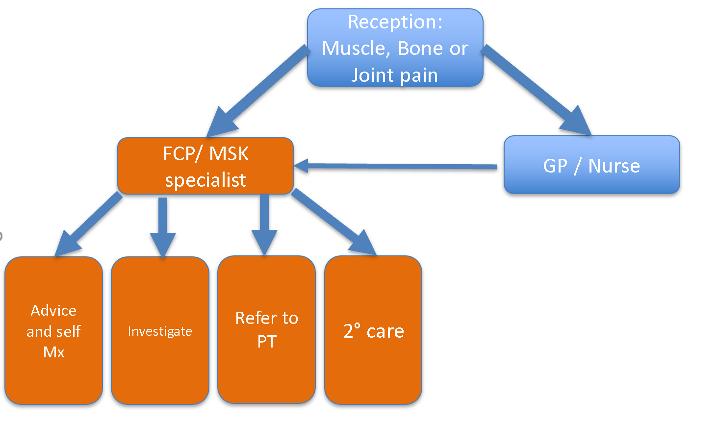
FCP Pathway

Slide 5
Used referred by GP as a way of identifying their route into service
Do I have data on outcome from FCP intervention
Make up some satisfaction outcomes
Talk about using standardised template
Additional problems – re read the template paper
More thorough intro into reasons and circumstances for new service

Slide 6
Objective 1 – will FCP provide additional capacity?
2018 = 686 patient contacts
2019 to Sep = 511 patient contacts
Total = 1197 patient contacts
GP average cost per patient = £30
ESP 8a Mid point cost = £28.27hr = 3 patient
GP = £35,910
ESP = £11,279
Saving = £24,631

Slide 7
Objective 2 - Does it add expertise to the current staff mix within PWE Healthcare?
4 highly experienced Physiotherapists with a minimum of 5 years working at ESP level.
Observation opportunities for student docs, ANPs, newly qualified staff and Physician associates.
MSK staff training – MSK assessment, when to investigate and refer to Physio or secondary care.
  Reduction in GP referral for MRI, Xrays and secondary care for knee, shoulder and lumbar spine

Slide 8
Objective 3 - Is FCP Physiotherapy valued by G.P.s?
“It’s great that our patients have direct access to the expertise and specialist MSK skill that our FCP team bring. The whole team have gained a better understanding of how to manage and direct MSK conditions more appropriately’”

Slide 9
Objective 4 - Is FCP Physiotherapy valued by patients?
96% of patients rated the services as good or excellent
99% of patients were likely or extremely like to recommend the service to their family and friends (FFT)

Slide 10
Secondary Savings
2017 Vs 2018
31% reduction in investigations (Xray, MRI and USS)
43% reduction in referral to secondary care
20% reduction in referral into PT / MSK service (14% increase in 2017)
1% required prescription of analgesia – script obtained during consultation.
<1% required separate GP review
7% had seen had seen GP / Nurse first

Slide 11
Troubleshooting
Data collection and comparison has been difficult.
  MSK tagging of electronic consultations is a must!!
Difference between practitioners
Objectives too broad
Trail off in performance in second year

Slide 12
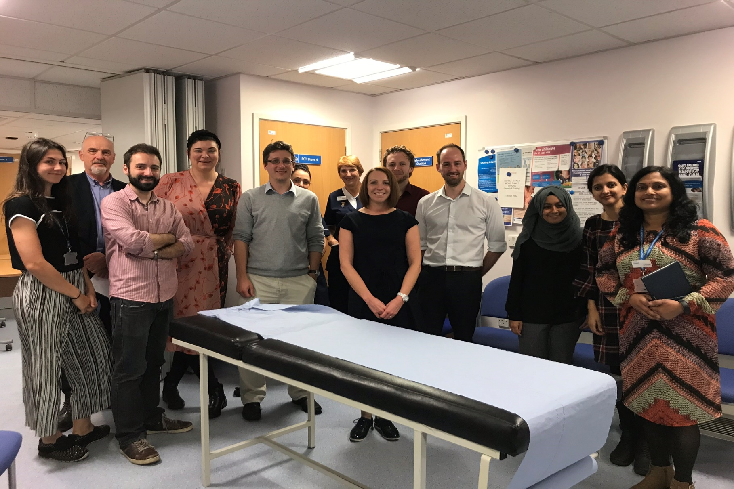
Team Effort

