Slide 1

The NHS Long Term Plan
and local influencing
Rob Yeldham
Director, Strategy, Policy & Engagement
@RobYeldham
yeldhamr@csp.org.uk

Slide 2
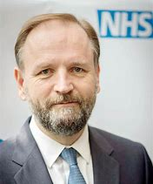
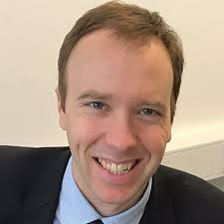
Basics of the LTP
NHS England national strategy for the next 5 years
Endorsed by Government
Guides ICS / STP level planning
Linked People Plan under development
Notes:
So what is political? – question to council
Charity commission definition uses the elephant test

Slide 3




CSP influenced four areas
Notes:
So what is political? – question to council
Charity commission definition uses the elephant test

Slide 4
What is in the LTP ?
Transformational focus on prevention and rehabilitation
Physiotherapy workforce considered a priority in delivering this
GP led Primary Care Networks (servicing populations of 30-50k) to develop integrated primary and community services
Commitment to increase funding of both primary and community services as a proportion of the overall health budget
Notes:
So what is political? – question to council
Charity commission definition uses the elephant test

Slide 5
Primary care
Endorsement of the FCP model as part of new vision for integrated primary and community services
More physios working at advanced practice level in primary care -5050 additional FCPs as part of primary care workforce target
Physiotherapists as part of the primary care workforce in rapid response teams
Attract and retain registered physios to work in primary and community settings
Notes:
So what is political? – question to council
Charity commission definition uses the elephant test

Slide 6
Community rehab
Community rehabilitation across most clinical priorities an area for significant development
Proposal for integrated community hubs, with physiotherapy workforce part of MDTs (possibly being rowed back on)
Notes:
So what is political? – question to council
Charity commission definition uses the elephant test

Slide 7
Pulmonary
Pulmonary rehab should be offered to all eligible COPD patients
Eligibility should be expanded to include those with less severe symptoms
Expanding pulmonary rehabilitation, using a population-management approach to find eligible patients who have not been referred
Developing digital tools for rehabilitation and self-management
Notes:
So what is political? – question to council
Charity commission definition uses the elephant test

Slide 8
Cardiac care
Scaling up and improving promotion of cardiac rehabilitation to “be amongst the best in Europe”
More integrated and high intensity rehab outside of hospitals for the first 6 months and beyond
Improvements by 2020 and full roll out over the next 10 years
Potential value of combining generic pulmonary and cardio rehab
Notes:
So what is political? – question to council
Charity commission definition uses the elephant test

Slide 9
Stroke
Commitment to expand stroke rehab
Needs assessments of stroke patients to include rehabilitation post discharge
Notes:
So what is political? – question to council
Charity commission definition uses the elephant test

Slide 10
Other areas
Commitment to access to physiotherapy for women post birth
Needs assessments of cancer patients to include rehabilitation post discharge
Focus on digital, data and technology
Notes:
So what is political? – question to council
Charity commission definition uses the elephant test

Slide 11
Workforce
Full People Plan to follow
Make use of the growing supply of physios as a workforce solution
Supporting ongoing expansion
More AHPs and support workers, as proportion of workforce overall
Support workers taking on higher levels of responsibility
Notes:
So what is political? – question to council
Charity commission definition uses the elephant test

Slide 12
How is this being implemented?
Plans are devolved to ICS / STP levels – should have been done by April
Some elements funded via GP contract, so PCNs involved
Workforce planning is also being developed at ICS / STP levels - ongoing
NHSE accept planning capabilities varies !!!
AHP councils may be consulted
Notes:
So what is political? – question to council
Charity commission definition uses the elephant test

Slide 13
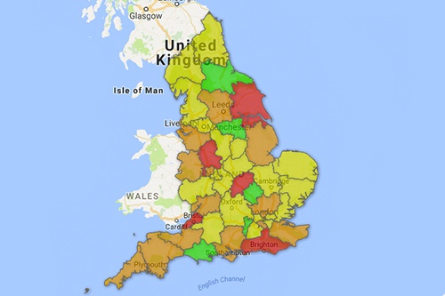
Plan to influence locally
It needs to be locally informed (population specific)
It needs to be local system focussed (ICSs, STPs, PCNs)
It needs to happen locally (so we need our help)
Regional ALB AHP leads involved
Notes:
So what is political? – question to council
Charity commission definition uses the elephant test

Slide 14
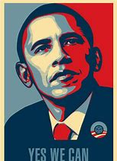
Plan to influence – yes we can
“In my view there has never been a better time for healthcare decision-makers to sit up and take notice of physiotherapists and what we can deliver for their patient population locally. In many ways we hold the key to care pathway transformation. We just need to show them what is possible, along with the evidence to support it and the courage and strength to see it through to reality.
“I have sought opportunities to influence key stakeholders to deliver the best care for our patients. I would encourage all members to look at what opportunities are open to them to influence locally.”
Jo Lishman, Chair of the CSP North West Regional Network
Notes:
So what is political? – question to council
Charity commission definition uses the elephant test

Slide 15

Plan to influencing
Check your STP/ICSs plan or plans
Do they reflect:
- the commitments in the LTP ?
- scale of community need ?
- right workforce needed to deliver the plan ?
3. Ask:
- how is your organisation is feeding into local workforce plans ?
- if AHP clinical and professional leads are involved?
- is there an AHP Council for your STP / ICS involved?
Notes:
So what is political? – question to council
Charity commission definition uses the elephant test

Slide 16
Service leads and managers
Pitch what your services can do to implement the LTP to lead commissioners or PCNs
Organise a session with senior managers on the offer your service can make to deliver the LTP locally
Ask senior management what their plans are around the LTP commitments
Offer to support implementation plans for physio services and signpost commissioners to the CSP for advice on implementation
Invite local decision makers to visit your service
Tell the CSP what is happening locally.
Notes:
So what is political? – question to council
Charity commission definition uses the elephant test

Slide 17
Stewards
• Raise the physio workforce implications of the LTP through your staff side
• Tell the CSP what is happening locally
Notes:
So what is political? – question to council
Charity commission definition uses the elephant test

Slide 18
Any CSP member
Follow your STP and CCG on Twitter, share CSP resources on FCP and rehab with them, ask them what they will do to implement change
Attend any local public meetings with decision-makers
Join your local Patient Participation Group
Go to an MP Surgery or write to your MP share CSP resources, ask them to contact the STP to ask how they intend to deliver LTP rehab and physio commitments locally
Notes:
So what is political? – question to council
Charity commission definition uses the elephant test

Slide 19
Any CSP member
Invite decision makers on a service visit to meet patients and see how impactful physio is
Talk to a local group and suggest they contact the STP about hoe the LTP in being implemented
Tell the CSP what is happening locally
Notes:
So what is political? – question to council
Charity commission definition uses the elephant test

Slide 20

Resources are available
www.csp.org.uk/nhs-plan-england
CSP LTP briefings
Professional networks briefings on women's heath, cardiac, stroke, pulmonary rehab, cancer and older people
Physiotherapy Works evidence briefings
Advice via enquiries@csp.org.uk
CSP regional staff team
CSP FCP programme team
Notes:
So what is political? – question to council
Charity commission definition uses the elephant test

Slide 21
Questions
Notes:
So what is political? – question to council
Charity commission definition uses the elephant test

