Slide 1
Implementation of the Role of
First Contact Practitioners
Sarah Withers
Head of FCP Implementation FCP
@CSP_FCP #FirstContactPhysio

Slide 2
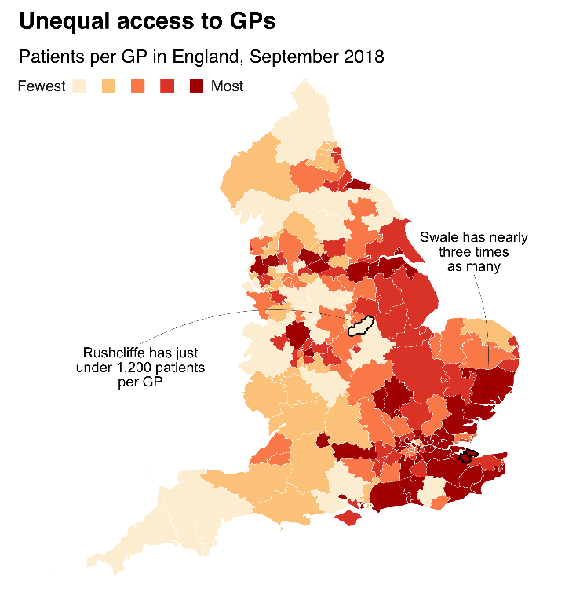


Change is coming…

Slide 3

FCPs in MSK within the
Primary Care team: what
does this approach
deliver?
Assess and diagnose
(including screening for serious pathology)
Potential interventions:
Give info on self-care and enable and support behavior change
Discuss fitness for work
Undertake social prescribing
Discuss physical activity and health
Refer to a course of treatment (e.g. physiotherapy)
Refer to a secondary care service
Request investigations
Medicines optimization
Administer joint / soft tissue injections (if qualified).
In one session
First Contact Physiotherapist will…
Person presenting with a MSK condition is booked in to see an FCP by the GP receptionist
…so fewer steps and on the right path from the start

Slide 4
Benefits of FCP
For patients
Safe, efficient and effective
Quick access to treatment, tests and specialists if needed
Quick access to advice and information to start improvement
Quicker…
access to MSK expertise
referral to other services and tests (if needed)
Improved…
delivery of healthy living message
patient self-care through supporting of self-management programmes and social prescribing
patient experience

Slide 5
Support
73%
of people said they would see a physio instead of a GP for back or neck pain
85%
of GPs agree with
the FCP model

Slide 6
Benefits of FCP to the local healthcare system
For the healthcare system
Safe, efficient and effective
Shorter waiting times –for tests, appointments, and surgery
Fewer…
inappropriate MRIs & X-rays
inappropriate secondary care referrals
re-referrals for the same condition
More GP appointments available for others Improved conversion rates to surgery
Reduced prescribing rates and costs

Slide 7
NHS England evaluation
Summer 2018: 41 out of 42 STPs put forward an existing or new FCP service for evaluation. Cited in Long Term Plan in 2019. Consists of:
Local context questionnaire (re: services’ funding, governance, staffing, providers)
FCP appointment data captured on practices’ clinical data systems
Experiences of patients (including PROMs and PREMs), GPs and physiotherapists

Slide 8

NHS England evaluation
The results from the 2018/19 evaluation of FCP in England (involving over 40 services) will be published this autumn. It is expected to include over 50,000+ FCP consultations.
97% of patients questioned would recommend the service
99% of patients had complete confidence in the FCP’s competency
FCPs wrote 12% fewer drug prescriptions than GPs
FCP patients received 10% fewer blood tests compared to GP patients
74% of patients received advice from the FCP (compared to 4% of GP patients)
Referrals to orthopaedics significantly reduced
interim
findings

Slide 9

A five year framework for GP contract reform
(published January 2019)
In 2020, first contact physiotherapists (at Bands 7 and 8a) will be eligible for 70% reimbursement from the Additional Roles Reimbursement Scheme
By 2024, the new Scheme is expected to have created 20,000+ new posts in general practices, with an average PCN having access to 3 FCPs, 5 clinical pharmacists, 3 link workers, 2 physicians associates and 1 community paramedic (with flexibility for PCNs to determine the staff mix)

Slide 10
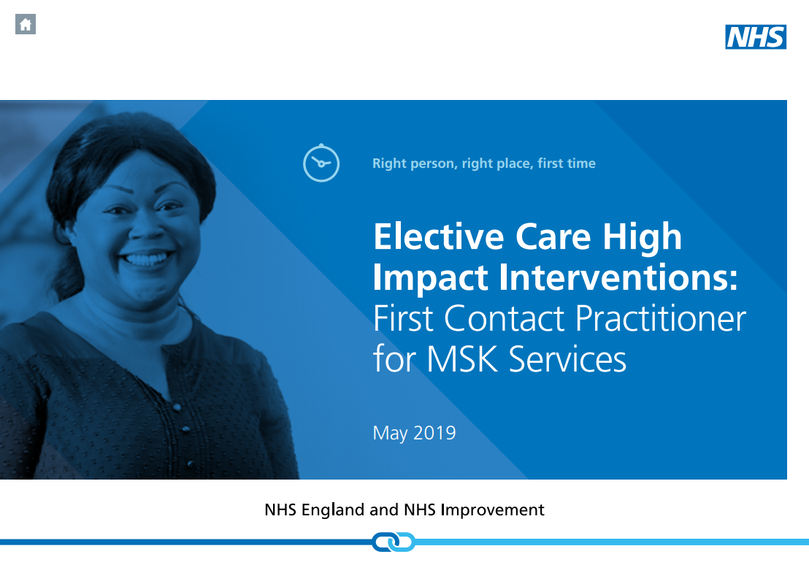
Elective Care High Impact Interventions: FCP for MSK Services Specification (published May 2019)
In 2019/20: STPs are required to select at least two further sites/network of GP practices (circa 50k population) to add to the 2018/19 cohort and establish FCP services in the selected sites.
This implementation plan builds on sites mobilised during 2018/19 and on local and national evidence base
bit.ly/30GY3NA

Slide 11
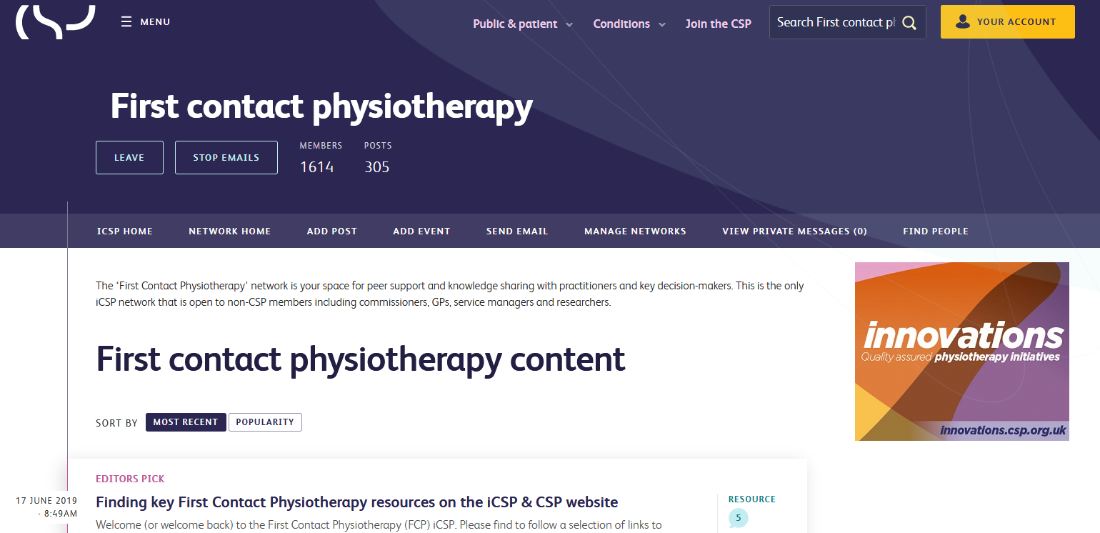
Resources @ csp.org.uk/fcp
Implementation guidance for FCPs
Data collection guidance (and templates for Emis,
SystmOne & Vision)
Job description information
Videos of FCP services (from HEE)
Calculator for estimating potential savings of FCP
Frequently Asked Questions on FCP
Case studies at innovations.csp.org.uk
Join the FCP forum at www.csp.org.uk/icsp/fcp or email fcp@csp.org.uk

Slide 12
The FCP workforce for 2020 + beyond
Full roll out dependent on expansion of FCP posts
NHSE’s Long Term Plan and GP contract framework commits to this
1 FCP (WTE) per 10k
population
First wave of FCPs = existing advanced practice roles in MSK community & triage services.
At present: around 9,000 physios at B7+ are employed by NHS providers in England
Physiotherapy is growing: 40% more graduate education places since 2015
Requires 6,000 FCPs (WTE)

Slide 13

Solutions to meet the needs
MSK Core Capabilities Framework: for self-,peer- and employer-based assessment > skillsforhealth.org.uk
Master’s modules on FCP (either standalone or as part of MSc courses)
E-learning: free modules on FCP related areas
and on Person Centred Approaches > e-lfh.org.uk
Mentoring: from within the wider MSK service
and/or the primary care team

Slide 14
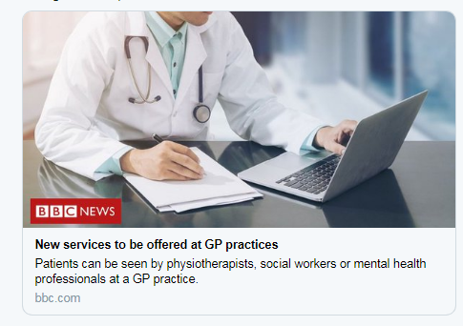
Communicating to local systems
Later this autumn, NHSE will publish findings from the national FCP evaluation with an accompanying media campaign.
This is an opportunity to:
  share local findings
  raise the profile of FCP and its benefits to the wider system
  address misconceptions

Slide 15

The CSP’s priorities on FCP:
Supporting FCP implementation
Developing workforce
Leading on evaluation (at national
and local levels)
Working with Higher Education
Institutes on workforce development
Providing resources
Enabling peer support
Informing and influencing public policy

Slide 16

@CSP_FCP #FirstContactPhysio

