Slide 1
Understanding
First Contact
Physiotherapy
in the North West
^{www.csp.org.uk}
Sima Moyo
FCP Physiotherapist
NCIC/Workington ICC
14 October 2019

Slide 2


My background
Employer: NCIC – North Cumbria Integrated Care NHS Foundation Trust
Experience: > 20years 18 in the NHS – MSK
Postgraduate Qualifications – Exercise Prescription, Joint Injection Therapy, First Contact Practice
Clinical Areas - Trauma and Elective Orthopaedics
- Rheumatology
- Fracture Clinic
- Pain Management: Chronic pain programmes & pain clinic
- Out- patients MSK
- ESP in Orthopaedics
- FCP in Primary care since December 2017
Roles/Duties (P&P) - Clinical
- Team Lead: People Management
- Education/Teaching
- Service development/improvement/evaluation/audit
Current clinical role - 4 days in FCP and 1 day in MSK & Rheumatology Injection Clinic

Slide 3
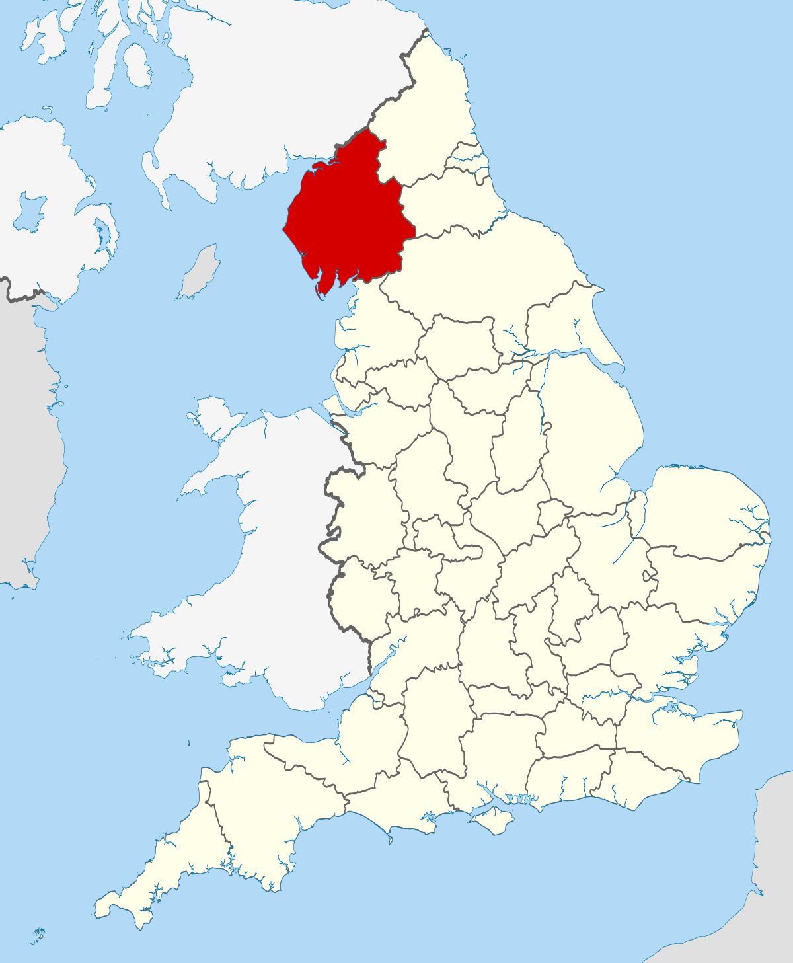
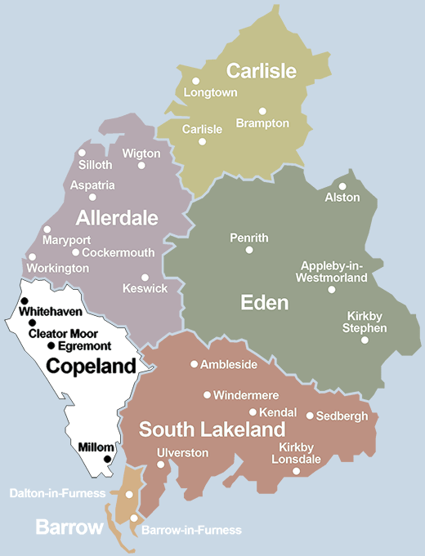
Geographic location & Demographics of the Service
West Cumbrian Coast
Semi-rural
Geographic isolation
Long-term unemployment above national average
A predominantly blue-collar workforce

Slide 4
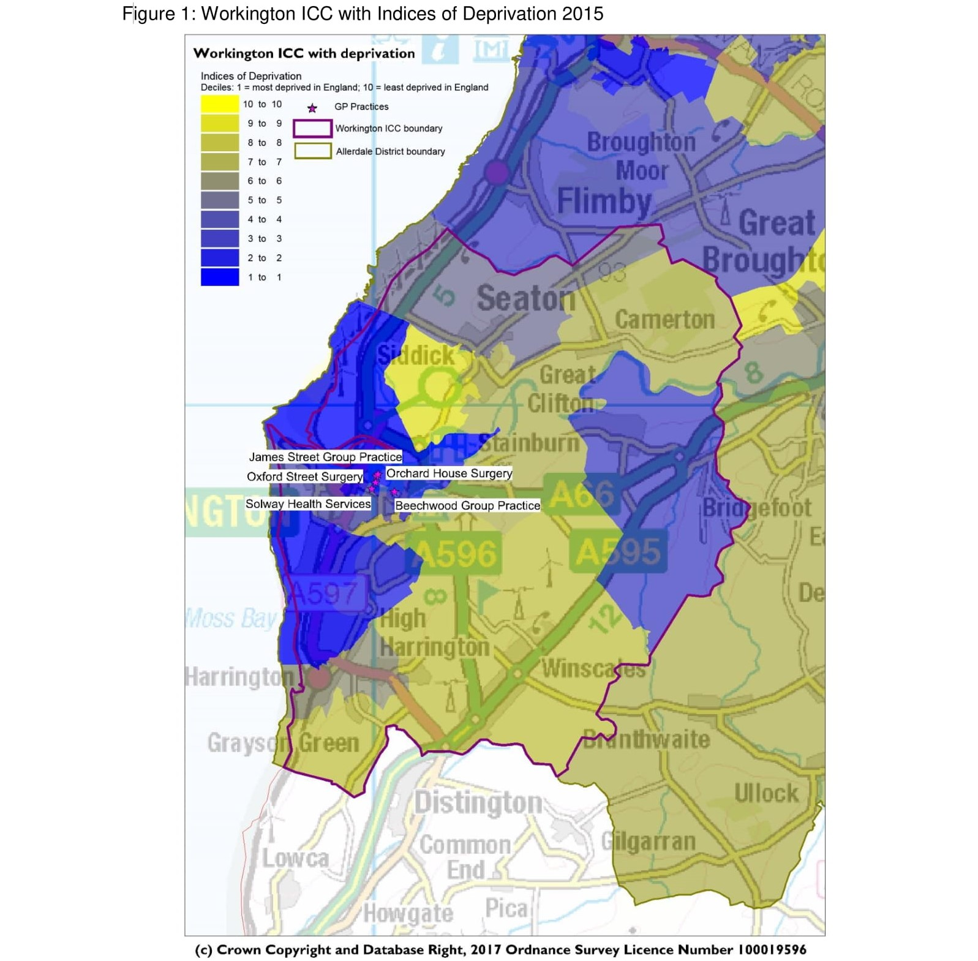
Workington ICC and Health Profile
5 GP Surgeries
Population: 33,494
Older population projected to increase
Life Expectancy below national average
Hospital stays for alcohol related harm above national average
Elective hospital admissions for hip replacement above national average
Deaths from stroke worse than national average
More patients with high blood pressure; diabetes; asthma; and dementia than national average
Source - Workington ICC webpage

Slide 5
Service Background
Recognition of the growing burden of disability in the UK due to MSK conditions and the strain this puts on the NHS in particular the primary care (1 in 5)
Changing population –age and chronic conditions/diseases
Success Stories of FCP in neighboring regions
Challenges in recruitment and retention of GP in the region
Geographical isolation leading to increased demand on primary care services
Onboard and supportive commissioners
The role of the FCP in primary care is to assess patients with soft tissue, muscle and joint pain and to decide on the most appropriate management pathway. FCP posts in General Practice: A guide for implementation in England (May2018Version3)

Slide 6
FCP Service – Cluster model within the Workington ICC
Local Pilot March 2017 – March 2018
National Pilot March 2018 – Present (Evaluation –Patient registration)
Base – Workington Com. Hosp.(Primary Care Centre)
Mentor – Resident GP
Support – Visiting GP (from one of the practices)
Clinical Networks - PCC clinicians
- Acute care teams
- Physio MSK Services
- Community services
Appointments – GP Practices
Diary management & Gen. admin.
- Workington Health

Slide 7
FCP Clinic Structure
Morning Session
30 min clinic set up
5 x 30 min New slots
1 x 30 min Review slot
1 x 30 min Admin. Slot
Afternoon Session
1 x 30 min review slot
4 x 30 min New slots
2 x 30 min Admin slots
Typical Clinic activity
Consultation
Requesting investigations and onward referrals
Treatment - injections, occ. Mobs
ex prescription/advice
Review - injections & telephone
Admin - Calls/emails
- Investigations review
- Record keeping/Pilot
data
- Clinic activity log

Slide 8
Lessons Learnt –Implementation and Practice
Successes/Opportunities
Challenges/Threats
Well established ICC
Supportive and engaging CCG
Supportive management
Positive feedback
Good clinical support network
Constant/ongoing communication
Training/P&P Development
More than 1 MSK Services
Multiple roles/time constraints
Data capture/reporting
Remote location
Clinical isolation
Limited skill set
Mentor to mentee ratio
High staff turn over

Slide 9
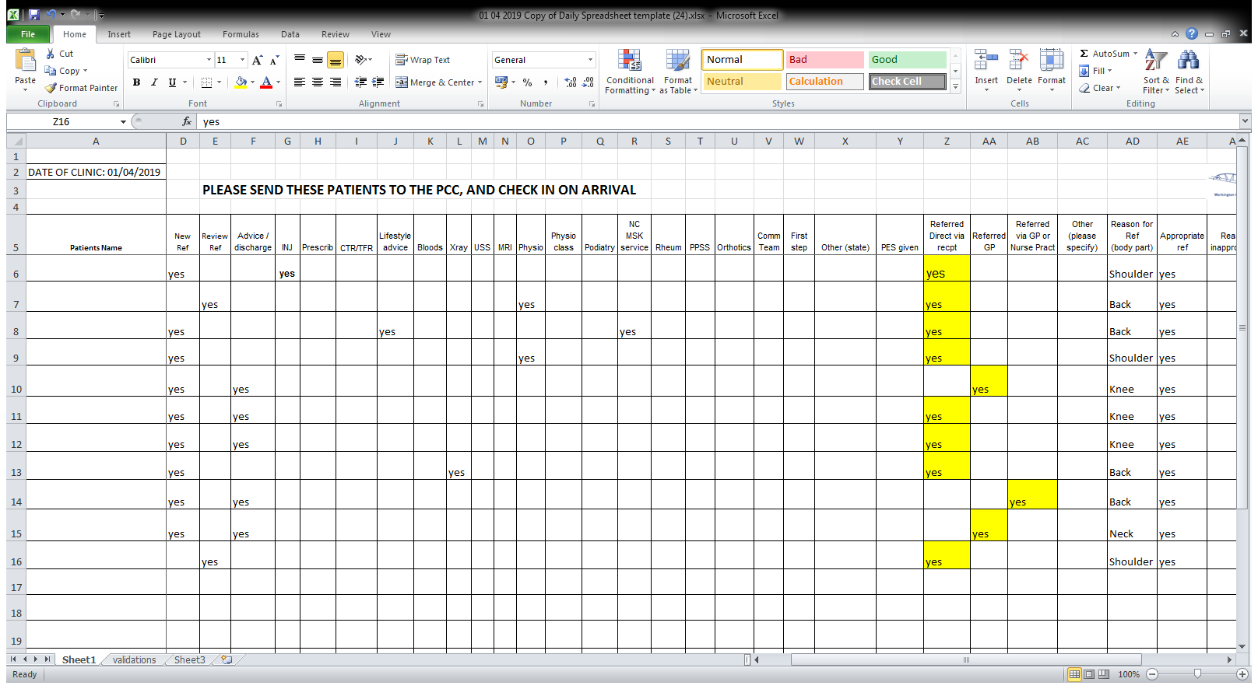
SERVICE EVALUATION

Slide 10
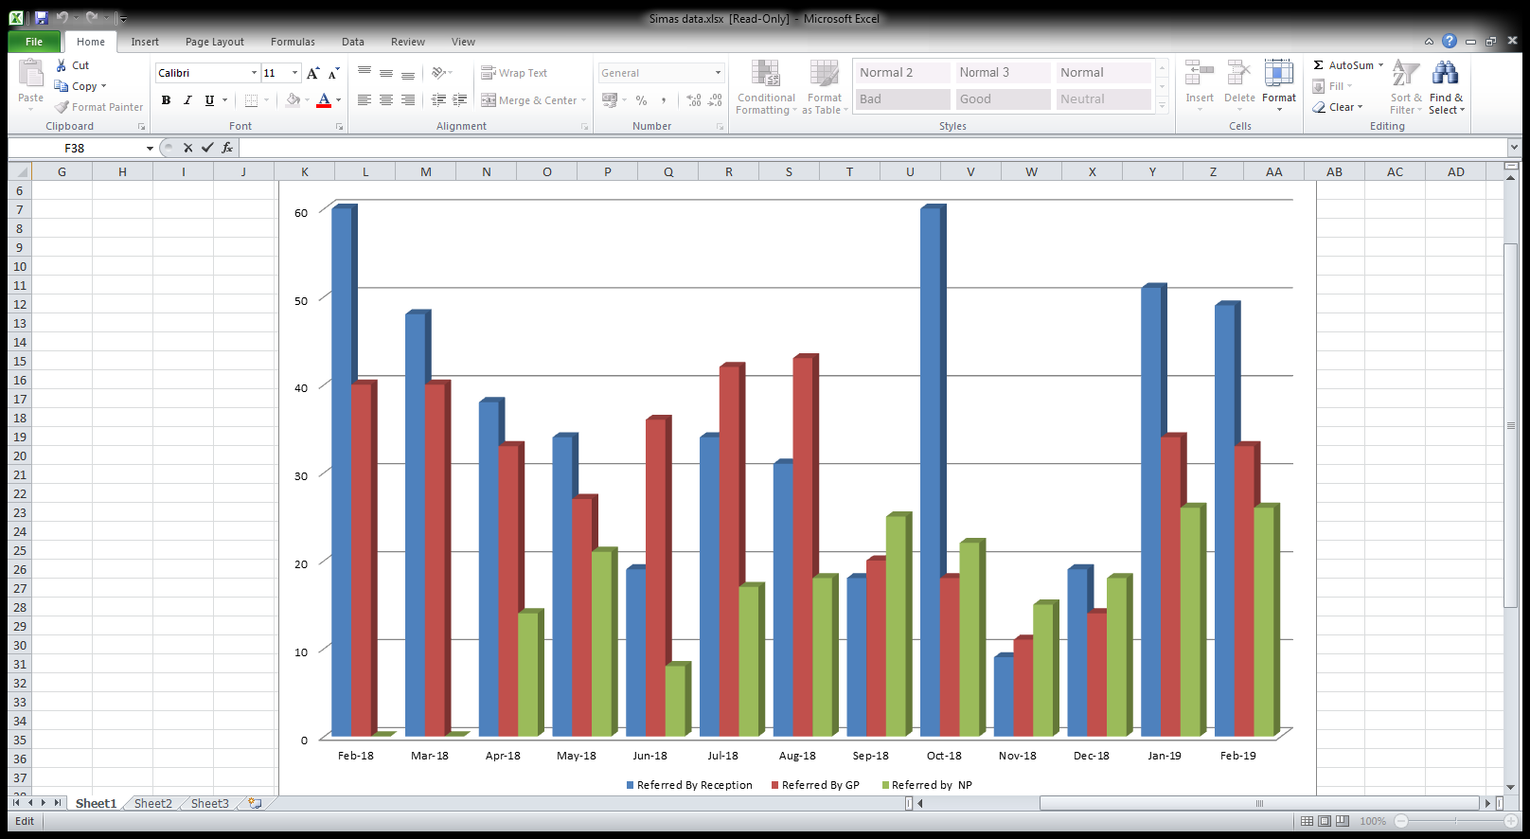
Workington ICC FCP Clinic Data
Feb 2018 –Feb 2019

Slide 11
THANK YOU

