Slide 1
Exercise Prescription
Becky Owen
Clinical Specialist in Rehabilitation
SMSKP

Slide 2


3 sets of 10
Notes:
Is this the magic number? Or what we just give because we do?

Slide 3
Take Home Messages
Rehab is exercise
    However much we try to sell activity, rehab or movement, it will always be exercise
    Strength and conditioning is rehab and prehab
Good movement patterning → Skill acquisition
Good programming drives a specific adaptation to the imposed demands
Notes:
Skill acquisition is impossible without the appropriate capacity. Without appropriate muscle mass and strength we will not be able to complete our day to day tasks, let alone the more advanced movements we want to be able to complete.
Good movement patterning will always lead to improved abilities to learn and maintain a skill properly. The quality of our exercise prescription is much more important than our quantity

Slide 4
Could we get better results?
Are we really being efficient?
Are we the most effective we could be?
Why do so many people prescribe 3 x 10?
Notes:
Over the next few slides I hoping you will be able to question your own exercise prescription and it’s efficiency and effectiveness. We can always be more effective and efficient but what if one small change to our approach can help

Slide 5
How does exercise prescription for an elite athlete differ from someone on ITU?
Time under tension
Notes:
How does our exercise prescription differ when giving a programme to an elite athlete in comparison to a patient in an ITU bed?
It should not differ at all, the principles are exactly the same and we are should be helping to drive an adaptation through time under tension. This may be an isometric exercise for helping to build muscle or to help maintain muscles
An elite athlete may be able to move a greater mass than our sedentary patients, but the movement patterning should still be the same. All movement patterns can be regressed by making the movement pattern smaller, supported or static and can all be progressed with increased range, repetitions and load. It is about the muscle groups we are using and how we move.
Strength training can be functional, but is a sit to stand not a squat and putting something in the cupboard just a shoulder press? Isn’t walking up stairs a lunge? And isn’t a lunge just a squat? How many people over complicate strength training and forget it is just about stressing a muscle through time under tension

Slide 6
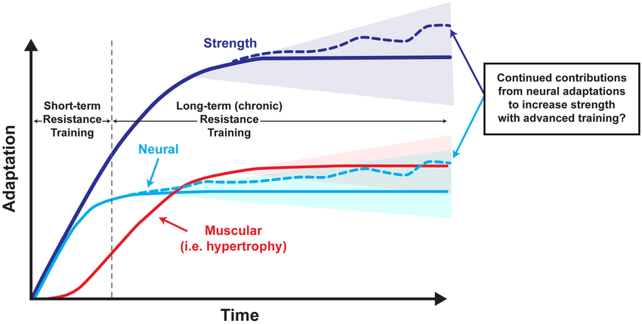

Slide 7
Building strength
What are the goals?
Build muscle
Build strength
Build specific strength
  Endurance
  Power
  Reactive/Plyometric
Notes:
Needs to be specific to each individual
Remember, without the muscle mass, we can not build muscular strength. So hypertrophy is our first port of call. This does not mean making someone into the Michelin man, but helping to build the necessary muscle fibres to be able to gain maximal strength, endurance and power to allow us and our patients to complete their skills.
If a person is wanting to sit on the edge of the bed, they will need the strength to do so, this is the same for someone wanting to run a marathon and the worlds strongest man. The only difference is the duration of the training session they may do, the repetitions they have and the movement patterns and range they choose.

Slide 8
Squat
Progression
Regression
Add load
Increase repetitions
Increase depth
Move to an unstable surface
Staggered squat/sit to stand
Side lunge
Lunge
Step up
Single leg squat
Pistol squat
Reduce reps and sets
Reduce depth
Sit to stand
Wall ball squat
Bridging
Isometric sitting
Isometric supine lying
Notes:
The progression is the bit we tend to be able to do easily. Most physios have a good ability at making a skill a bit harder, but do when breaking it down into it’s simple components, it becomes much more challenging

Slide 9
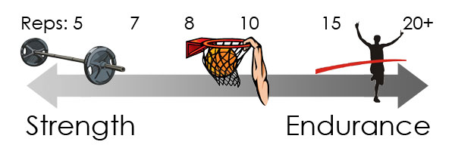
ACSM Guidelines
Notes:
The American College Sports Medicine Guidelines talk about appropriate sets and reps, but what if our patients can not achieve these gold standard reps?
The next set of slides will quickly show the advised prescriptions

Slide 10
Hypertrophy
Loading and Volume
Rest Intervals
Frequency
3-5 sets
8-12 repetitions OR fatigue
70-85% 1RM
60-120 seconds
2-3 times a week
Notes:
This is where we help someone build the muscle mass. This is down to myofibril and sarcomere hypertrophy and is focussed on time under tension.
Here we can see there are ideal sets and reps. But the focus for many of our low level patients or patients at the start of their rehab journey with an acute injury, will be time. How long would 8-12 reps take someone? If we said 60 seconds, why not use isometric holds building up to 60 seconds? This is where Jill Cook talk about time under tension and static holds for an accumulation of time to help tendons with strength and pain.
There is a place for isometric and eccentric loading in our high and low level patients

Slide 11
Max Strength
Loading and Volume
Rest Intervals
Frequency
3 sets
6-12 repetitions when sub maximal
120-180 seconds
2-3 times a week
85-100% 1RM
Necessary to allow for hormonal, cv and metabolic responses
Advised 48 hours between sessions
1-5 repetitions if maximal
Notes:
Maximal amount of force exerted in a single attempt
Moving the heaviest item you can. Repeat
Eccentric strength will appear greater than concentric
Initial strength gains as a result of neural adaptations
Finite amount of max strength available
Training helps us to minimise the difference between true maximal strength and our maximal strength
This could be isometric, in lying, sitting, standing. But without heavy loading, we will not drive the hormonal changes needed to drive muscle adaptation

Slide 12
Building power
Loading and Volume
Rest Intervals
Frequency
1-3 sets multi joint
4-6 reps
120-180 seconds to allow for phosphocreatine replenishment
2-3 times a week
40-60% 1RM
Notes:
Why are we talking about power for someone sat in a chair? We know power is necessary for a sports player, but why with an elderly person?
To overcome inertia, we need a powerful movement. To stand from sitting, we need to be ‘powerful’. To jump high ir run fast, we need to be powerful. This should not be overlooked

Slide 13
Building endurance
Loading and Volume
Rest Intervals
Frequency
3 sets
15-25 repetitions or fatigue
<60 seconds for 15 reps
2-3 times a week
Lighter loads
60-120 seconds for 25+ reps
Can be trained up to 6 x a week
Notes:
Ability for a muscle to repeatedly or sustainable contract for long periods of time
Moderate to low loads of resistance training
Biggest challenge is not being within the hypertrophy phase
Aiming to increase capillary and mitochondrial volumes
Increases intramuscular glycogen stores
NEED to reach fatigue to gain endurance. This may be 2 repetitions for one patient and 100 for another // add load!

Slide 14


Building bone density
https://twitter.com/i/status/1452667011763511296
Notes:
We need to be challenging our bones to maintain and build bone density. So to minimise osteoporosis running, walking, jumping and even repeated movement against a hard surface is necessary to improve our bone density.
In space, astronauts are looking at using a Pilates reformer to imitate gravity and to help maintain bone density and build muscle mass. How could we do this for our patients on the ward? Could we kick the end of a bed? Can we throw and catch? How do you think you could help a patient get strong and improve bone density?

Slide 15
References
American College of Sports Medicine
Gabriel, D., Kamen, G., & Frost, G. (2006). Neural Adaptations to Resistive Exercise. Sports Medicine, 36(2), 133-149. doi: 10.2165/00007256-200636020-00004Kraemer, W., & Ratamess, N. (2005). Hormonal Responses and Adaptations to Resistance Exercise and Training. Sports Medicine, 35(4), 339-361. doi: 10.2165/00007256-200535040-00004
Linnamo, V., Pakarinen, A., Komi, P. V., Kraemer, W. J., & Häkkinen, K. (2005). Acute Hormonal Responses to Submaximal and Maximal Heavy Resistance and Explosive Exercises in Men and Women. The Journal of Strength and Conditioning Research, 19(3), 566.
Rehabilitation. (n.d.) In The Oxford Language Dictionary. Google
Selvanayagam, V. S., Riek, S., & Carroll, T. J. (2011). Early neural responses to strength training. Journal of Applied Physiology, 111(2), 367-375.
Smilios, I., Tsoukos, P., Zafeiridis, A., Spassis, A., & Tokmakidis, S. P. (2014). Hormonal responses after resistance exercise performed with maximum and submaximum movement velocities. Applied Physiology, Nutrition, and Metabolism, 39(3), 351-357.
Xu, Y., Wang, Y., Chen, J., He, Y., Zeng, Q., Huang, Y., Xu, X., Lu, J., Wang, Z., Sun, X., Chen, J., Yan, F., Li, T., Guo, W., Xu, G., Tian, H., Xu, X., Ma, Y., Wang, L., Zhang, M., Yan, Y., Wang, B., Xiao, S., Zhou, L., Li, L., Zhang, Y., Chen, H., Zhang, T., Yan, J., Ding, H., Yu, Y., Kou, C., Jia, F., Liu, J., Chen, Z., Zhang, N., Du, X., Du, X., Wu, Y. and Li, G., 2020. The comorbidity of mental and physical disorders with self-reported chronic back or neck pain: Results from the China Mental Health Survey. Journal of Affective Disorders, 260, pp.334-341.

