Slide 1

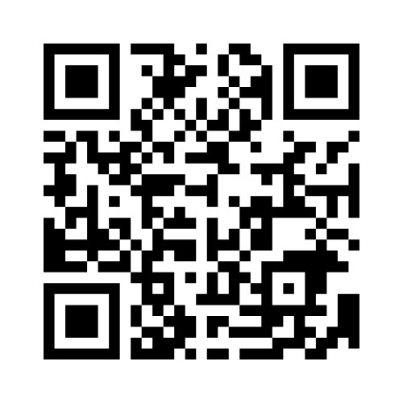
CSP South East Coast Regional Network
Health Inequalities Projects
@CSPSouthEast
Please complete our quick poll via this QR code or by visiting menti.com and enter code 13 93 43 2

Slide 2
Tweet your observations from today:
@CSPSouthEast

Slide 3
Housekeeping
Please make sure you have signed in so we know who is in the building for safety purposes
No fire alarms planned – so if an alarm sounds all visitors will need to leave by the main door, use the stairs only and out of the building turn right and walk to the end of the road until asked to go back in.
The toilets are situated near the lifts – you will need an access card to get back into the offices – please collect an access card from the registration desk (and make sure your return it) – if you forget your card just ring the bell to get back in
Please do not bring any cups and glasses into the Lois Dyer meeting room – we have had too many spillages in the past!
Presentations will be recorded (but not the Q&A or delegate participation elements)

Slide 4
Agenda
9:50 | Health Inequalities discussion starter with CSP Professional Advisor Clare Aldridge and CSP Head of Practice Improvement Helen Sharma
10:15 | CSP Chief Executive, John Cowman
11:15 | Break
11:30 | Head of Research and Development, Matt Liston
12:10 | Clare Aldridge and Helen Sharma liberating structures session 2
12:25 | Anne Canby, Assistant Director of Allied Health Professions, East Sussex Healthcare NHS Trust
12:55 | Lunch
1:55 | Pramod Selkar, Head of Services - Cardiac and Pulmonary Rehabilitation, Kent Community Health NHS Foundation Trust and Kate Savage, Senior Clinical Lead Physiotherapist
2:25 | Wendy Vaughan, St George’s University
2:55 | Michelle Long, Stroke rehabilitation quality improvement manager (SQuiRE) South East NHSE
3:20 | Clare Aldridge and Helen Sharma liberating structures session 3
3:35 | Panel discussion
4pm | Close

Slide 5

Health Inequalities discussion starter
CSP Head of Practice Improvement Helen Sharma & CSP Professional Advisor Clare Aldridge

Slide 6


The CSP South East Coast Regional Network
Notes:
Intro presenters
We know that we have lots of great knowledge in the room today, some people are already thoroughly immersed in using health inequalities as drives to transform their services and others are interested in getting started in this work.
We will all have insight that is valuable to share.
Helen and I will be running 3 short sessions across the day to help to get that knowledge in the room flowing, to give people space to share their thoughts. motivations and priorities to help inspire and support each other around the complex challenges of tackling health inequalities.

Slide 7

What do we mean by Health inequalities?
Health inequalities are differences in health across the population, and between different groups in society, that are systematic, unfair and avoidable.
Notes:
I wanted to open with a definition to help focus our minds on health inequalities. What so we mean by health inequalities?
Health inequalities are differences in health across the population, and between different groups in society, that are systematic, unfair and avoidable.
Health inequalities are ultimately the differences in the status of people’s health, but also the differences in care that they receive and the opportunities they have to lead healthy lives.

Slide 8
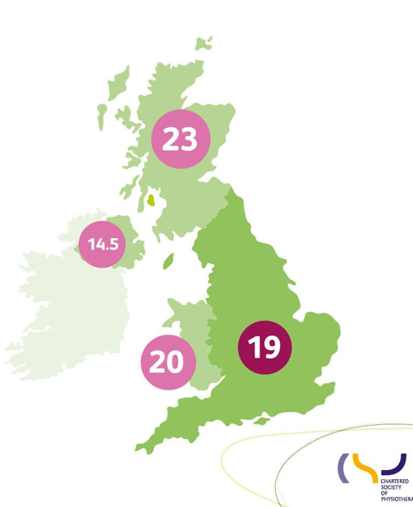

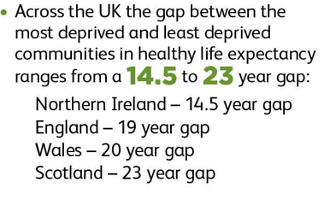
(CSP Easing the Pain Report 2022)
The health inequity gap
Notes:
Causes of health inequalities in the UK are numerous and varied. This makes tackling and reducing health inequalities a complex challenge requiring the collective action of different organisations and stakeholders.
Our first activity is going to focus in on what the HI challenges and priorities are in your local population and your services.
But before we do that I want to share the UK health inequity map from the CSP Easing the Pain Report- 2022.
This illustrates the number of years that a person can expect to live in good health varies across the UK, comparing the gap between the most deprived and the least deprived communities.
Examples from across the UK quoted by The Health Foundation:
A woman born in Wokingham can expect to live 15 more years in good health than a woman born in Blackpool. A man born in Richmond upon Thames can expect to live 17 more years in good health than a man born in Belfast.
In the Orkney Islands female healthy life expectancy at birth is 75.0 years, while in Blackpool it is just 55.3 years.
The impact of deprivation, further pertinent statistics
People in the poorest communities are 60% more likely to be diagnosed with a LTC. They also have a 30% higher chance that their condition will be more severe.
People in the bottom fifth of deprivation levels (so in the highest areas of deprivation) are nearly twice as likely to have MSK or respiratory conditions and 4 times as likely to have mental health issues than those living in areas of lowest deprivation.

Slide 9
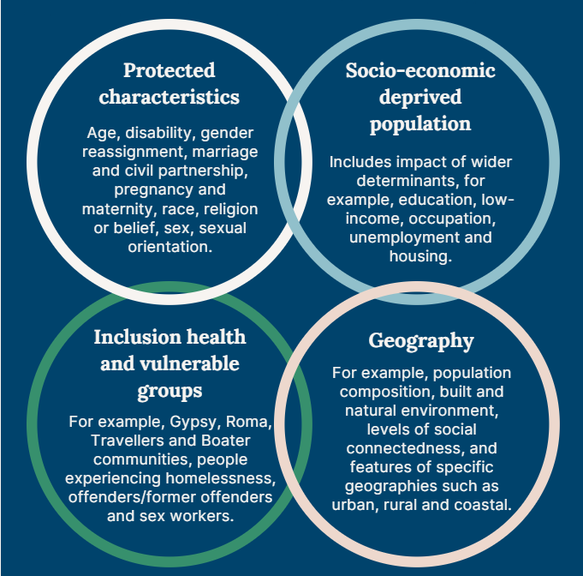
Wider determinants of health
Source: King’s Fund
Notes:
​​The conditions in which we are born, grow, live, work and age can impact our health and wellbeing, and are sometimes referred to as wider determinants of health. ​
This King’s Fund Venn diagram categories the wider determinants of health and illustrates the complex interactions that those at greater risk of health inequalities may experience, meaning people can fall into combinations of these categories. This can compound and multiply the impact and severity of health inequalities experienced.​
​
For example, someone who is unemployed may be more likely to live in poorer quality housing with less access to green space and less access to fresh, healthy food. This means some groups and communities are more likely to experience poorer health than the general population. These groups are also more likely to experience challenges in accessing care.

Slide 10


Avoid inertia due to being overwhelmed by the scale of the problem and don't wait for the perfect data to get started; start now in the spirit of service improvement.
Notes:
Recent Arthritis and Musculoskeletal Alliance (which the CSP is part of) ARMA. Has some great messages around how we can get started with tackling health inequalities which can be applied across all sectors and specialisms. A great call to action for us all to consider across today is:
Avoid inertia due to being overwhelmed by the scale of the problem and don't wait for the perfect data to get started; start now in the spirit of service improvement.

Slide 11
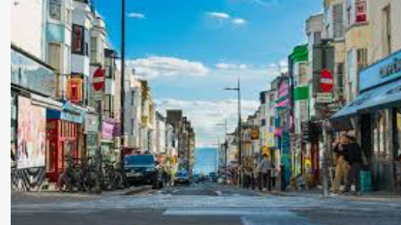
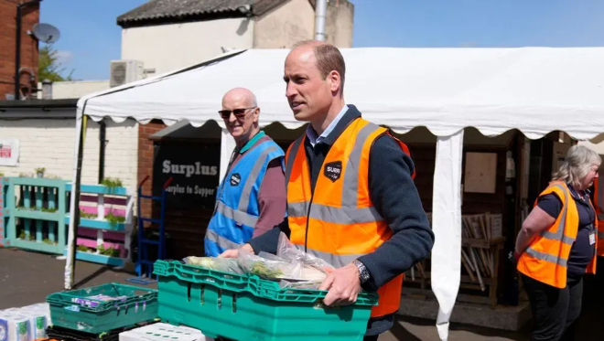
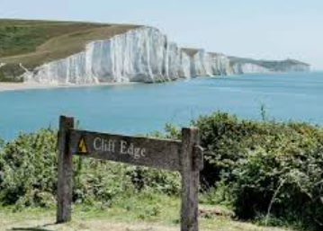
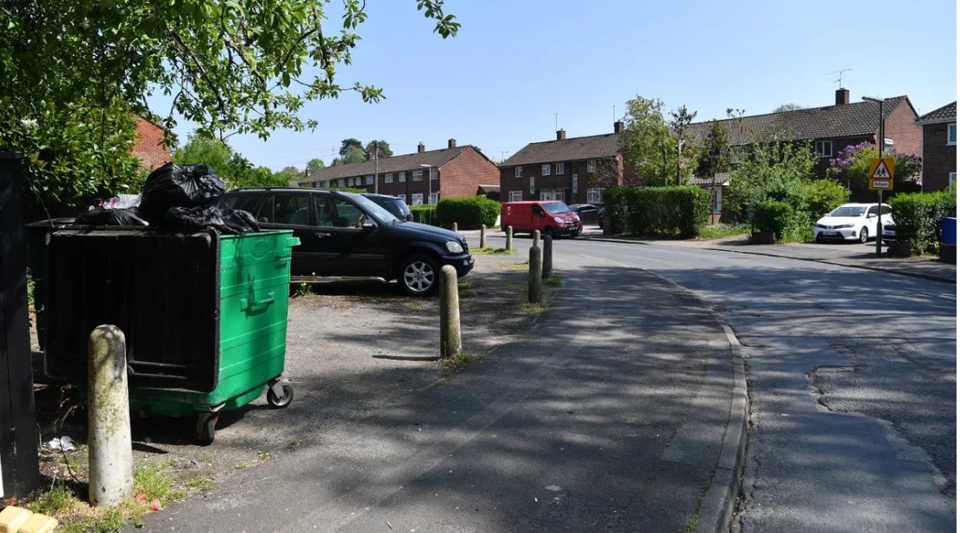

Notes:
Aim:
Understanding your population is crucial for comprehending how health inequalities may affect services. This knowledge enables you to address service improvement questions: such as, who accesses and participates in the service successfully, and who does not, and why?
To get the day underway, we are going to undertake a rapid fire group activity to get us all thinking and reflecting about the challenges of health inequalities that impact our work, what our drivers are for undertaking or considering this work and share this insight to set the landscape of the challenges in SEC.
In a moment I am going to ask everyone to stand up and we will form 2 concentric circles an inner circle and an outer circle.
I will ask you to stand and face one another.
Ask participants to introduce themselves to their partner.
We have 5 open ended statements that I will share and then give you 30 seconds to complete the statement, either of you can go first and then the second person will have a further 30 seconds to respond to the same open ended statement.
Once you have had your say the outer circle will stay still and the inner circle to will step to the right to speak to the next person.
There are absolutely no right or wrong answers here, but it is a great opportunity to use the knowledge in the room to help map out what is happening in SEC currently with regards to HI work and priorities.
I will read the questions and ding the bell to get you to move onto the next question.
The questions will be up around the room on the screens.
I will ask you to quickly put very brief thoughts on each point on your summary sheet at the of the activity, I will then collate this the information and share this back to the groups, hopefully by the end of next week!
Let’s go!
Prince William helps to loads trays of food into vans during a visit to Surplus to Supper, in Sunbury-on-Thames, Surrey, England, Thursday, April 18, 2024.
Woking borough council (46% of children live in poverty)
Tunbridge Wells, Kent (Southborough where over 30% of children were living in poverty in.
Woking poverty is on the increase.

Slide 12


Form two circles.
You will find yourself directly across from one other person. One person facing ‘out’ and the other ‘in’. Finish the sentence that appears on the screen.
1) First person speaks for 30 secs – DING – switch roles
2) Second person speaks for 30 secs – DING DING – move one space to your right
Notes:
In a moment I am going to ask everyone to stand up and we will form 2 concentric circles an inner circle and an outer circle.
I will ask you to stand and face one another.
Ask participants to introduce themselves to their partner.
We have 5 open ended statements that I will share and then give you 30 seconds to complete the statement, either of you can go first and then the second person will have a further 30 seconds to respond to the same open ended statement.
Once you have had your say the outer circle will stay still and the inner circle to will step to the right to speak to the next person.
There are absolutely no right or wrong answers here, but it is a great opportunity to use the knowledge in the room to help map out what is happening in SEC currently with regards to HI work and priorities.
I will read the questions and ding the bell to get you to move onto the next question.
The questions will be up around the room on the screens.
I will ask you to quickly put very brief thoughts on each point on your summary sheet at the of the activity, I will then collate this the information and share this back to the groups, hopefully by the end of next week!
Let’s go!

Slide 13
Question 1:
My motivations to tackle health inequalities are….

Slide 14
Question 2:
What I find challenging in my current situation is….

Slide 15
Question 3:
If we do nothing to address health inequalities…...

Slide 16
Question 4:
The most pressing health inequality issues facing the population I serve are….

Slide 17
Question 5:
The biggest health inequalities challenge in my service is….
Notes:
Please complete the table and I will come round a collect them.

Slide 18
CSP CEO John Cowman
cowmanj@csp.org.uk
@theCSP
@CSPSouthEast

Slide 19
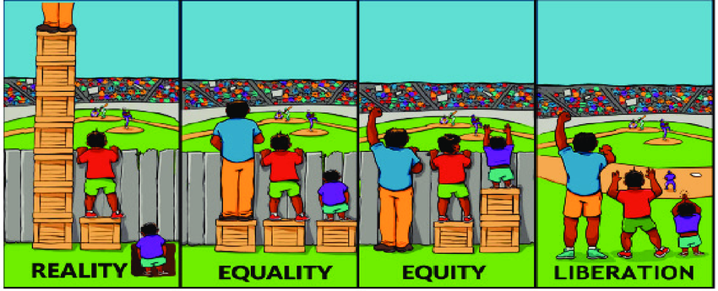
Equality vs Equity
Reality
Equality
Equity
Liberation

Slide 20
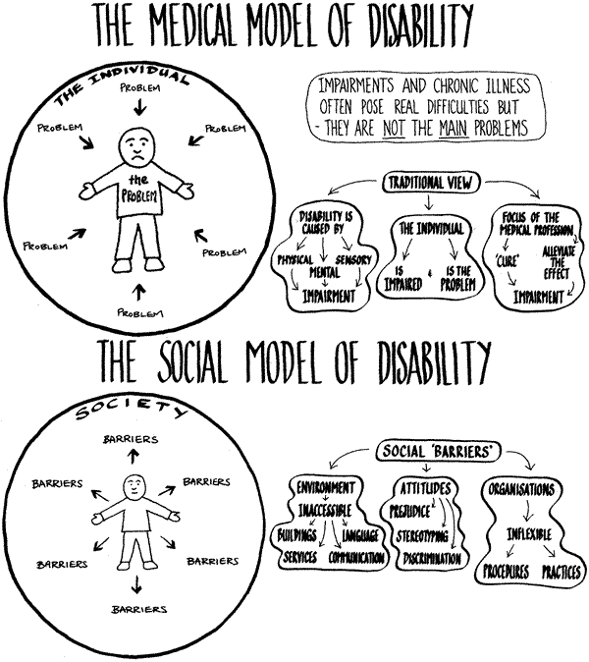
Medical versus Social

Slide 21
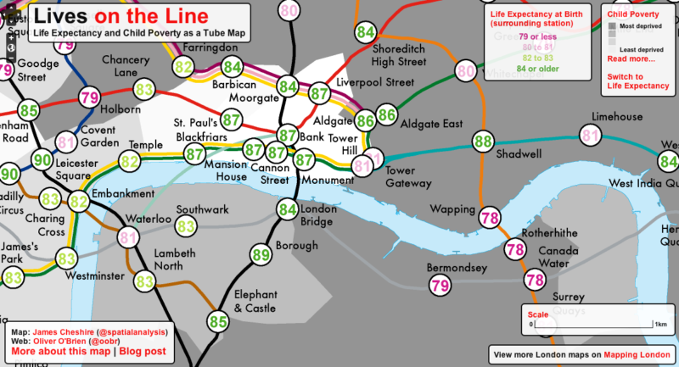
Health Inequalities

Slide 22




Health Inequalities
On average, men die 23 years younger than women in the general population.
On average, women with die 19 years younger than women in the general population
39% of people died an avoidable death
32% of people died an avoidable death
26% of people with an avoidable death
(LeDeR, 2023; ONS, 2022).

Slide 23
Barriers to Health Equality
a lack of accessible transport links
patients not being identified as having a learning disability
staff having little understanding about learning disability
failure to recognise that a person with a learning disability is unwell
failure to make a correct diagnosis
anxiety or a lack of confidence for people with a learning disability
lack of joint working from different care providers
not enough involvement allowed from carers
inadequate aftercare or follow-up care.
(Heslop et al. 2013; Tuffrey-Wijnes et al. 2013; Allerton and Emerson 2012).

Slide 24





How the Profession is responding
Key work the CSP is doing nationally:
Easing the pain report
Contributed and influenced the ARMA national inquiry into musculoskeletal (MSK) health inequalities and deprivation
Response to Women’s health strategy
Inequalities
Inequalities Health Alliance member
10 year cancer plan consultation
Notes:
Key health inequality work the CSP is doing nationally :
Easing the pain report, infographics and presentation slides https://www.csp.org.uk/publications/rehabilitation-recovery-reducing-health-inequity-easing-pain
· Contributed and influenced the ARMA national inquiry into musculoskeletal (MSK) health inequalities and deprivation https://www.csp.org.uk/news/2024-03-19-physiotherapists-are-tackling-musculoskeletal-health-inequalities https://www.csp.org.uk/system/files/documents/2023-08/ARMA%20Health%20inequalities%20inquiry%20response%20FINAL.pdf · CSP response to Women’s health strategy https://www.csp.org.uk/news/2021-06-15-csp-urges-government-reform-healthcare-women https://www.csp.org.uk/system/files/documents/2021-06/Women%27s%20health%20strategy_140621_pdf.pdf · Lobbying CSP professional network Pelvic, Obstetric and Gynaecological Physiotherapy (POGP) and the Community Rehabilitation Alliance (CRA) has resulted in invitations from NHS England to support the implementation of women's health hubs https://www.csp.org.uk/news/2024-03-13-nhs-england-invites-physios-help-implement-womens-health-hubs-improve-pelvic-health
· Inequalities Health Alliance member – We are members of the IHA. 250 members campaigning for a cross-government strategy to reduce health inequalities. Made contact with Asha Intensive Care Society Tasha following a positive IHA meeting, at which Tasha presented the Easing the Pain report These follow on meetings led to ICS joining the CRA. Inputted into joint letters, statements and campaigns.
· 10 year cancer plan consultation – calling for Health Equality to be made mandatory for all cancer service planning and delivery. The mandate should include: a minimum dataset, inequalities measures, and a health equity audit as part of routine monitoring and reporting of actions taken to address inequalities. https://www.csp.org.uk/news/2022-04-28-physiotherapy-influences-future-cancer-care-england https://www.csp.org.uk/system/files/documents/2022-04/10_year_cancer_plan_call_for_evidence_response.pdf -

Slide 25
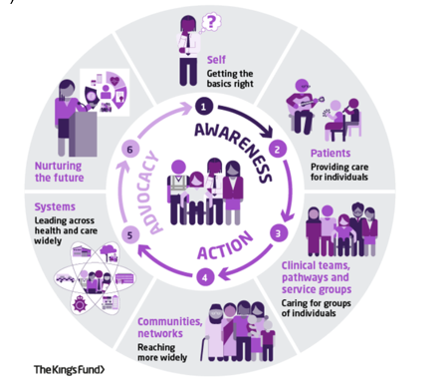
My role in tackling health inequalities: a framework for allied health professionals The King's Fund (2021)
Notes:
In this complex and intersectional picture of multiple factors that impact health inequalities how can CSP members work to tackle health inequalities?
It can feel like a big mountain to climb and sometimes there is a perception that it is not our job or it can be difficult to know where to get started
Physiotherapists, alongside other AHPs, are the third largest clinical workforce, with physios being the largest AHP profession. Therefore, there is huge potential for physio team members contributions to tackling health inequalities to be impactful.
Physio services support patients across pathways and through all stages of life and are therefore really well placed to identify and understand the key characteristics and the needs of the populations they serve.
Small changes to services can improve access to underserved and vulnerable communities, helping to tackle health inequalities.
The King’s Fund has created a framework to support AHPs to get started with seeing their place and take action in tackling health inequalities.

Slide 26
The Individual
The Patient
Clinical Teams and
Communities and Networks
System
The Future
Notes:
The Framework encourages all AHPs throughout their career to contribute towards improving health inequalities via three approaches: raising awareness, taking action and optimising advocacy through six routes to change:
1 Self: everyone’s individual contribution counts – such as increasing your own awareness of health inequalities and considering what unconscious bias you have which could impact your practice. There are excellent resources available such as the King’s Fund’s Health Inequalities in a Nutshell paper.
2 Patients: is your patient at risk of experiencing barriers to healthcare such as learning difficulties, poverty and deprivation or low health literacy? What can you do to improve their equity of access? Could these steps benefit other patients?
3 Clinical teams, pathway and service groups: does your service collect and effectively utilise demographic data about patients?
Are there any gaps in the information you collect? Does the data tell a story about an underserved community in your patient population?
Practical example: You want to make your MSK clinic hours more accessible. You survey existing patients about convenient clinic opening hours–the outcome is that the existing hours are fine.
Consider: With this approach you are not reaching those who struggle to access the clinic.
Look for ways to include opinions from a much wider population that may be struggling to access the service - such as asking via local GP practices or local orthopaedic teams.
4 Communities and networks: Working together across services is essential to ensure the needs of your population are fully understood.
Consider how health inequality may impact at different junctures in patient’s health journey. Is there anything you could do to advocate for patients as they transition from your service into another service? Do groups of patients get lost along the way?
Are the referrals/ self-referrals received by your team reflective of the population in that local area – if not, why not? Can awareness be more widely raised in different ways and to different audiences (for example faith groups, online social groups, local cafes and libraries).
5 Systems: If there are known populations not accessing certain services it is the duty of the system to reach out to where those communities gather.
However, everyone can be proactive in building relationships within the system to promote engagement - for example building relationships with relevant community groups.
6 Nurturing the future: How can we plan for the changing needs of our population? Population health changes do not provide swift outcomes. NHS England suggests that population health changes may be felt 15-20 years down the line but the decisions we make today are crucial for the healthy lives of the future population

Slide 27
The CSP Health Inequalities project team professional network discussion
How we can help you make a difference?
Notes:
Alongside this national influencing work, the CSP is developing resources and support opportunities to help members tackle health inequalities through their practice.
The CSP Health Inequalities project team undertook broad ranging insight across 2023 with the aim of understanding member baseline knowledge, capability and ask them what resources and support they need to transform services and reduce health inequalities.

Slide 28
Fundamental issues, members need:
knowledge about health inequality and quality improvement
More
confidence in applying knowledge into practice​
More
opportunities to engage; demonstrating benefit​
More
research and evidence
More
Notes:
The project team heard from over 4500 members who told us that they needed more……

Slide 29
What are the CSP’s health inequalities project team’s plans to support members?
Building the evidence base
Building a supporting community
Learning resources
Service transformation
Notes:
Guided by the member insight, work is getting started which includes:
Networking opportunities: the start of which is the Health Inequalities iCSP which launched on 1st May 24 (linked in the next slide)
Further development of the existing CSP online health inequalities resources into a hub with the aim of getting pertinent health inequalities information at members fingertips (this is developing over 2024 with the aim of it being fully available to members in the 1st quarter 2025)
Building the evidence base with the development of a database of service improvement examples, illustrating how physio team members can tackle health inequalities in practice. The team would love to hear about any work you are doing in your practice to tackle health inequalities.
A repository of education and training resources.
The project team would welcome speaking to anyone who would like to find out more about their work or who have any questions about health inequalities in their practice.

Slide 30
How we can help you make a difference
Access the CSP Health Inequalities webpages to find out more about how health inequalities can impact on your clinical practice, service and community:
https://www.csp.org.uk/professional-clinical/improvement-innovation/health-inequalities
CSP Getting started webinar https://www.youtube.com/watch?v=q7jNzeakuwo
Connect with CSP representatives locally including CSP Stewards and CSP Equality Reps who can help with influencing change (use the online ‘find your rep’ facility: https://www.csp.org.uk/people-directory/reps
Join the iCSP Health Inequalities online network:
https://www.csp.org.uk/icsp/health-inequalities
Join the iCSP Influencers network: https://www.csp.org.uk/icsp/influencers
Notes:
Pertinent CSP resources and networking opportunities

Slide 31
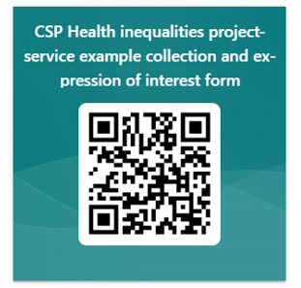
How we can help you make a difference
Share your health inequalities work to inform and inspire other members by completing the linked service improvement MS Form and connecting with the CSP Health Inequalities project team: https://forms.office.com/e/DXwYyUBuFh
Notes:
The CSP Health Inequalities project team are really keen to find out more about what work teams are undertaking to tackle health inequalities to both increase the evidence base and find illustrative examples that can be shared to inspire other members to undertake work to address health inequalities. The QR and link above will take you to a quick form to share some key information about the work/ project with the team

Slide 32
Thank you!
cowmanj@csp.org.uk

Slide 33
Break – resume 11:25

Slide 34
Head of Research and Development
Matt Liston

Slide 35

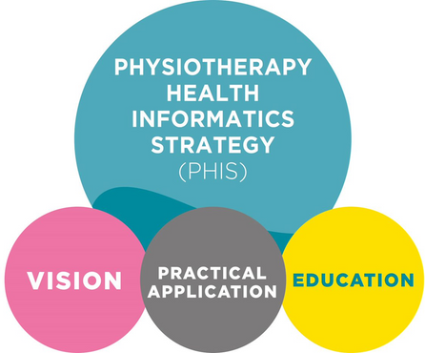
Telling Stories With Data
Matt Liston
Head of R&D

Slide 36
What is data?
In its broadest terms
Facts and statistics collected together for reference or analysis
Things known or assumed as facts, making the basis of reasoning
Population statistics, Demographics, Outcome measures, Surveys, Focus group transcripts, User feedback, Webpage hits, Research data,

Slide 37
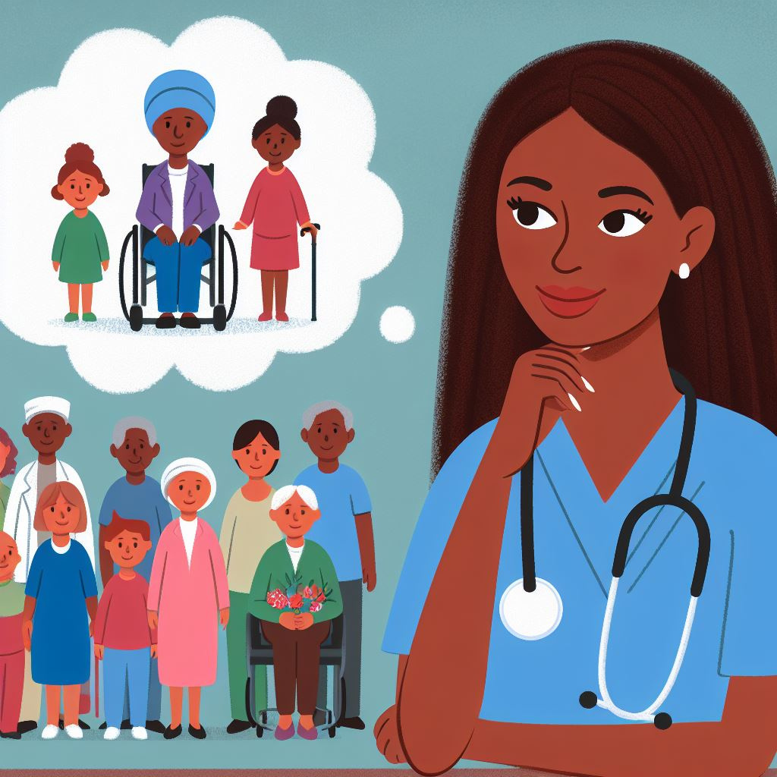
Why Data?
Why Stories?
What Story?
Notes:
Helps support the development of a question, the exploration of a question, or the response to a question
Presence or absence of data can highlight issues
Proxy measures can be used also

Slide 38
Does my Chronic Pain service meet the needs of those who need it most?

Slide 39
- Organisational strategy determines we should explore inequity.
- I have just read the 2021 Versus Arthritis report exploring inequity in people with chronic pain
- My chronic pain service has a complex and diverse cohort, they are highly impacted by pain.
- I need managers to support work to explore our chronic pain service

Slide 40

What’s the type of Story I need to Tell?
Who are my audience?
What do they need to hear?
What is their starting point?
Where do I need them to get to?
What action do I need them to take?
How am I going to get them to take their next step?

Slide 41
What’s the Story I need to Tell?
No assumptions
Start at the beginning
Provide the context
Introduce the characters
Define the problems
Hit the gap

Slide 42

People from minority ethnic backgrounds have greater incidence of chronic pain (44% of people who identify as Black live with Chronic pain)
Approximately 30% of the UK population live with chronic pain
Those that experience early social disadvantage are more likely to develop chronic pain in later life
People with chronic pain are twice as likely to live in the most deprived areas
Chronic pain impacts peoples peoples ability to enjoy family, recreational and social activities, work or complete activities of daily living.
Chronic pain is defined as persistent or recurrent pain that has gone on for more than 3 months
People with chronic pain are more likely to have other long term conditions
Whats the gap?

Slide 43
Chronic pain is defined as persistent or recurrent pain that has gone on for more than 3 months
Approximately 30% of the UK population live with chronic pain
People with chronic pain are more likely to have other long term conditions
Chronic pain impacts peoples peoples ability to enjoy family, recreational and social activities, work or complete activities of daily living.
Those that experience early social disadvantage are more likely to develop chronic pain in later life
People with chronic pain are twice as likely to live in the most deprived areas
People from minority ethnic backgrounds have greater incidence of chronic pain (44% of people who identify as Black live with Chronic pain)

Slide 44
The Gap
Because of the known interactions between pain, early disadvantage, social deprivation and ethnicity we need to ensure our chronic pain services address the needs of the people that need it most
We need to understand whether our referral routes, provision, uptake and outcomes are equitable
We need to understand the knock on effects of any inequity

Slide 45
How does Data Help?
Where do I find it?
What can it do?
What can’t it do?
What if I don’t have any?

Slide 46

Where to Look?

Slide 47

Health Data Flows
Upstream Data
Service Data
Downstream Data
Population Data

Slide 48
Health Data Flows
Who’s out there?
What do they need?
What do we do?
How do we benefit them?
Where do we stop them going?
How much do we save the system?
How does this compare?

Slide 49

Who is out there?
What do they need?
Population Data
Referrals
Risk profiles
Policy
Research
Upstream
Transactional
Outputs
Outcomes
Experience
Impact
ROI
What do we do?
Service level
Where do they go?
Where do we stop them going?
Downstream
GP / A&E episodes
Escalation of care
Benchmarking
Population data

Slide 50
Ethnicity | ONS Proportion of Local Population (%) | Proportion of referrals into Chronic Pain Clinic (%) | DNA Rate (%) | Completion of intervention (%)
Asian or Asian British | 17.7 | 12.3 | 20 | 85
Black, Black British, Caribbean or African | 7.2 | 2.2 | 35 | 60
Mixed or multiple ethnic groups | 5.1 | 7.1 | 17 | 79
White | 67.1 | 75 | 20 | 85
Other | 2.9 | 3.4 | 20 | 90

Slide 51
Ethnicity | PROMS | PREMS | Feedback / Qual / Other insight
Asian or Asian British
Black, Black British, Caribbean or African
Mixed or multiple ethnic groups
White
Other

Slide 52
Ethnicity | Attendance at GP | Medication Cost | Attendance at A&E | Ambulance Call Out
Asian or Asian British
Black, Black British, Caribbean or African
Mixed or multiple ethnic groups
White
Other
Notes:
Community assets? Using other support structures?

Slide 53
Does my service meet the needs of those who need it most?

Slide 54
In light of:
The published evidence
Data collection
Community conversations

Slide 55
What now?
Where do we start?
What should we do?
What do we measure?

Slide 56

STORY ONE:
IDENTIFY PROBLEMS
STORY TWO: EXPLORE AND DESCRIBE INTERVENTIONS
EXPLORE DATA AND CRAFT STORIES
DETERMINE ACTIONS, DATA ITEMS AND MEASURE
CONSULT WIDELY
EXPLORE AND UNDERSTAND THE DATA (AND GAPS)
UNDERSTAND THE STORY YOU NEED TO TELL
Start

Slide 57
What’s the Story I need to Tell?
Describe the solution
Define the impacts (and where they occur)
Describe and demonstrate the impact
Show the value
Show how this plugs the gap
Describe alternatives options / scenarios

Slide 58
AphA - www.aphanalysts.org
Health Economics Unit - www.healtheconomicsunit.nhs.uk
Kent Public Health Observatory - https://www.kpho.org.uk/
NHS Benchmarking
CSP webpages – 1) PHIS and 2) Health Inequalities
Office for national statistics - www.ons.gov.uk
Public Health Fingertips - https://fingertips.phe.org.uk/
GP data dashboard: https://digital.nhs.uk/data-and-information/data-tools-and-services/data-services/general-practice-data-hub
KeRNEL - www.kmkernel.org

Slide 59
Health Inequalities discussion 2
CSP Head of Practice Improvement Helen Sharma & CSP Professional Advisor Clare Aldridge

Slide 60

What is the story that I need to tell and where is the data?
Notes:
Further to Matt’s session, we wanted to pause to give people the opportunity to consider:
What is the story that I need to tell and where is the data?
We are going to explore this by undertaking an activity call 1-2-4-ALL.
Sequence of Steps and Time Allocation
Silent self-reflection by individuals on a shared challenge and jot down your thoughts and ideas (1 min).
Share your ideas in pairs, building on ideas from self-reflection. (2 min).
Share and develop ideas from your pair in foursomes (notice similarities and differences). (4 min).
Ask, “What are the top 3 ideas/tips about where is the data that stood out in your conversation?” Each group shares one important idea with all (5 min). Please write this on your flip chart.
I will collate in the flip chart at the end and collate this data and share it back with everyone after the event,

Slide 61
What is the story that I need to tell and where is the data?
Silent self-reflection individually- jot down your thoughts and ideas (1 min).
Share your ideas in pairs, building on ideas from self-reflection. (2 min).
Share and develop ideas from your pair in foursomes (notice similarities and differences). (4 min).
Each group to share with the room and note on flip chart “What is the top idea/tip about where is the data that stood out in your conversation?” Each group shares one important idea with all (5 min).
Notes:
Further to Matt’s session, we wanted to pause to give people the opportunity to consider: What is the story that I need to tell and where is the data?
We are going to explore this by undertaking an activity call 1-2-4-ALL.
Sequence of Steps and Time Allocation
Silent self-reflection by individuals on a shared challenge and jot down your thoughts and ideas (1 min).
Share your ideas in pairs, building on ideas from self-reflection. (2 min).
Share and develop ideas from your pair in foursomes (notice similarities and differences). (4 min).
Ask, “What are the top 3 ideas/tips about where is the data that stood out in your conversation?” Each group shares one important idea with all (5 min). Please write this on your flip chart.
I will collate in the flip chart at the end and collate this data and share it back with everyone after the event,

Slide 62





Data is key to identify barriers to services and to show the impact that work to address health inequalities is having
Local authority dashboard
OHID Public Health Profiles - Fingertips
Service data
Notes:
The ARMA HI inquiry calls on us to use data to drive our work to tackle health inequalities.
Above is some examples of key data sources to support you to get started.
Using data to identify, tackle and monitor barriers to access and unequal health outcomes. Analysing data allows services to identify unmet need – including where people from areas of deprivation are under-represented. However, this is not always easy. Service managers talked about the difficulties of collecting, accessing and integrating sources of data.
Healthcare professionals need to know and understand the cause of health inequalities and how they affect the community they serve. Without this knowledge, putting strategies in place to reduce health inequalities may lack impact.
Therefore, it is really important to know your population, to allow you to understand the barrier’s of those accessing and to help you establish who is accessing your services and more importantly who is not.
Population health data and service data can help you to adapt your services to meet the needs of your community by helping you create a clear picture about who is and really importantly is not successfully accessing your services and support.
Exploring population health data for your population will help you to understand who is and who is not accessing your services from your communities:
Health information about your local population and that of other areas of the UK
Health diagnoses for your local population and across the UK
Cross referencing this with your service data such as, protected characteristics, patient-reported experience measures (PREMs), did not attend (DNA) rates, attendance, complaints will help to inform you who is accessing and successfully engaging with your services and help you to see if your patient cohort reflects the local population. Are certain groups of patients not accessing or engaging with your services. If you can identify that patterns or gaps then this gives you a good baseline against which
Many organisations have data or health inequalities leads, so reach out for their support and advice for help with finding and collecting the data that you need.
Useful public health data sources:
The Health Foundation: Local Authority Dashboard: https://www.health.org.uk/evidence-hub/local-authority-dashboard
The impact of deprivation (reference for deprivation: The Index of Multiple Deprivation, commonly known as the IMD, is the official measure of relative deprivation for small areas in England- https://www.fscbiodiversity.uk/imd/#:~:text=The%20Index%20of%20Multiple%20Deprivation%2C%20commonly%20known%20as%20the%20IMD,32%2C844%20(least%20deprived%20area
Health Inequalities Improvement dashboard (England)- summary and links to data resources in England: https://www.csp.org.uk/professional-clinical/improvement-innovation/health-inequalities%20CSP%20Getting%20started%20webinar%C2%A0https://www.youtube.com/watch?v=q7jNzeakuwo

Slide 63
Anne Canby, Assistant Director of Allied Health Professions
East Sussex Healthcare NHS Trust

Slide 64
A Workforce Journey
Addressing Health Inequalities
Anne Canby,
Assistant Director of AHPs, ESHT

Slide 65
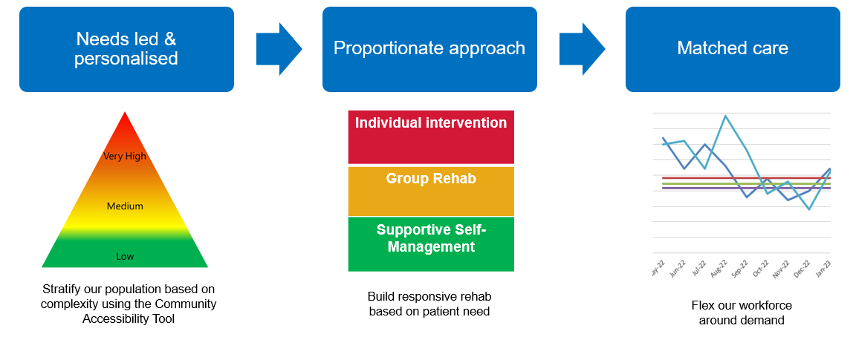
AHP Rehabilitation Workforce
Building Clinical Leadership & delivering proportionate matched care
Thanks to Karen Poole, AHP Consultant Rehab &
Sussex Clinical Lead for Rehab

Slide 66






Workforce Transformation Principles
Clinical Leadership
Train, Retain, Reform
QI Approach
Personalised Care
Interdisciplinary Approach
Clinical Leadership through consultant, advance practice and communities of practice. Building diverse clinical care professional leadership at all system, place, organisation and ICT.
Co-Design & Multiagency QI forum aligned to Delivery & Transformation Boards;
Building QI capacity & capabilities
Building Peer Leadership; Personalised Care Champions Care coordination. Embedding personalised care training
Needs Based; Collaboration to enhance outcomes; Integrated care across services, providers & sectors – ICTs;

Slide 67
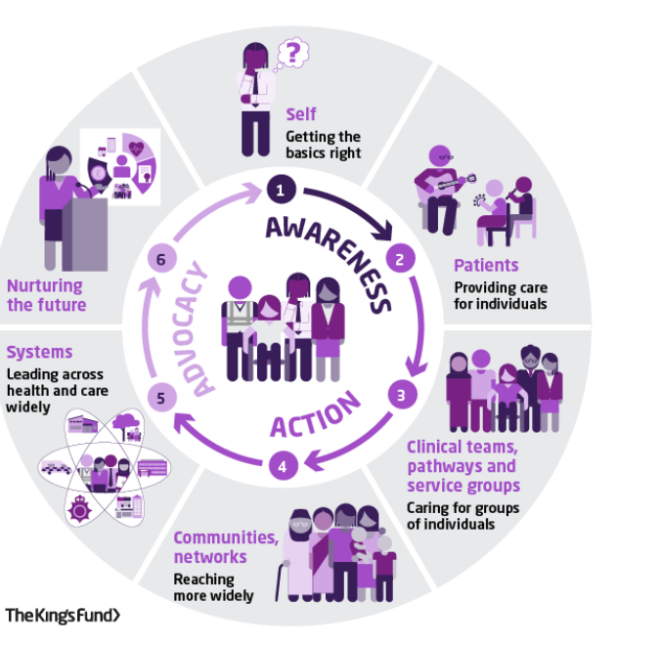

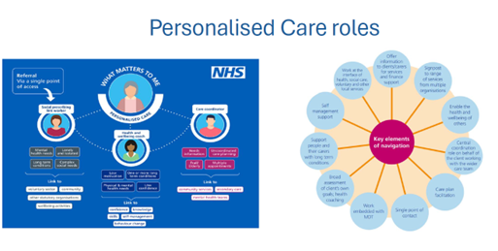

A tiered workforce model, matched to the needs of our patient population
Integrated Roles
Co-ordinator Roles
T Level students & Apprenticeship roles
Voluntary, community or social enterprise roles
& VtC
Co-Production & Partnership Roles
Clinical, professional, education and enabling roles

Slide 68
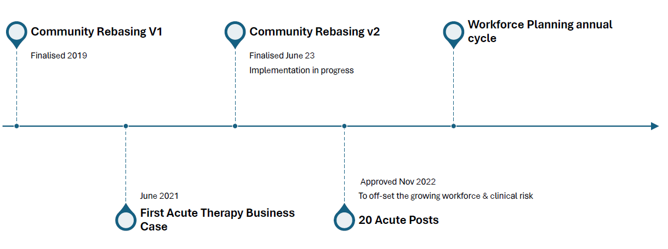

From theory to practice ………

Slide 69
Lunch – resume 1:54

Slide 70
CSP SEC Health Inequalities – Pulmonary Rehabilitation Team Experience
Pramod Selkar & Kate Savage
Head of Service & Senior Clinical Lead Physiotherapist
2nd May 2024

Slide 71
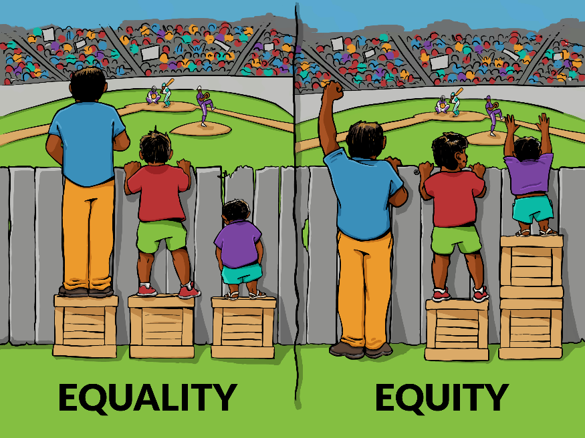
Health Equity
Equality: everyone is treated the same way regardless of need or any other individual difference
Equity: everyone is provided with what they need to be able to attain their highest level of health

Slide 72
Information and Analysis
Understanding of local population
Barriers to access healthcare/ service
Understanding service users issues

Slide 73
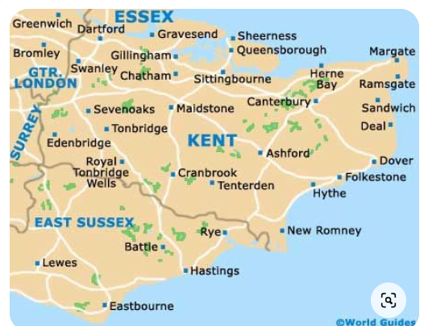

Slide 74
Systems & Data collections
Power BI
Collect Data through EPR
Patient feedback / surveys
Soft intelligence from staff

Slide 75
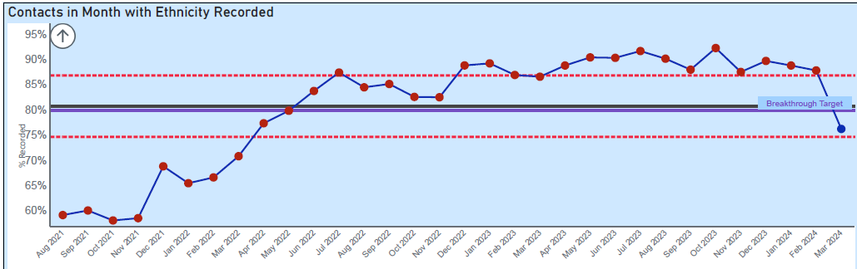
Ethnicity Recording
Service started ethnicity recording

Slide 76
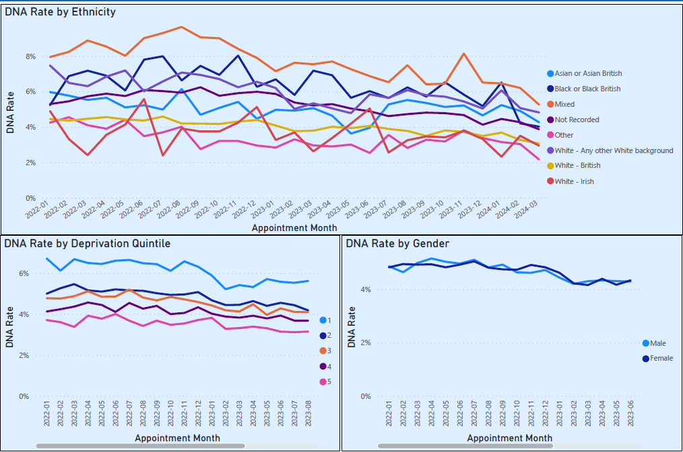
DNA Rate

Slide 77
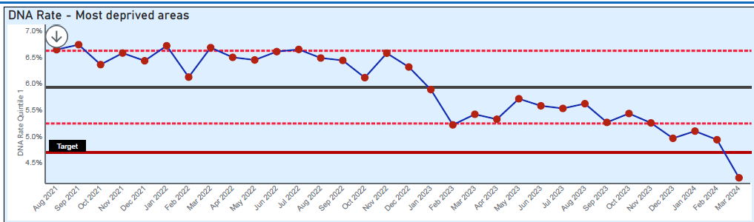
DNA by Deprivation
SMS reminder service started

Slide 78
Barriers
Limited English language
Poor literacy
Poor understanding of pro-active healthcare
Patients accessing face to face service logistically
Patients forgetting appointments
Poor awareness of service and importance

Slide 79
Practical Applications – Our Experience
Cultural solutions to overcome barriers – i.e. language/religious
Accessibility
Simplification of information and knowledge
Action on patient feedback

Slide 80
Cultural / Language Solutions
Interpreting Service
Limited English Language
Spoken leaflets in different languages
Poor literacy
Translatable leaflets
Poor understanding of pro-active healthcare
Pulmonary Rehabilitation Service | Kent Community Health NHS Foundation Trust (kentcht.nhs.uk)

Slide 81
Service Accessibility Solutions
Venue in each old CCG
Travel difficulty
SMS reminder service
DNA Rate
Service Intro leaflet with video
Poor awareness of service and importance

Slide 82
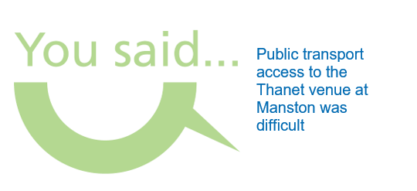
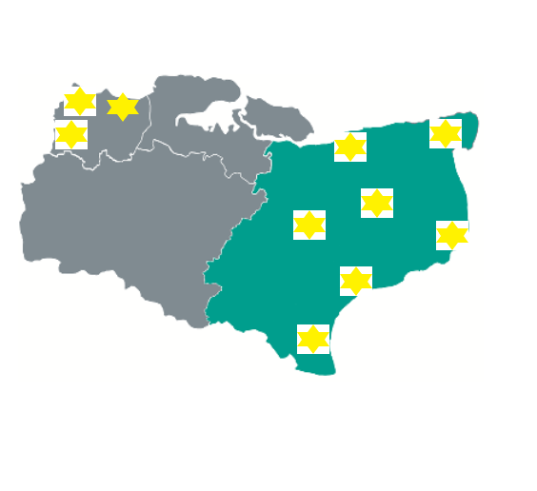
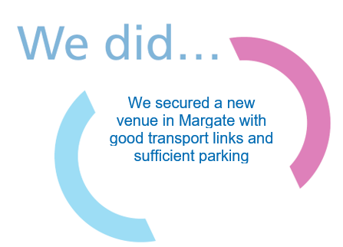
Clinic Locations

Slide 83


Socio-economic challenges
Pathway choice –
  Can’t afford transport
  Digital poverty
Supporting letters to employers
Benefit concerns
Pulmonary Rehab
Face to Face
Digital remote
Paper remote

Slide 84
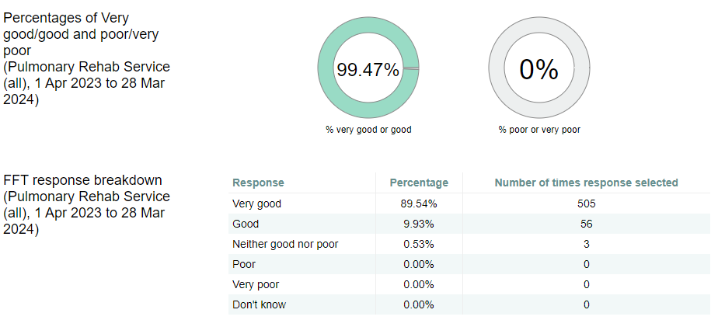

Slide 85
There were so many good points. Mainly, the staff that run the course are excellent. So helpful and patient.
I always felt safe, because the staff kept a close eye on us at all times. The course was stretching and I could feel gradual improvement in what I could do.
The quality of the staff and their care made the course. They were so attentive to personal needs and concerns, the lectures were very informative, increasing awareness
Everything has been good fun and the staff were amazing
The course was extremely well run with helpful staff that appreciated the difficulties that the participants go through with a debilitating condition

Slide 86
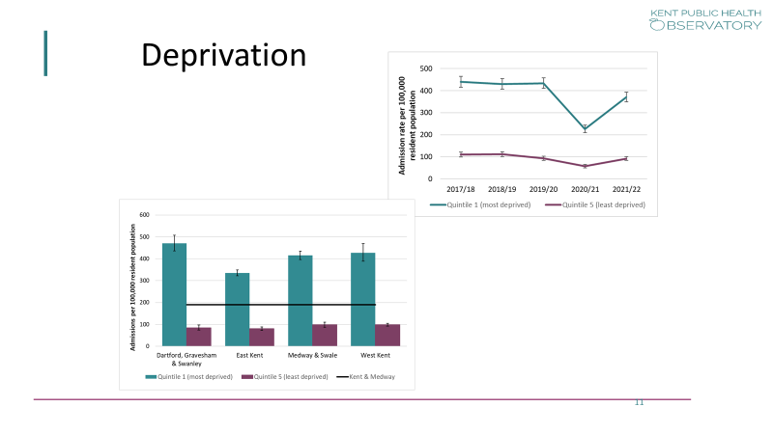
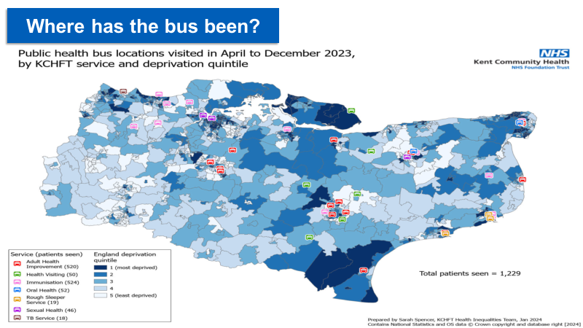
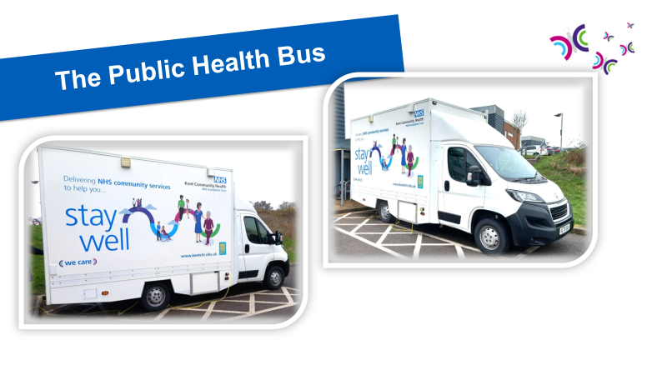
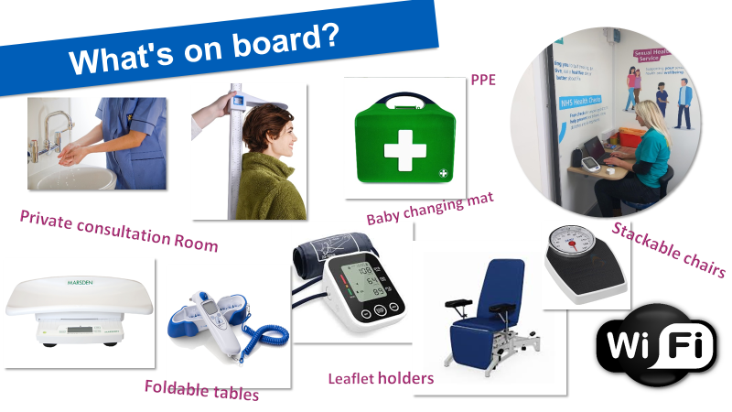

Slide 88

Health inequalities
A contextual understanding
Wendy Vaughan St George’s University of London

Slide 89

Group Activity
You are tasked with rescuing Romana
Half the room will represent Green Borough, the other half will represent Blue Borough
Each borough will be divided into 2 sub groups and assigned a number.

Slide 90

Instructions
Assigned to each group is a bag containing instruction, clues and additional tools needed to complete the.
Not every group has the same amount of resources!
Each group has been assigned a budget which you can use to ‘buy’ what you are missing.
These can not be purchased for less than £7 each.
You can work WITHIN boroughs but NOT across boroughs.

Slide 91
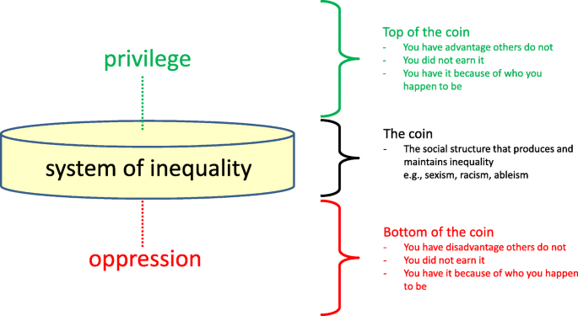
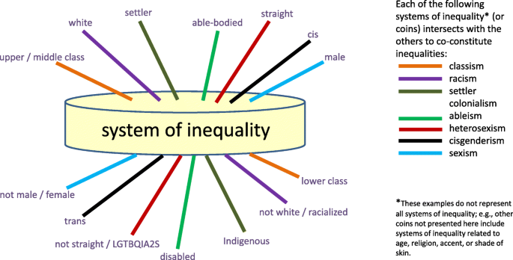
The coin model

Slide 92
What does Health inequality mean to you?- Student’s perspectives
“Its to do with money…if you can pay you don’t have to wait. I don’t think it’s race or religion has anything to do with it because I have not experienced it”
“It is not as bad now as it was in the past”
“I cannot relate as it doesn’t affect me on a personal level…my experience in society isn’t as bad compared to others”
“Access to services, facilities are good but there is not enough staff”

Slide 93
Clinician’s perspectives
“By the time they are seen by our service they are all at the same point and are equal…there is no inequality present”
“Well you could say that it doesn’t really exist if 2 people have the same opportunities but through choice 1 ends up homeless…where is the health inequality?”
“When patient’s are being discharged from hospital they all are provided with what they need…again technically none of them would be seen as experiencing health inequality”
“My clinical educator said the area we work in is middle class so I will not see any health inequality, and has asked me to write a reflection so I can be marked on that section of the CPAF”
“Me being a straight white woman middle class female, possessing so many characteristics on the top of the coin maybe I don’t see it as much a I could…I’m not sure if I’m aware enough?”

Slide 94
Statistics
Tower Hamlets
Life expectancy: Male 60.5 years Females 65.3 years
In 2014 these were reported as 55.4 years and 56.5 years respectively
Poverty rate 44%
Wandsworth
Life expectancy: Males at 65 -19.1 years; Females at 65- 21.8 years
Poverty rate 21%

Slide 95

Closing thoughts

Slide 96
Michelle Long
Stroke rehabilitation quality improvement manager (SQuiRE) South East NHSE

Slide 97


Health Equality and SQuIRe in the South East
Michelle Long (Michelle.long6@nhs.net)
Notes:
Michelle Long
Specialist Neuro PT working on a post acute level 2a neuro rehab unit and the South East SQuIRe

Slide 98


What is SQuIRe?
Stroke
Quality
Improvement
for
Rehabilitation
Notes:
What is SQuIRe
it is a quality improvement programme from NHSE Stroke Programme designed to improve delivery of stroke rehab
SQuIRe is an acronym
Stroke Quality Improvement for Rehabilitation

Slide 99

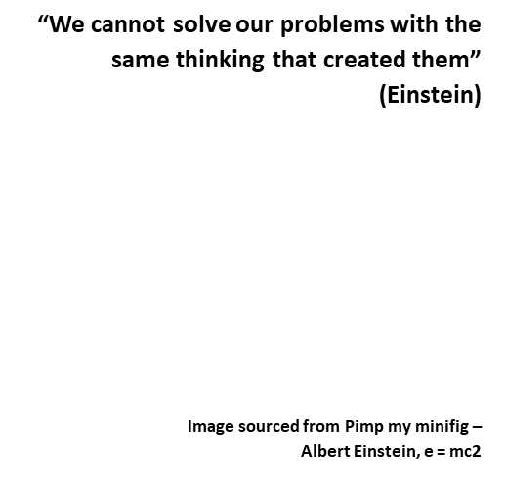


ICSSM, Core principles
Needs led stroke rehabilitation, moving away from time limited provision
7 day services
Intensity of rehab in line with needs and regardless of disability
MDT provision which includes all core professions, Psych, VR
Seamless integrated ESD/CNRT services with no handoffs or
referrals to “self”
Stroke Quality Improvement in Rehab
Notes:
At the heart of SQuIRe is the integrated Community Stroke Service which came into policy in Feb 2022 and describes community rehabilitation which is needs led, 7 day, intense, and delivered by a stroke specialist MDT along a seamless pathway.

Slide 100
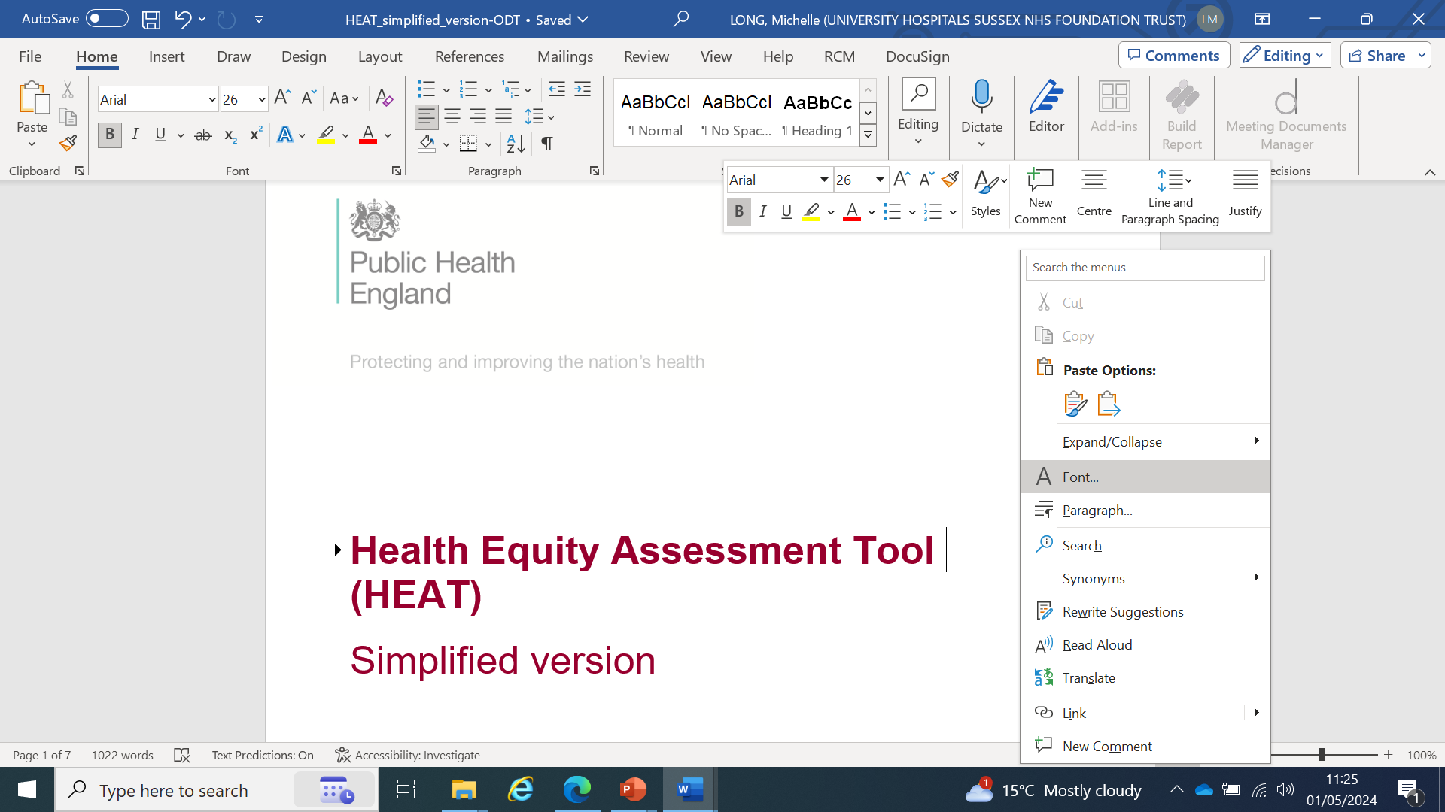
Equity Assessment
Notes:
As central tenet to the delivery of all SQuIRe projects is equity. Each project when writing their Project initiation document are also required to submit a Health Equity Assessment.
All of our projects are addressing some aspect of access and equity but using this tool to check that by delivering the project we are not disadvantaging others is important.

Slide 101
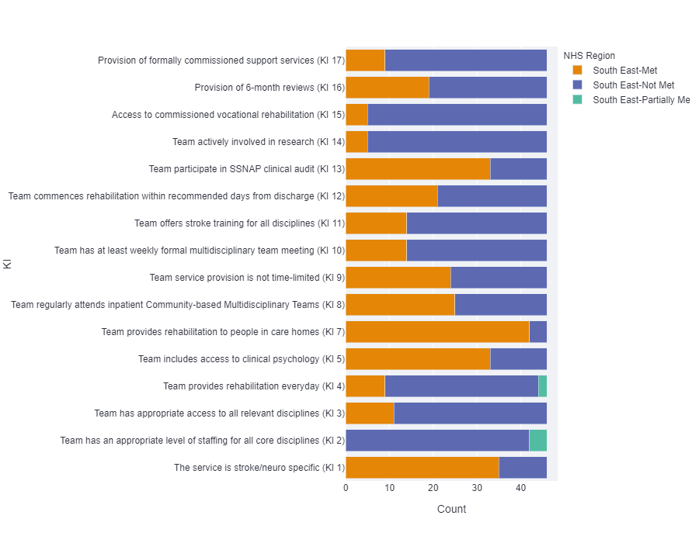
Equity?
Using data to tell us about provision
KI 1 - Access to stroke specialist service
KI 2 - Approp core staffing
KI 3 - All disciplines
KI 4- Rehab every day
KI 5 - Clinical Psych access
KI 6 - Nurses trained in stroke (inpatients)
KI 7 - Rehab in care homes
KI 8 - Attend MDT
KI 9 - Service not time limited
KI 10 - Weekly MDT with core
KI 11- Stroke training all disciplines
KI 12 - Commences rehab within recommended days
KI 13 0- SSNAP
KI 14 - Involved in research
KI 15 - Voc rehab
KI 16 - 6 month reviews
KI 17 - Support services
Notes:
At the start of the programme we looked at regional data to understand provision.
The Post acute organisational audit in late 2021 gave us some insights into equity of provision. This is the regional summary against the key indicators, orange being met and purple being not met and green partially met.

Slide 102
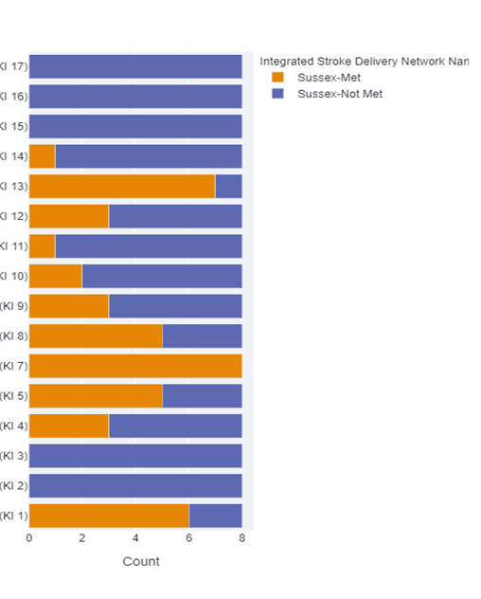
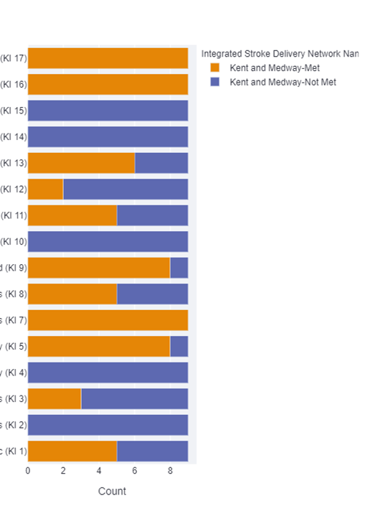
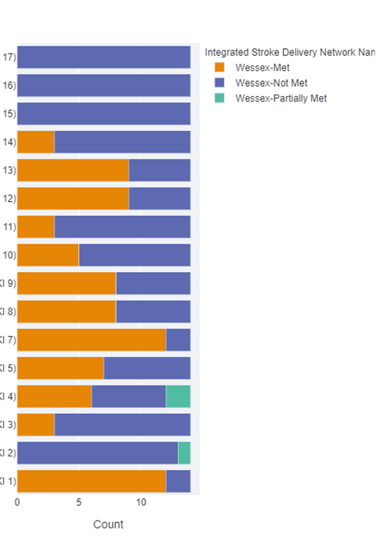
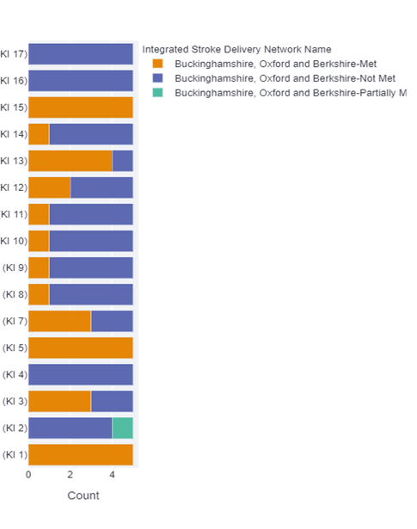
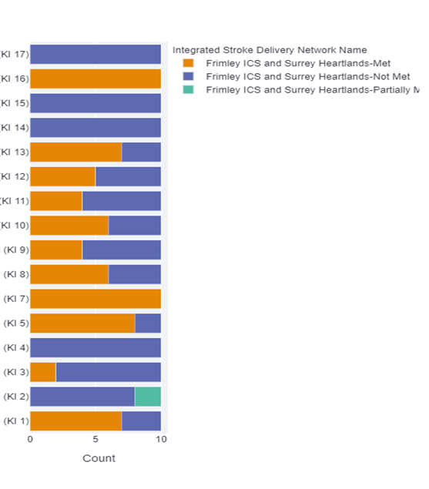
Community
Notes:
This slide breaks down the regional data to each Integrated Stroke Delivery Network. There are 5 in the SE, Sussex, Kent and Medway, BOB, Hampshire Isle of Wight and Surrey Heartlands and Frimley.
You can see that we have common themes that need to be addressed and also inequities, for example, KI 1 at the bottom stroke specific services shows an inequity of provision.
We used this, along with population and SSNAP clinical data to inform our priorities.

Slide 103
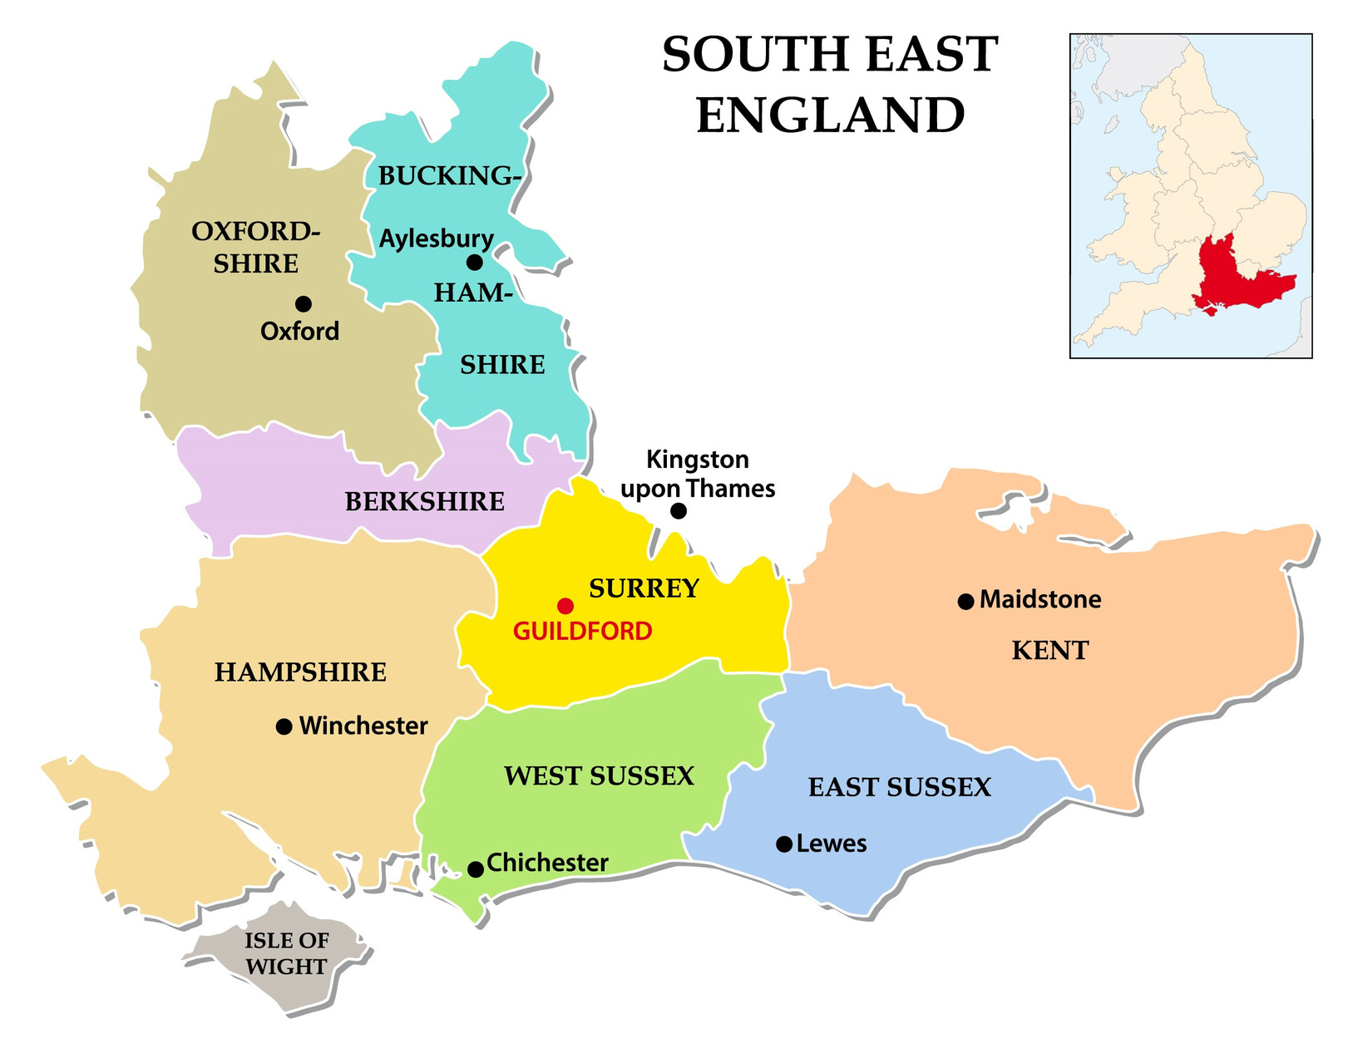

Notes:
We have 16 projects running in the SE all with the core aim to improve provision of community stroke rehab. There are over 70 projects in England
I have picked out 6 today to highlight and will talk a bit about prevention

Slide 104

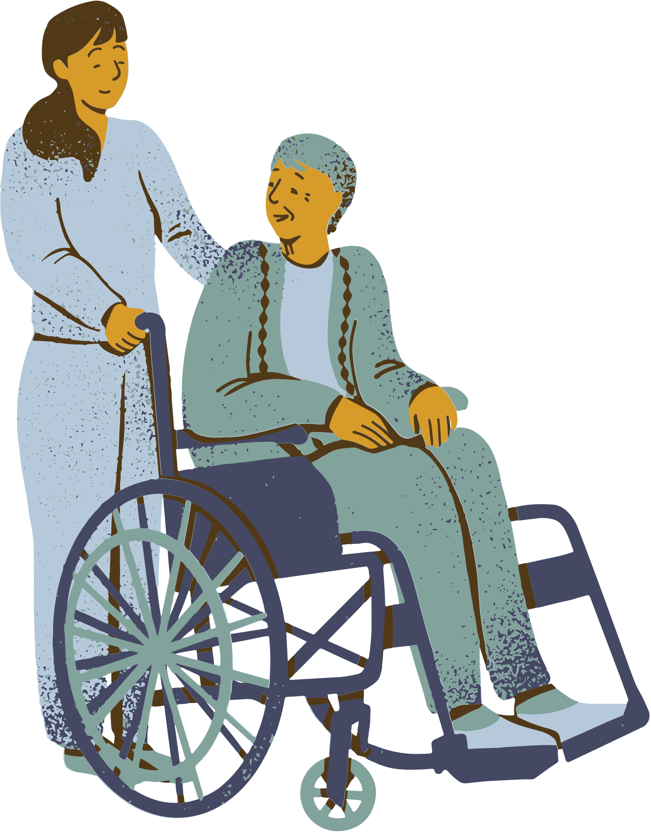





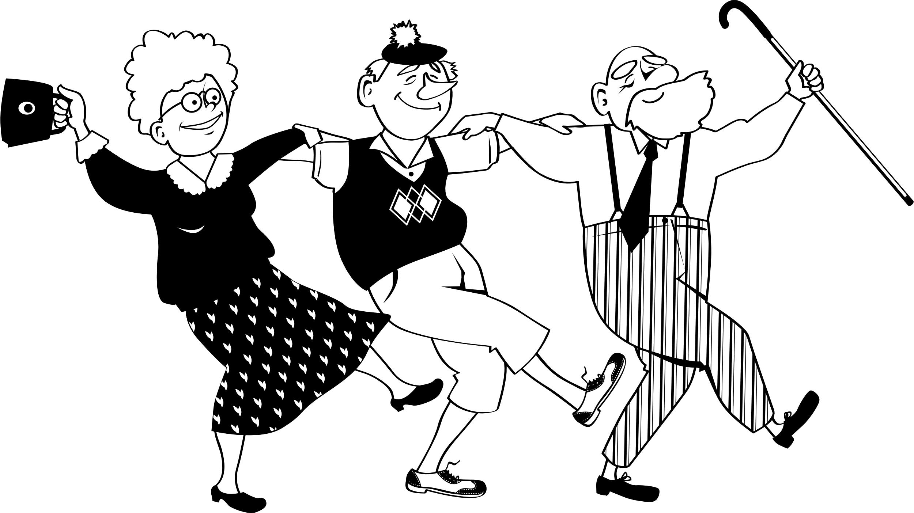
BOB, levelling up, provide the SRS in Oxfordshire
Sussex.
Responsive Rehab. Defining complex need and measuring the needs of pathway 3 patients. Test use of virtual case conference/ MDT to aid management
Kent and Medway,
to provide level 2 vocational rehabilitation embedded in an existing CST in Medway Swale
SOUTH EAST
SQUIRE PROJECTS ADDRESSING INEQUITY
Surrey Heartlands and Frimley.
Integrate SLT into the NW Surrey CST and to introduce aphasia peer support and education
BOB,
To test bridging support workers in Bucks in order to provide responsive specialist rehab to patients after ESD
Sussex,
Improve access to intensive rehab in rural areas by trialling community drop in groups
Notes:
In BOB we had inequitable access to life after stroke services due to historic commissioning. Oxfordshire had none. We provided funding for a levelling up project where we funded 12 months of the Stroke Association Stroke recovery service in Oxford. This project is in the write up phase measuring impact in the hope that we can secure sustained funding.
Kent and Medway; specifically in Medway and Swale have a higher than the national average incidence of working age stroke. It also has pockets of significant deprivation with higher than average rates of unemployment. We are funding a level 2 vocational rehab project in order to widen access to back to work schemes for working age strokes in this area.
In BOB after early supported discharge ends, there is no stroke specific rehab for patients that cannot attend an outpatient clinic. We are testing the impact of bridging support workers that bridge between ESD and the neuro outpatients service and deliver needs based stroke specialist rehab to patients at home that otherwise would have been seen by generic teams.
Sussex we gave a small amount of money to test delivery of a stroke specific UL rehab group in rural settings. This is to widen access to rehab in rural communities and to improve efficiency of service delivery.
Surrey described significant inequities of provision for their patients with aphasia. In their North West team patients were waiting 1 year for SLT as opposed to patients in the bordering system getting responsive SLT with no waits. This project has uplifted the SLT service and is working with service users to co-design and deliver peer support groups in order to increase practice opportunities.
Sussex are exploring the needs of complex pathway 3 patients, those that are discharged to NH and have patchy follow up. They have defined what we mean by complex and are collecting data on needs in the system in order to inform commissioning and transformation.
All of these projects have embedded co-design into their processes embedding PPV at steering groups

Slide 105
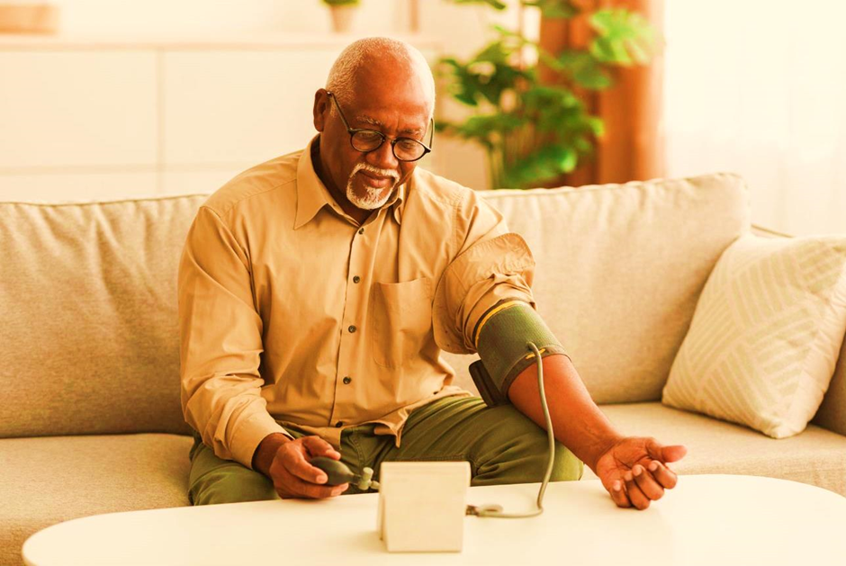

Notes:
Finally I will talk a little about a small project that we have been doing to look into provision of secondary prevention across multiple regions which includes Sheffield, Bolton, Nottingham, Birmingham and Sussex.
We know that people from some BAME backgrounds have a higher incidence of stroke and that people from more deprived areas live longer in ill health. We know that the disease burden across England is increasing with two thirds of those over 65 predicted to have multiple comorbidities by 2037. CVDR is a leading cause.
Our project group is drawn from multiple regions and represents potential for diversity in design.
Patient and carer feedback from the national PREMs survey told us that

Slide 106





Why?
Increased risk of events after TIA and stroke
ESD CST and prevention patchy
Increasing disease burden
What PREMS have told us
Notes:
There were multiple reasons why we wanted to do this project:
Those patients that have suffered TIAs or stroke are at increased risk of further events; 26% within 5 years of first stroke and 39% by 10 years (Mohan et al 2011). When Claire presented her pitch she told a compelling patient story which described a person becoming increasingly disabled with repeat events over a matter of months. We all wanted to be part of preventing that from happening to others.
In the updated national stroke guidelines and NICE guidelines (2023), it is recommended that we take a comprehensive personalised approach to secondary prevention and that we utilize behaviour change approaches to aid lifestyle changes linked to risks such as diet, weight, BP and alcohol intake and that links with community based exercise facilities are promoted in order to support people with stroke and TIA to continue to live well.
Patients suffering mild stroke and TIA are not seen by any ESD services and have poor follow up in the community. This means that we fail to maximize opportunities to influence secondary prevention via lifestyle changes.
There is well documented increasing multi-morbidity and disease burden which increases with age. It is predicted that two thirds of those over the age of 65 will have multiple health conditions by 2037 unless we do something now to reverse the trend. It is essential that we maximize approaches that support patient self-efficacy and put prevention at the heart of everything that we do.

Slide 107

PREMS
Post-stroke
6600 respondents
  18-31% said NOT received advice on BP management and would have liked it
  22-30% said they had NO or partial understanding of medications following explanation
  17-23% said NOT received healthy lifestyle advice and would have liked it. 12-21% DID receive it and found it helpful. 48-67% said they had no need for this advice
?due to failure to make link lifestyle and stroke risk
Notes:
We can use the recently reported stroke PREMs project to understand current provision of some aspects of secondary prevention. It is worthy of note that, of the PREMs respondents in the project systems, between 30% and 37% reported that they had had 2 or more strokes. It is clear we could do more to aid prevention.
Patients in Birmingham and Solihull, South Yorks, Nottingham, Greater Manchester, Sussex and Kent told us that:
• between 22% and 30% of respondents reported that they had either partial or no understanding of their medications following explanation.
• between 9% and 16% had not had their medications explained to them.
• between 18% and 31% reported that they had not received advice on BP management and would have liked it.
• between 7% and 23% of patients reported that they had not received healthy lifestyle advice and would have liked it.
• Interestingly – between 48% and 67% of patients reported that they had no need for healthy lifestyle advice. It is unclear if this represents a group of people that had received lifestyle advice from other sources, whether there was a failure to link lifestyle and stroke risk or whether other factors were affecting the response. Using PPV co-design in this project, we will seek to understand this in more depth.

Slide 108

Challenges of delivery
  Meaningful PPV
  Accessing all 5 systems
  Time for project team to meet
  No money to create new resources

Slide 109

Next Steps
  In Sheffield, plan to link up Health and Well-Being Coaches with all nurses involved in stroke prevention so can start using this service that already exists. Let’s connect the dots!
  In Hampshire, ‘Help Hampshire’ stroke exercise group programme extending their research to across the South East.
  Sussex ISDN updating their website for stroke prevention info/local services and trialling health instructors in the stroke rehab pathway

Slide 110

Recommendations
  Literature review of research linked to behaviour change models for successful secondary prevention
  Map what is being done
  ? quick wins (BP, workforce/ who does it, staff education)
  A PPV, possibly with national focus, is used to design any resources and delivery
  HWB coaches - emerging practice. Is there a brain and heart health approach we could take?
  COP for brain and heart health prevention leads and mapping of services. ?CVD prevent

Slide 111
Health Inequalities discussion 3
CSP Head of Practice Improvement Helen Sharma & CSP Professional Advisor Clare Aldridge

Slide 112
15% Solutions
Discover and focus on what each person has the freedom and resources to do now to contribute towards tackling health inequalities.
Notes:
A reminder of ARMAs call to action: Avoid inertia due to being overwhelmed by the scale of the problem and don't wait for the perfect data to get started; start now in the spirit of service improvement.
We all have different circles of influence within our roles and our gifts.
For this last activity we will be asking where do you have discretion and freedom to act? What can you do without more resources or authority so how can you have an impact on tackling health inequalities from today?
These may be bite-sized, quick win or idea that you can take into action aimed to get the ball rolling.
Sequence of Steps and Time Allocation
First in pairs, generates a list of 15% Solutions. 5 min.
Individuals share their ideas with a small group (4 members). 2 min. per pair.
Group members provide a consultation to one another (asking clarifying questions and offering advice). 2 min. per person and one person at a time.
Share your top 3 ideas on post-its.

Slide 113
15% Solutions
First in pairs, generates a list of 15% Solutions. 5 min.
Individuals share their ideas with a small group (4 members). 2 min. per pair.
Group members provide a consultation to one another (asking clarifying questions and offering advice). 2 min. per person and one person at a time.
Please note down and share your top 3 ideas
Notes:
A reminder of ARMAs call to action:
Avoid inertia due to being overwhelmed by the scale of the problem and don't wait for the perfect data to get started; start now in the spirit of service improvement.
We all have different circles of influence within our roles and our gifts.
For this last activity we will be asking where do you have discretion and freedom to act? What can you do without more resources or authority so how can you have an impact on tackling health inequalities from today?
These may be bite-sized, quick win or idea that you can take into action aimed to get the ball rolling.
Sequence of Steps and Time Allocation
First in pairs, generates a list of 15% Solutions. 5 min.
Pairs share their ideas with a small group (4 members). 2 min. per pair.
Group members provide a consultation to one another (asking clarifying questions and offering advice). 2 min. per person and one person at a time.
Share your top 3 ideas on post-its.

Slide 114
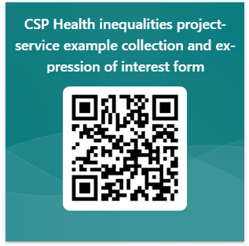
Please share your health inequalities project and work with the CSP
https://forms.office.com/e/DXwYyUBuF
Notes:
The CSP Health Inequalities project team would be grateful to find out what work teams are undertaking to tackle health inequalities to both increase the evidence base and find illustrative examples that can be shared to inspire other members to undertake work to address health inequalities. The QR and link above will take you to a quick form to share some key information about the work/ project with the team

Slide 115
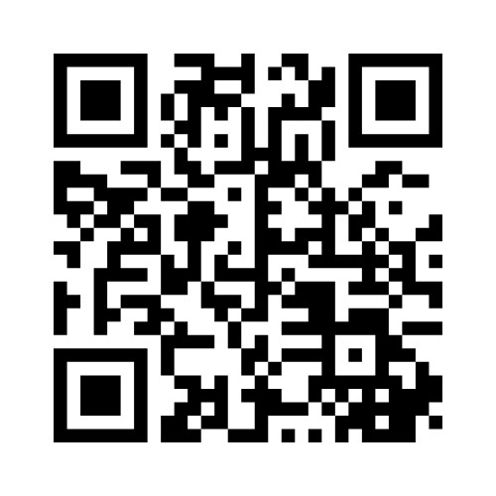
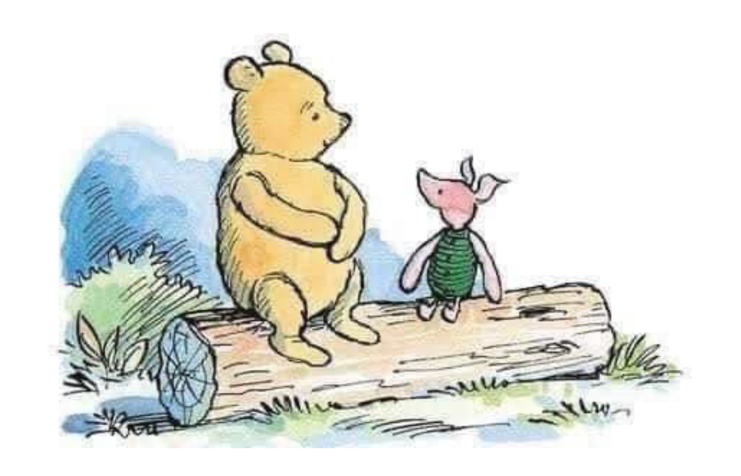
Before you go….
Please tell us your reflections and actions using this QR code or visit menti.com and enter code: 7487 0046
Notes:
"Today was a Difficult Day," said Pooh.
There was a pause.
"Do you want to talk about it?" asked Piglet.
"No," said Pooh after a bit. "No, I don't think I do."
"That's okay," said Piglet, and he came and sat beside his friend.
"What are you doing?" asked Pooh.
"Nothing, really," said Piglet. "Only, I know what Difficult Days are like. I quite often don't feel like talking about it on my Difficult Days either.
"But goodness," continued Piglet, "Difficult Days are so much easier when you know you've got someone there for you. And I'll always be here for you, Pooh."
And as Pooh sat there, working through in his head his Difficult Day, while the solid, reliable Piglet sat next to him quietly, swinging his little legs...he thought that his best friend had never been more right."
A.A. Milne

Slide 116
Dates for your diary
Upcoming series of events focused on international recruitment:
Wednesday 10 July 12:30 (online event 1)
Wednesday 11th September 12:30 (online event 2)
Thursday 7th November (all day in-person event at London Holiday Inn Gatwick – venue to be confirmed subject to availability)

