Slide 1
Community Appointment Days: An Innovative Way of Delivering MSK Healthcare
The Community Appointment Day Collaborative 2024
Jennifer Atkinson, Hayley Jennings, Kirstie Smith
Notes:
Thank you for welcoming us all to present today.
Delighted to give you a panel of local innovators, healthcare leaders, who will share their experiences of Community Appointment Day’s across the West Midlands. Introducing Hayley ROH and Kirstie Solihull. While we stand here today, we must credit all of our teams, clinical and non-clinical, our Community Partners and our Communities for making the events we have held come to fruition. To date we have held 2 large and 2 spin off CAD’s between us and it’s our pleasure to share some our experiences with you on a subject matter that we are all deeply passionate about.

Slide 2
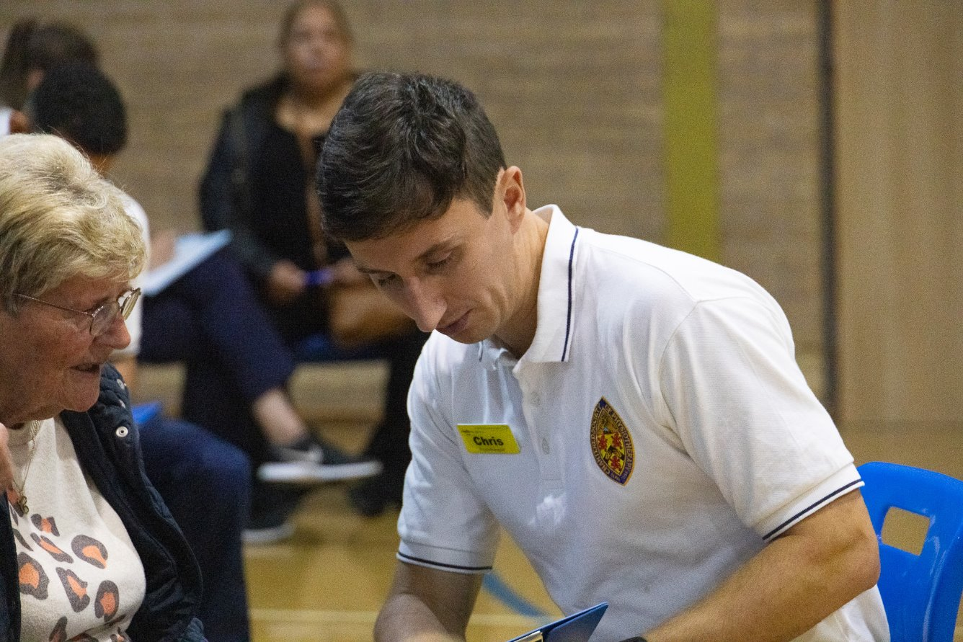
CAD Innovation - Session Aims:
What are CADs & why now?
Provide detail on key chosen areas of planning
Share outcomes
Look to the future
Notes:
So that there is some structure these are the key areas that we hope to cover – but I make no apology that we are a trio prone to bouncing off each other and so the order may vary!

Slide 3
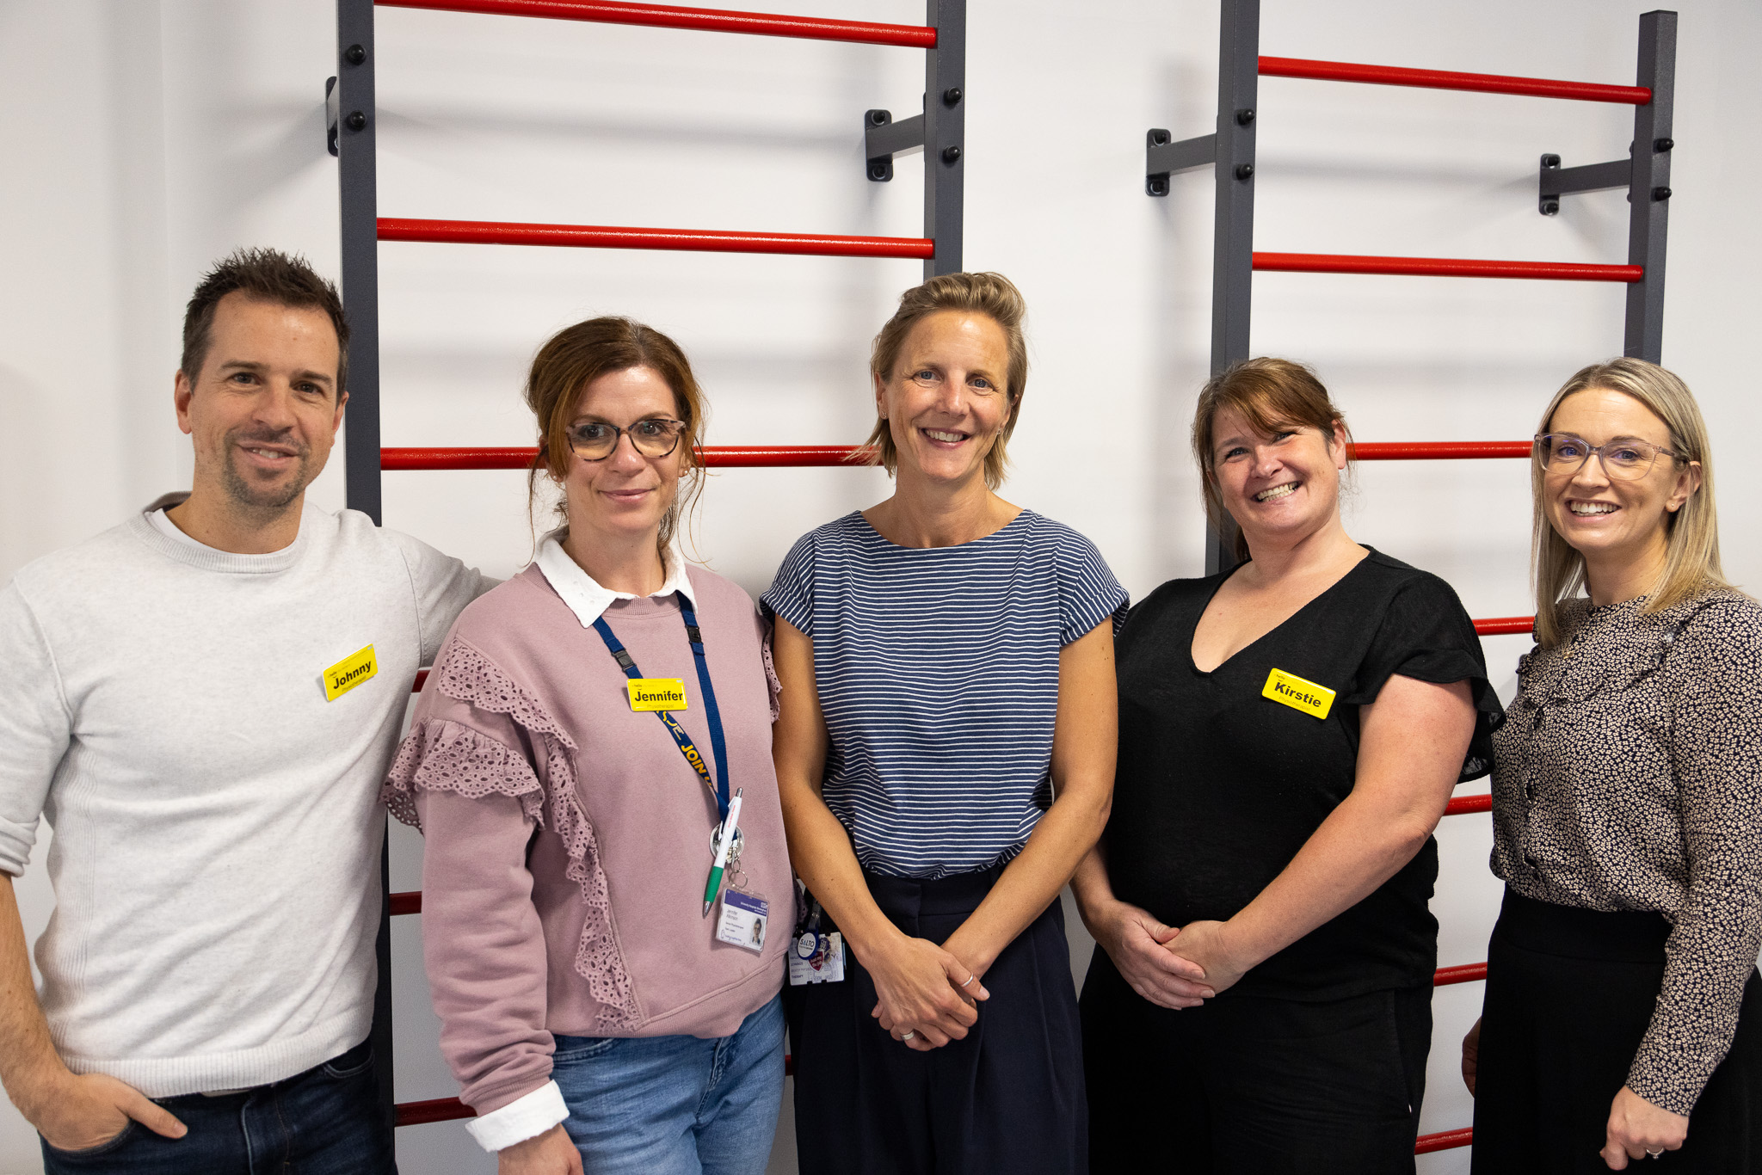

Slide 4
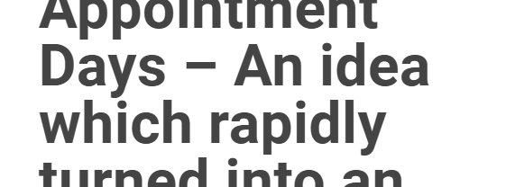
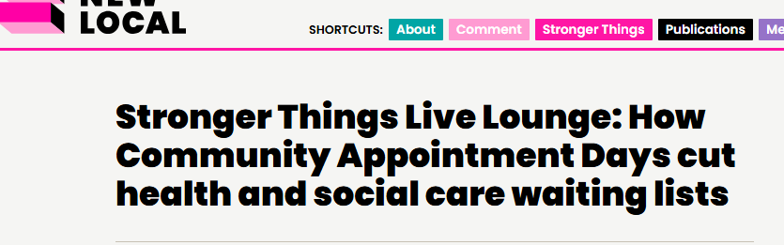
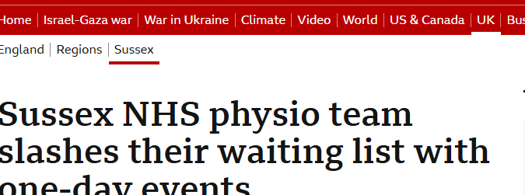
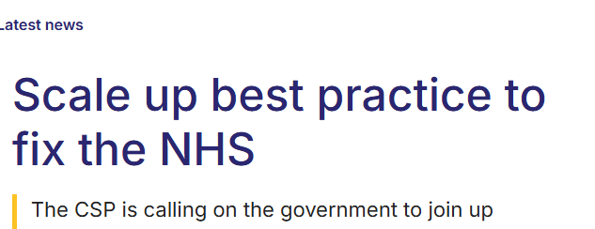
The Headlines
Notes:
Community Appointment Days grabbed the headlines in the Spring of 2023; Sussex community MSK took an idea that began as a few chairs and under the lead of Laura Finnucaine delivered the first Community Appointment Day. It was the impact on the waiting list that grabbed the headlines but if you listen or read any of the literature / webinars from the team, it wasn’t a ‘wait list initiative’, although the effect on the wait list was a happy outcome.
CADs involves inviting patients on the waiting list to a central location in the community, often a leisure centre for an opportunity to have conversations
with a variety of clinical and community support services.
In fact, the primary goal of the CAD initiative is to deliver a different model of care which aims to support attendees in self-managing their conditions and identify necessary next steps for further treatment.

Slide 5
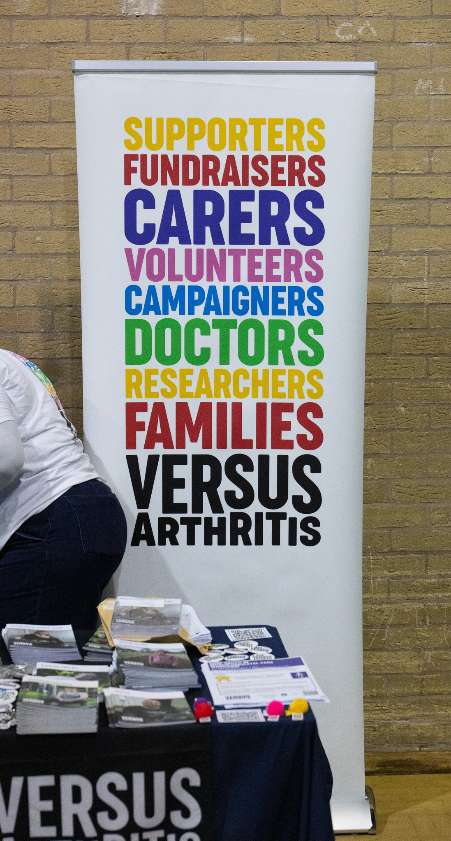
“We’re not going to get out of this situation with increased efficiency… The Community Appointment Days were a real shake up of the system.”
“It’s about really changing those models of care, enabling people to step out of the passivity of being a patient and into something which is much more befitting with who you are and all of your other elements of your life.
Stronger Things Live Lounge: How Community Appointment Days cut health and social care waiting lists - New Local
Notes:
& why does that matter?
I share with you here two quotes that really resonate with me from the Sussex CAD Webinar.
Because MSK wait times have not recovered to pre Covid levels and Covid ended, a while a go!
Patients come with greater layers of complexity, and what we mean is patients have multifaceted issues, and those issues can intersect and where longer waits exacerbate chronicity and complexity ………..and we know this is exacerbated in areas of Birmingham * ),
People are living longer with multiple health conditions. By 2035, it is projected that the number of individuals aged 65 and older with four or more chronic conditions will double, with roughly one-third of these individuals also suffering from mental health issues (Prevention is Better Than Cure, 2018).
We won’t simply get out of this with greater efficiency.
The primary goal of the CAD initiative is to deliver a different model of care which aims to support attendees in self-managing their conditions and identify necessary next steps for further treatment.
And what was found was = A much higher proportion of people who attended the CAD than usual care had the skills and confidence to take a PIFU from the event. Of course this has impact on service needs and hence the headlines.
I have a personal view on how this may impact teams wellbeing. Do we consider the impact consciously or subconsciously of never feeling we can do enough, because the wait for care is so long – would we feel different if we could get a handle back on it?

Slide 6

Why a CAD?
Psycho
Psycho
Bio
Social
Social
Notes:
Support people beyond their MSK condition with a focus on health promotion & access to local community services
Impact on reducing waiting lists
Opportunity to deliver a different model of care
Patients get bounced around the system
www.youtube.com/watch?v=424bk7nsewo
Covid – AHPs transferability, flexibility, innovation
Sussex went first – we.ve read up, tuned in to webinars by the group
Involvement with Solihull – 1st local CAD,
Planned how we’d like to continue to work together
We,e had funding advise from C Miller Director of AHPs

Slide 7
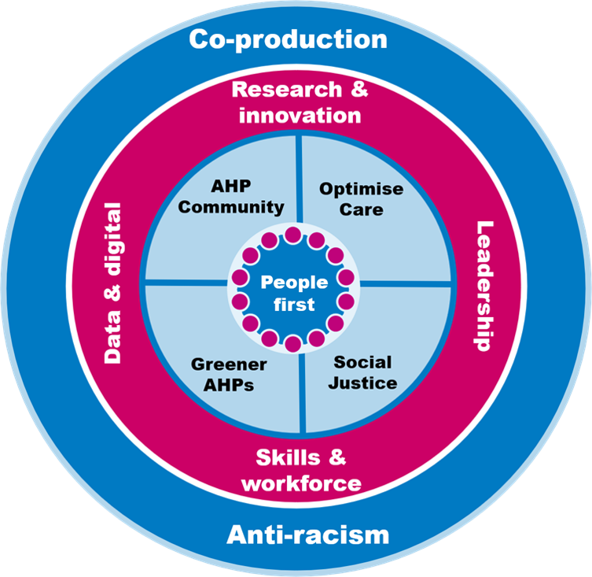


Strategy Alignment
Notes:
The Community Appointment Day initiative aims to enhance patient care delivery in MSK services, utilising community resources while ensuring equitable and accessible healthcare in line with The AHP Strategy 2023, (NHS England 2023) and the Birmingham Solihull Strategy for Health and Care (NHS Birmingham and Solihull 2023). WE will come back to this alignment.
CAD’s fit the the NHS Long Term Plan system priorities which call for personalisationa dn a fundamental shigt in the way tha the NHS works alongside individuals moving towards a broader cultural change, ‘a shared responsibility for health’. Moving from ‘one size fits all’, to tailored support. Seeing staff connect with communities for healthier choices.
What we would like to share with you next is some of our shared experiences of delivering 2 CADs+ across the region
BSOL – service +
ROH Collab QE
And the beauty of this happening in our area is we have collaborated from the outset, what we may end up with is regional learning and that is really exciting!

Slide 8
Plan Strategy Alignment
1. Coproduction, People First & Optimising Care
Engagement across secondary and primary care, linking with community partners.
Emphasis on community-powered solutions.
2. Environmental Sustainability
Implementation of Dr Doctor (patient engagement platform) to minimize paper use.
Promotion of digital resources and enhancing digital inclusion.
3. Social Justice
Conducting waiting list analysis (time waited and postcode) to ensure equitable invites and location.
Addressing the digital divide with a phased booking window.
Ensuring accessibility through location choice and support options (landing page, interpreters, quieter sessions).
Notes:
Explain how our planning was aligned to meet the key areas of focus outlined by the AHP Strategy: AHPs Deliver 2023

Slide 9
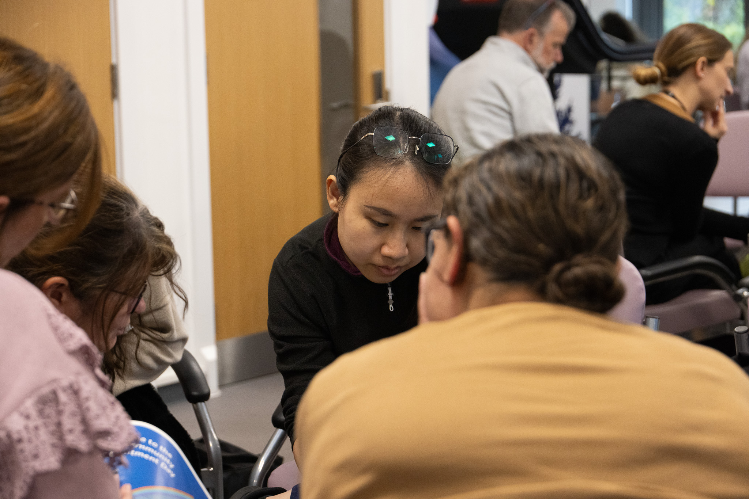
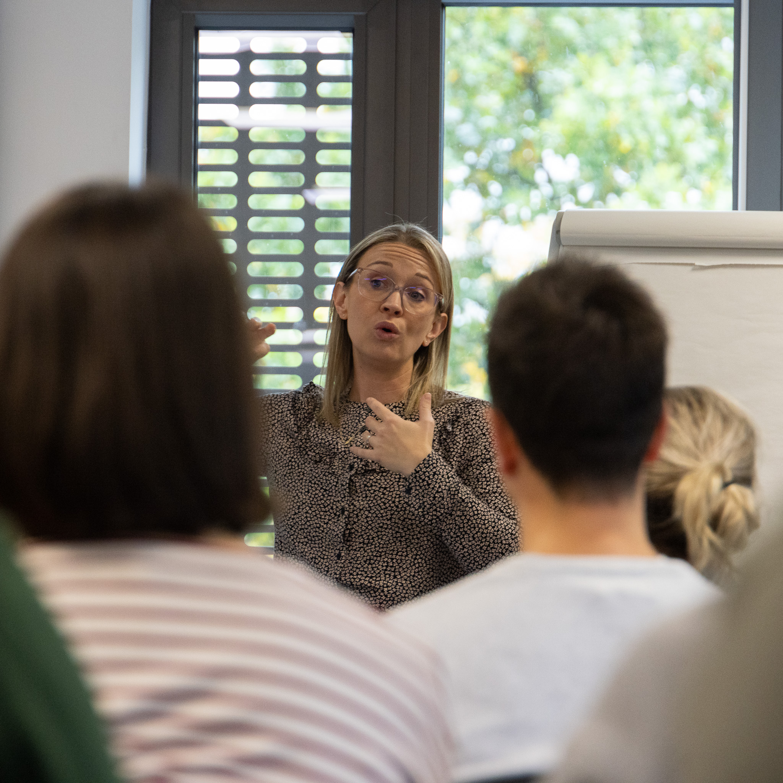
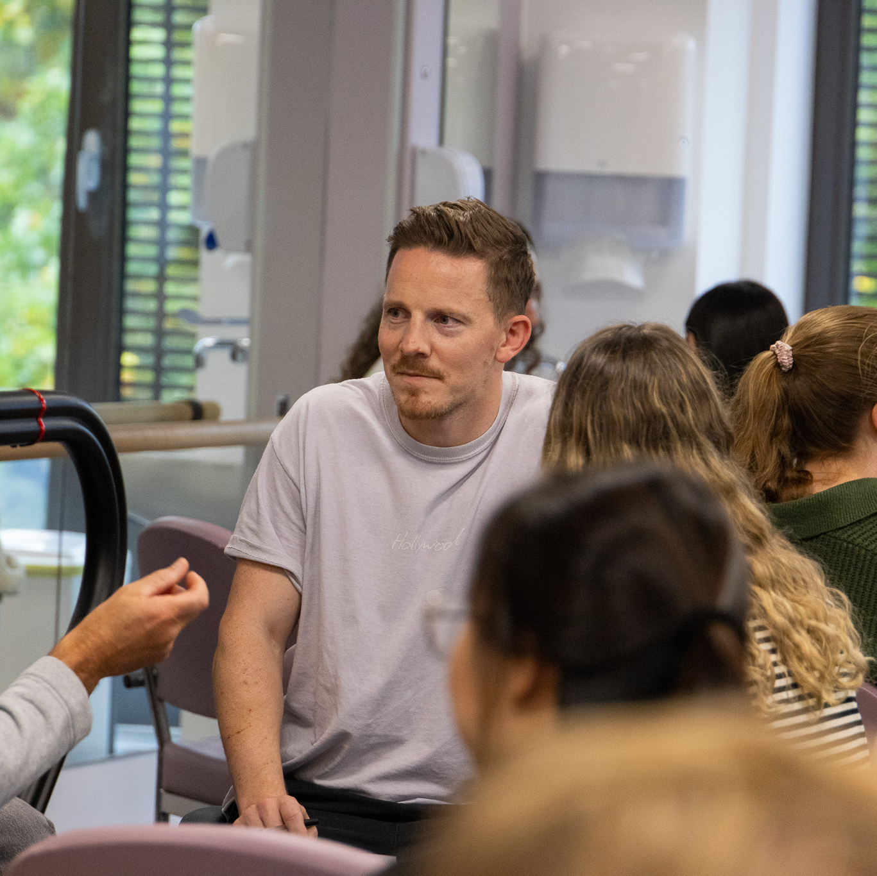
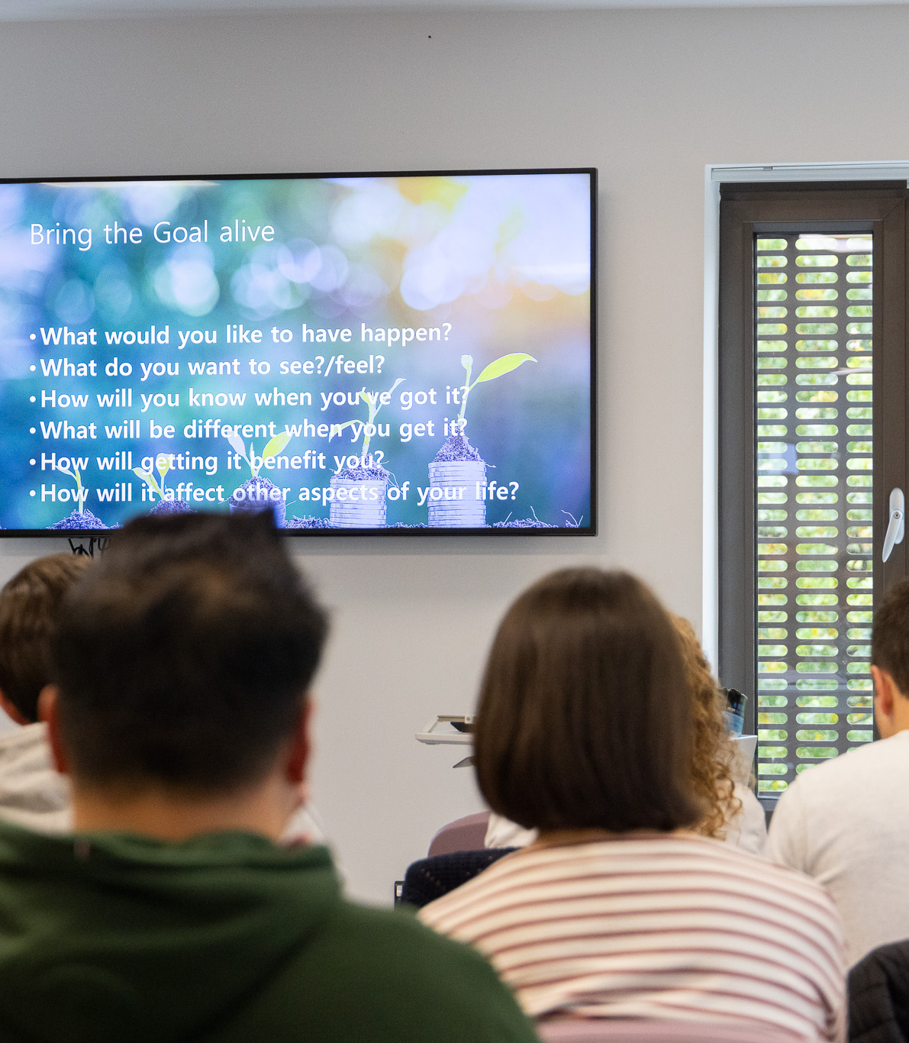

Staff Training

Slide 10
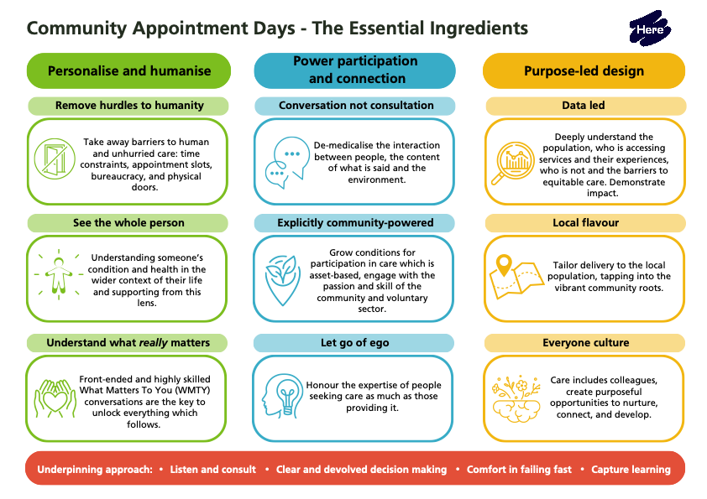
Notes:
Remove hurdles to humanity: Personalised & humanized, unhurried care…changing from conveyor belt care to humanized care (no time constraints).
See the whole person: Remove barriers such as computers/notes & enable clinicians to see the whole person.
Understand what really matters: Understand what matters to you – what is going on for that individual in the wider context. This forms the front end of the conversation & is the first real discussion to find out what an individual really needs. Based on strength-based conversation (health coaching, motivating, health behaviour change…which are all things we will work on throughout the day)
Conversation not consultation: really demedicalise the conversation, so not going in with tell me about your back pain much more focused on what’s going on for you, what have you tried?
Explicitly community-powered – thinking about community & voluntary sector orgs who can support the event
Let go of ego – recognize that the individual is an expert in what’s going on with them, build a therapeutic relationship
Data led – need to be better at this
Local floavour understanding the local picture. Nationally the data shows there are conditions that are clustered together, so often arthritis is clustered with obesity & diabetes. So in future we need to look at what support services would be valuable to certain diseases/conditions
Everyone Culture – staff feeling burnt out, long waiting times “how are we going to get these down”, feeling isolated in rooms/curtains…the CAD is a real opportunity to work together & connect with other staff
Really trying to do something different – work in a different way. We’re not just lifting what we do in daily practice & placing it in a sportshall.

Slide 11
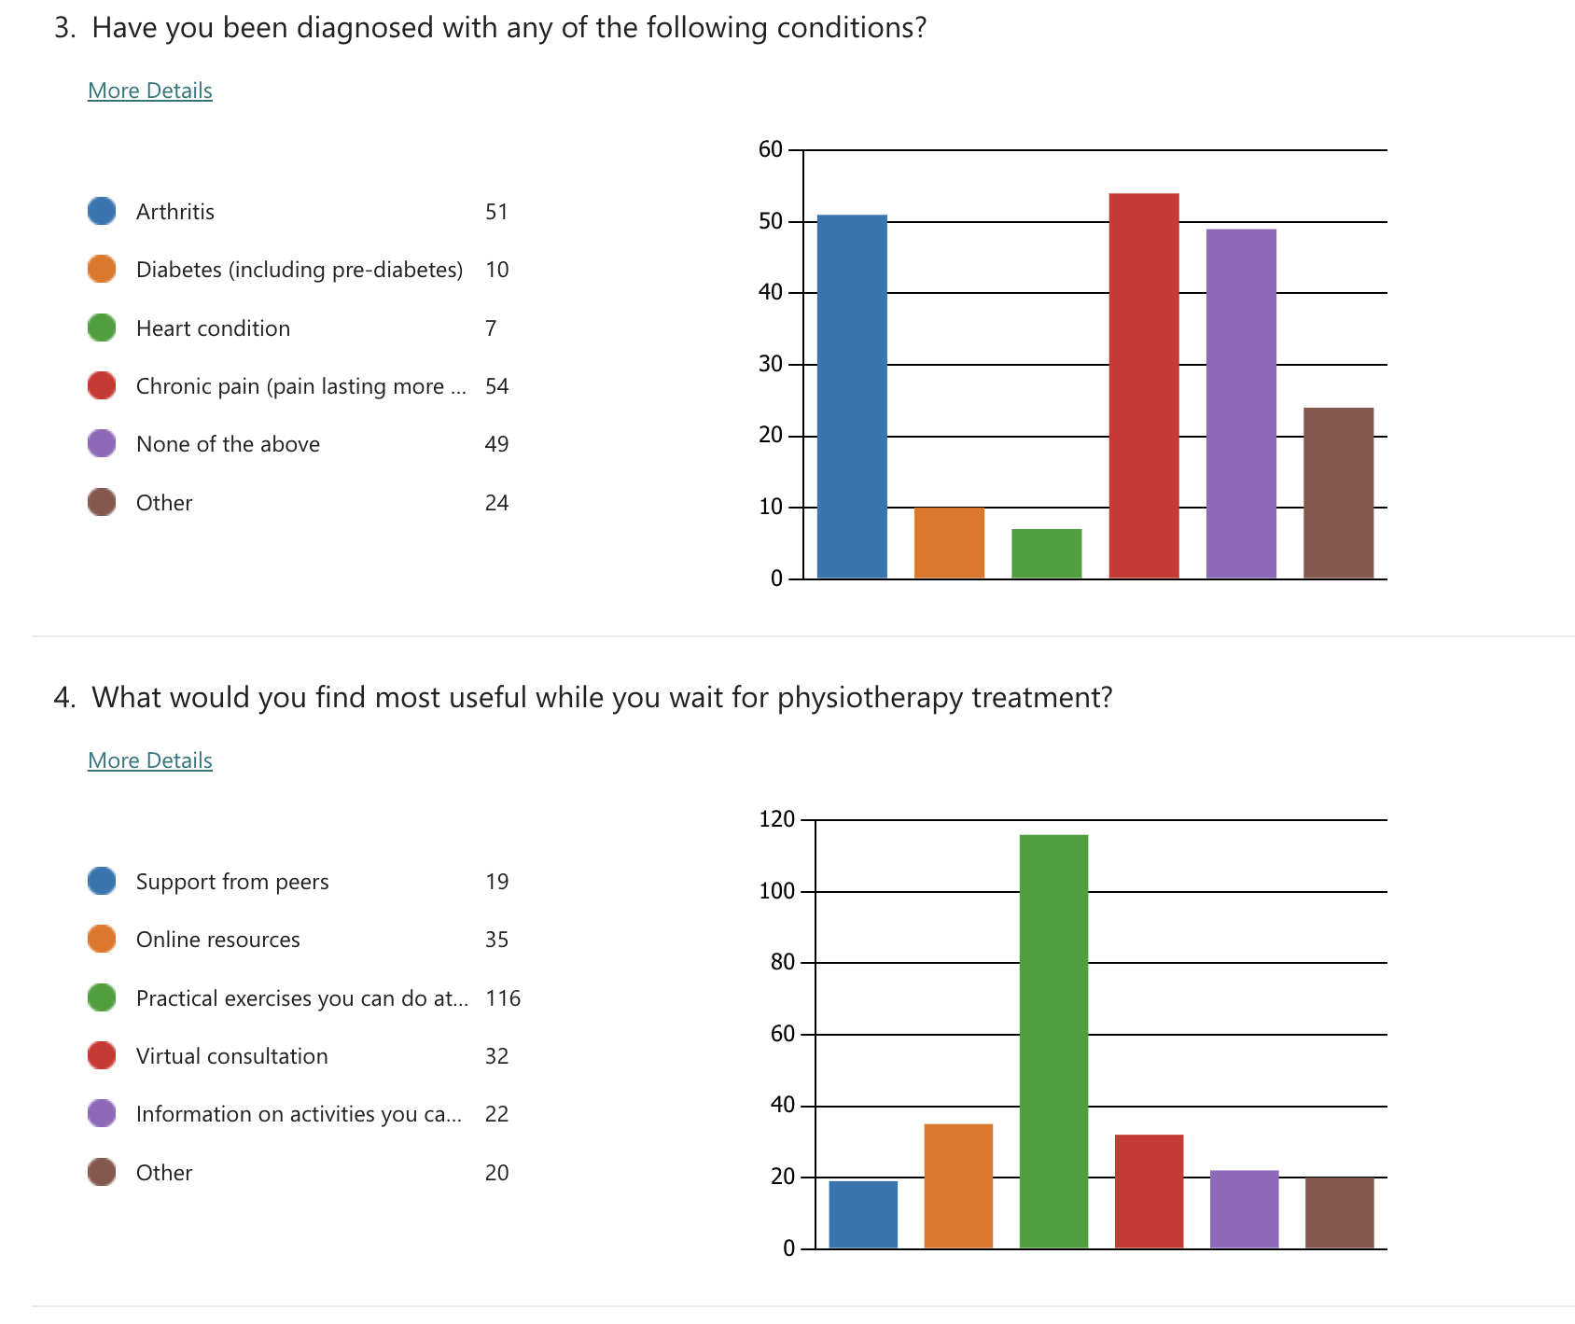
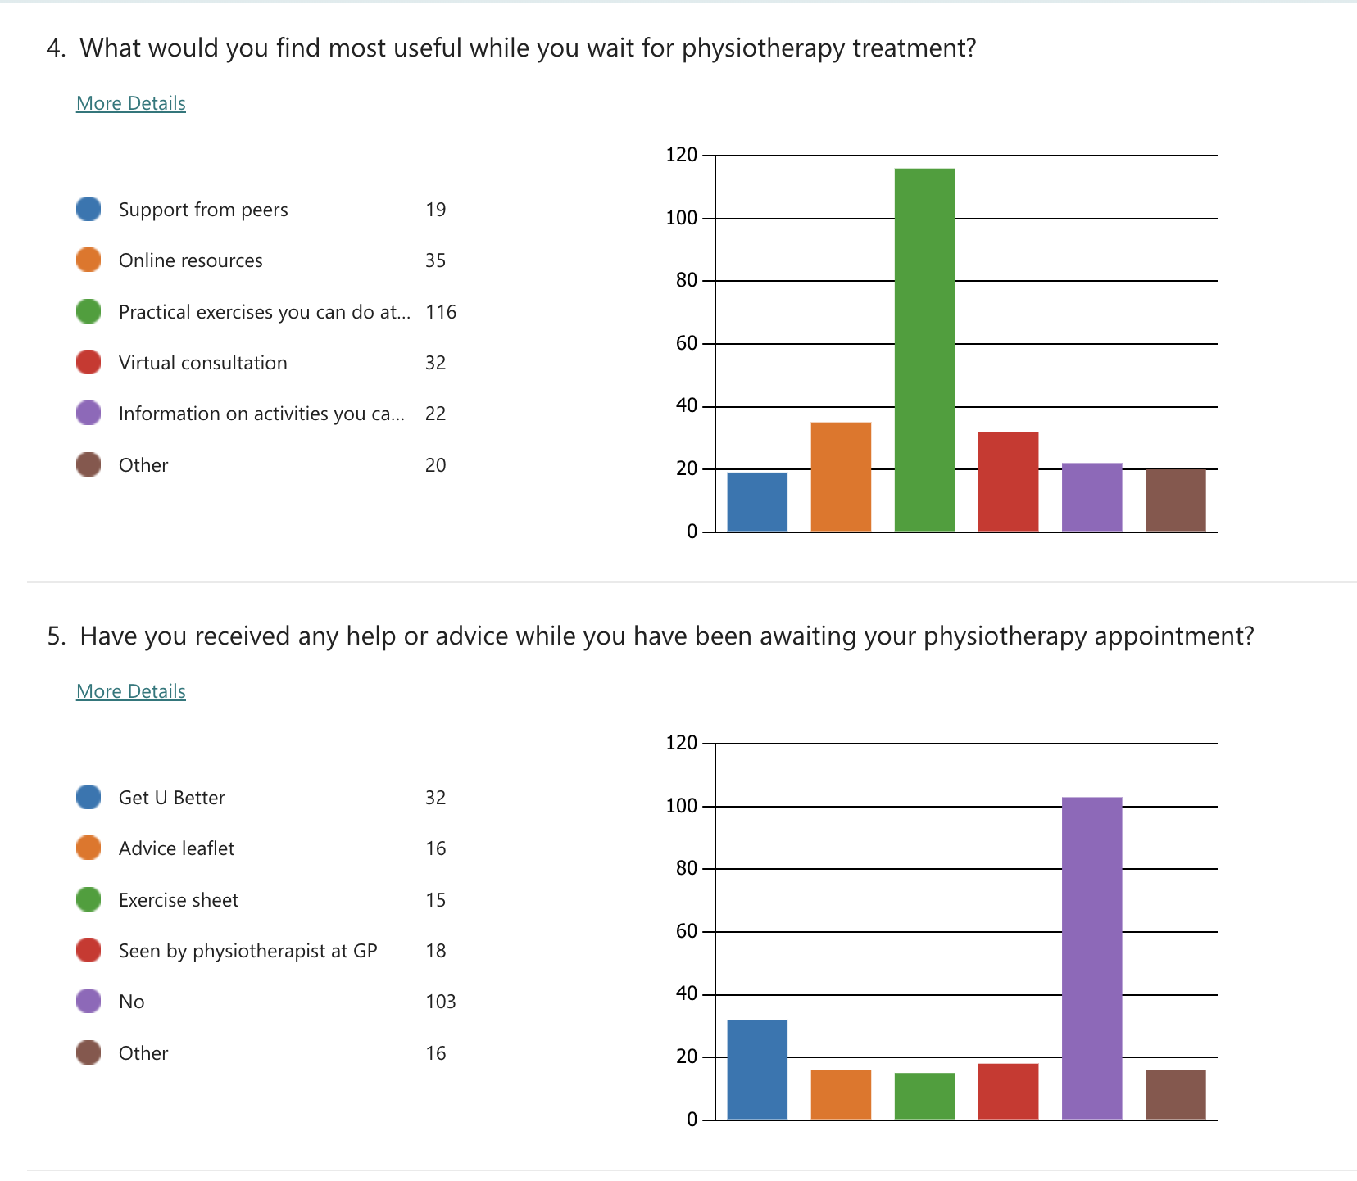
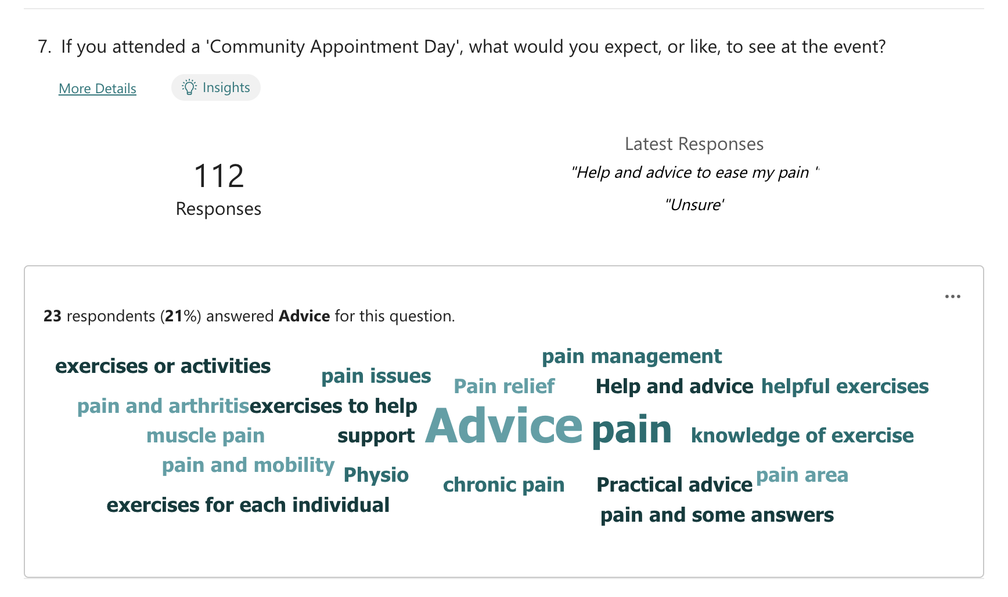

April
Development of Project Steering Group
Creation of the Project Charter
July
Analysis of Waiting List
Community Venue Agreed
August
Community Partner Engagement
September
Invite for Patients to Book
Personalised Care Institute Training
October
Delivery of One-Day Bespoke Training

Slide 13
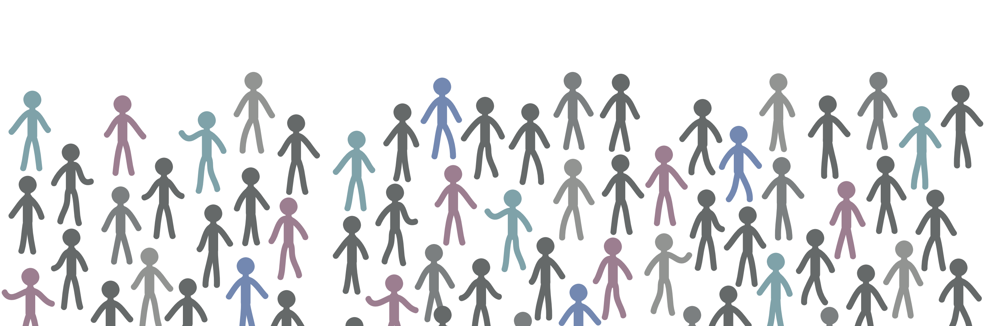
Community Hub

Slide 14







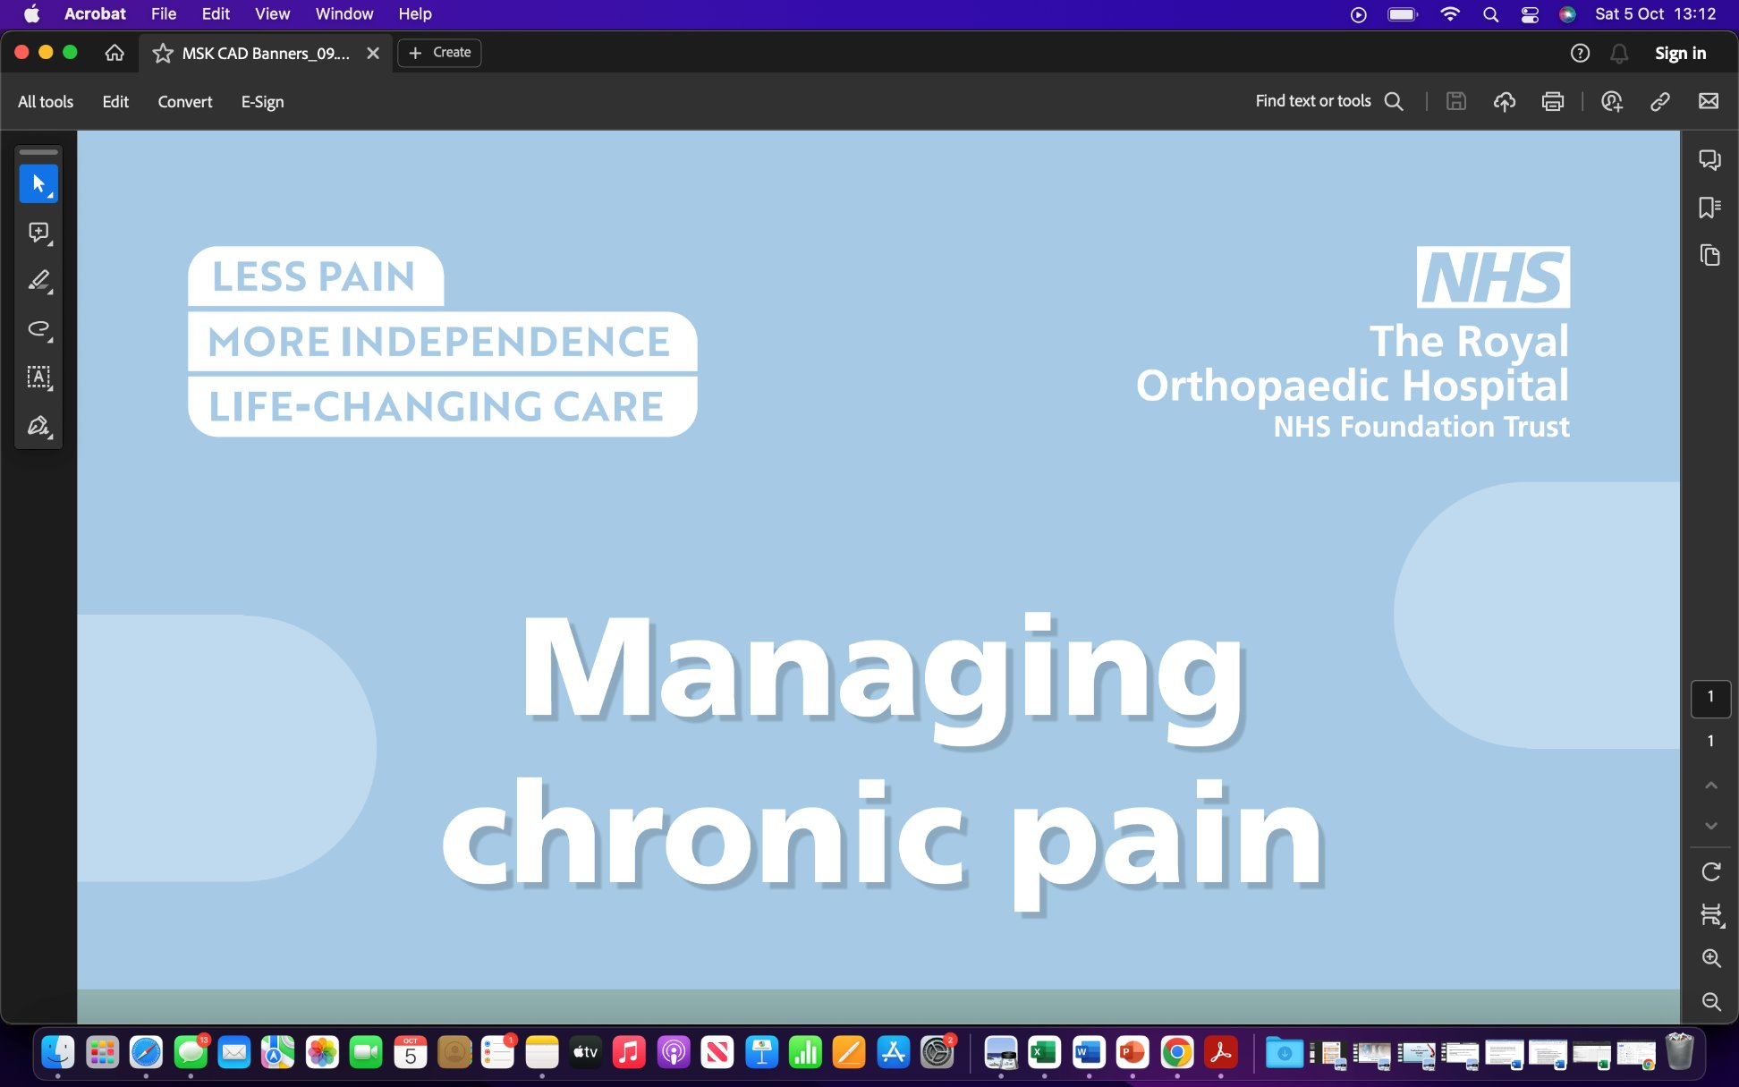









Notes:
17 community partners across two events

Slide 15

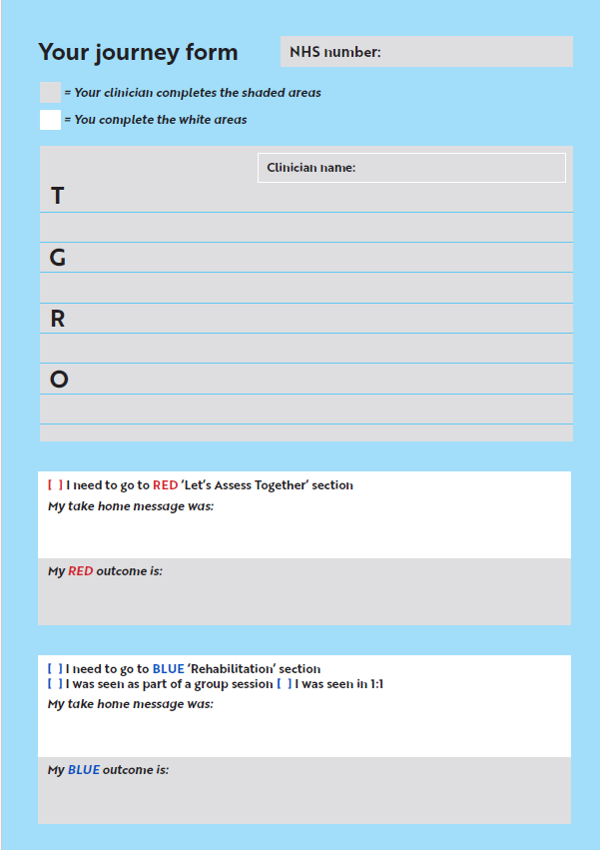
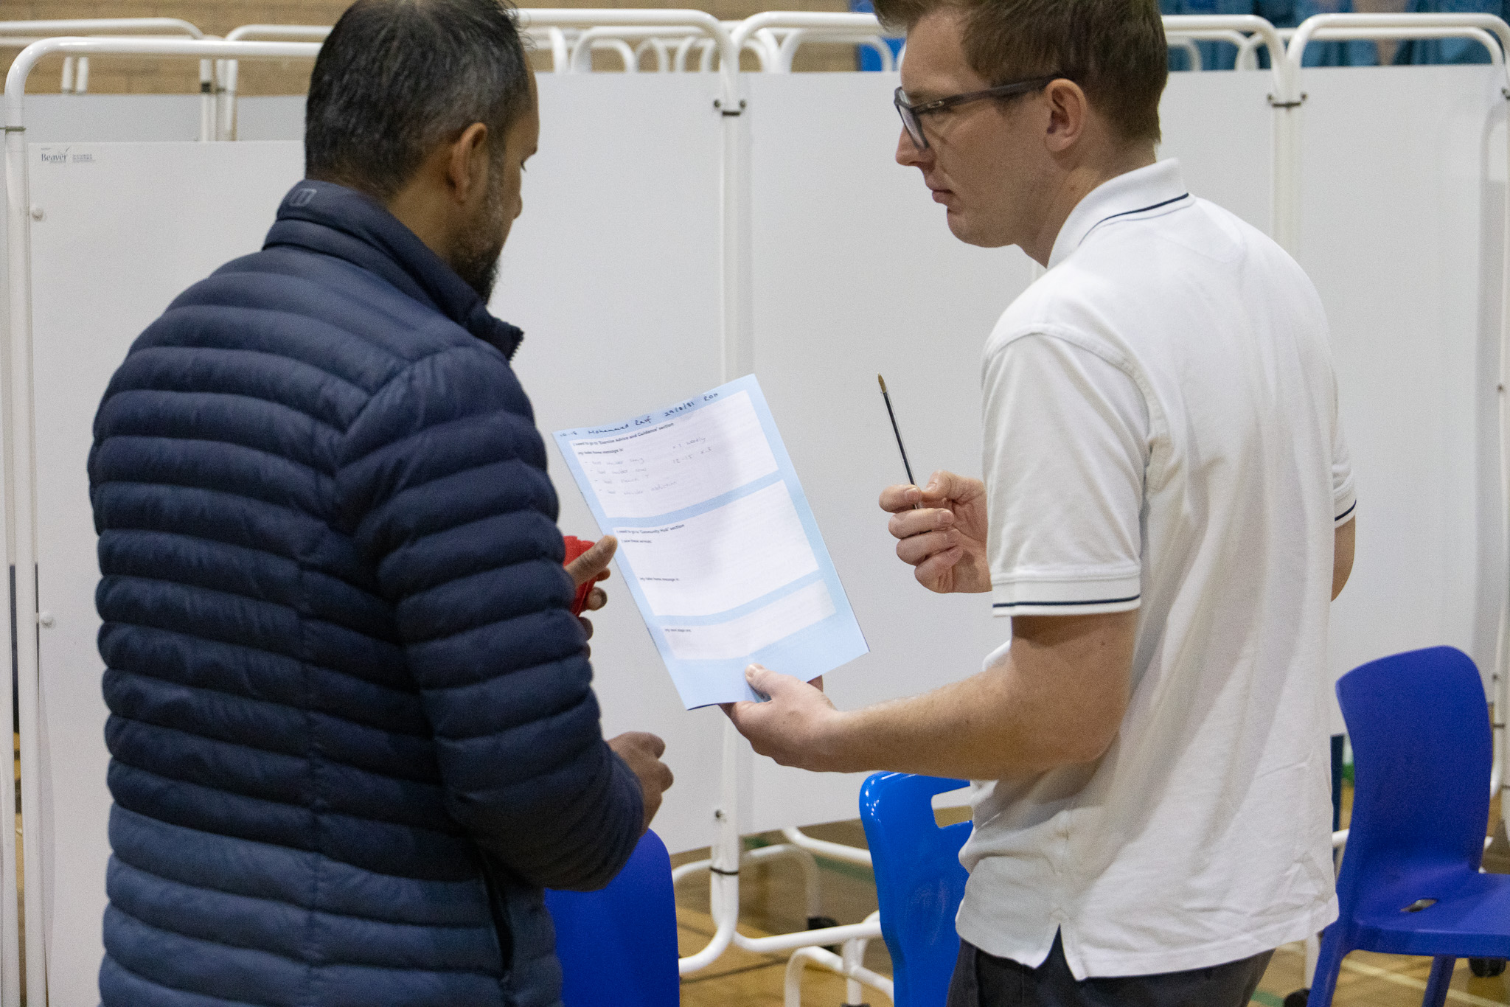
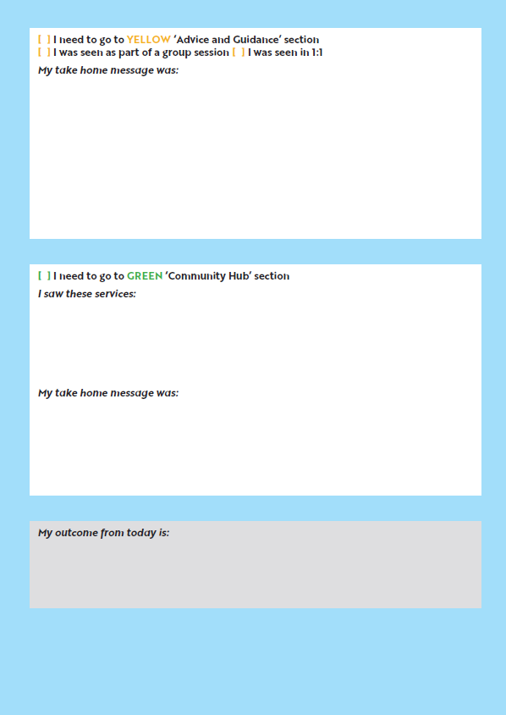
Documentation
Notes:
Hayley ? Training and documentation
Hayley GROW model
Barriers?

Slide 16
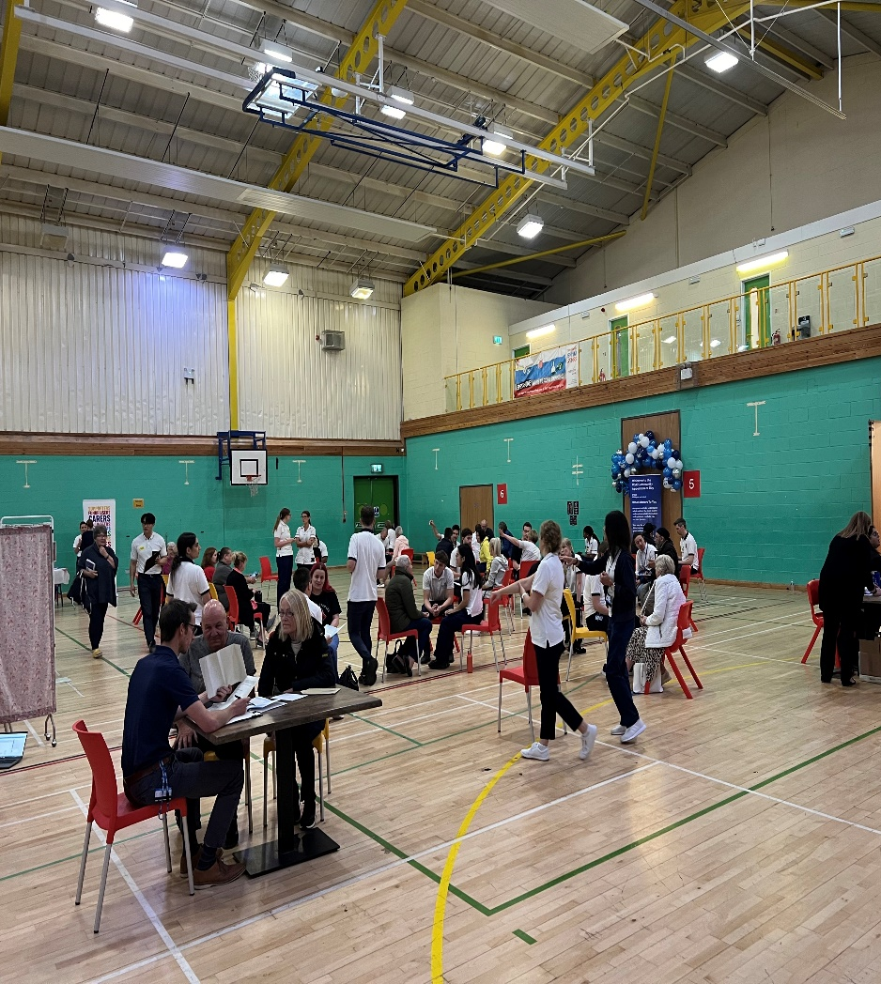
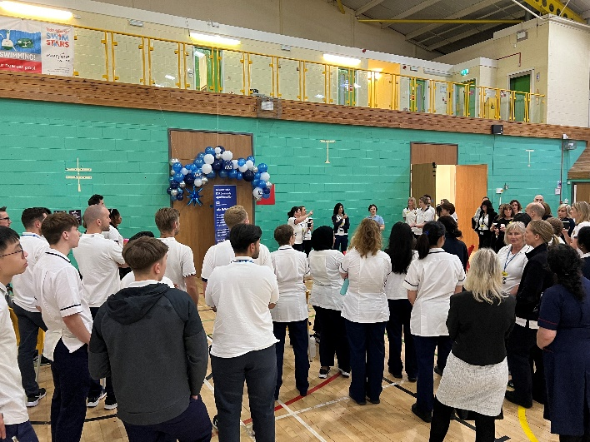
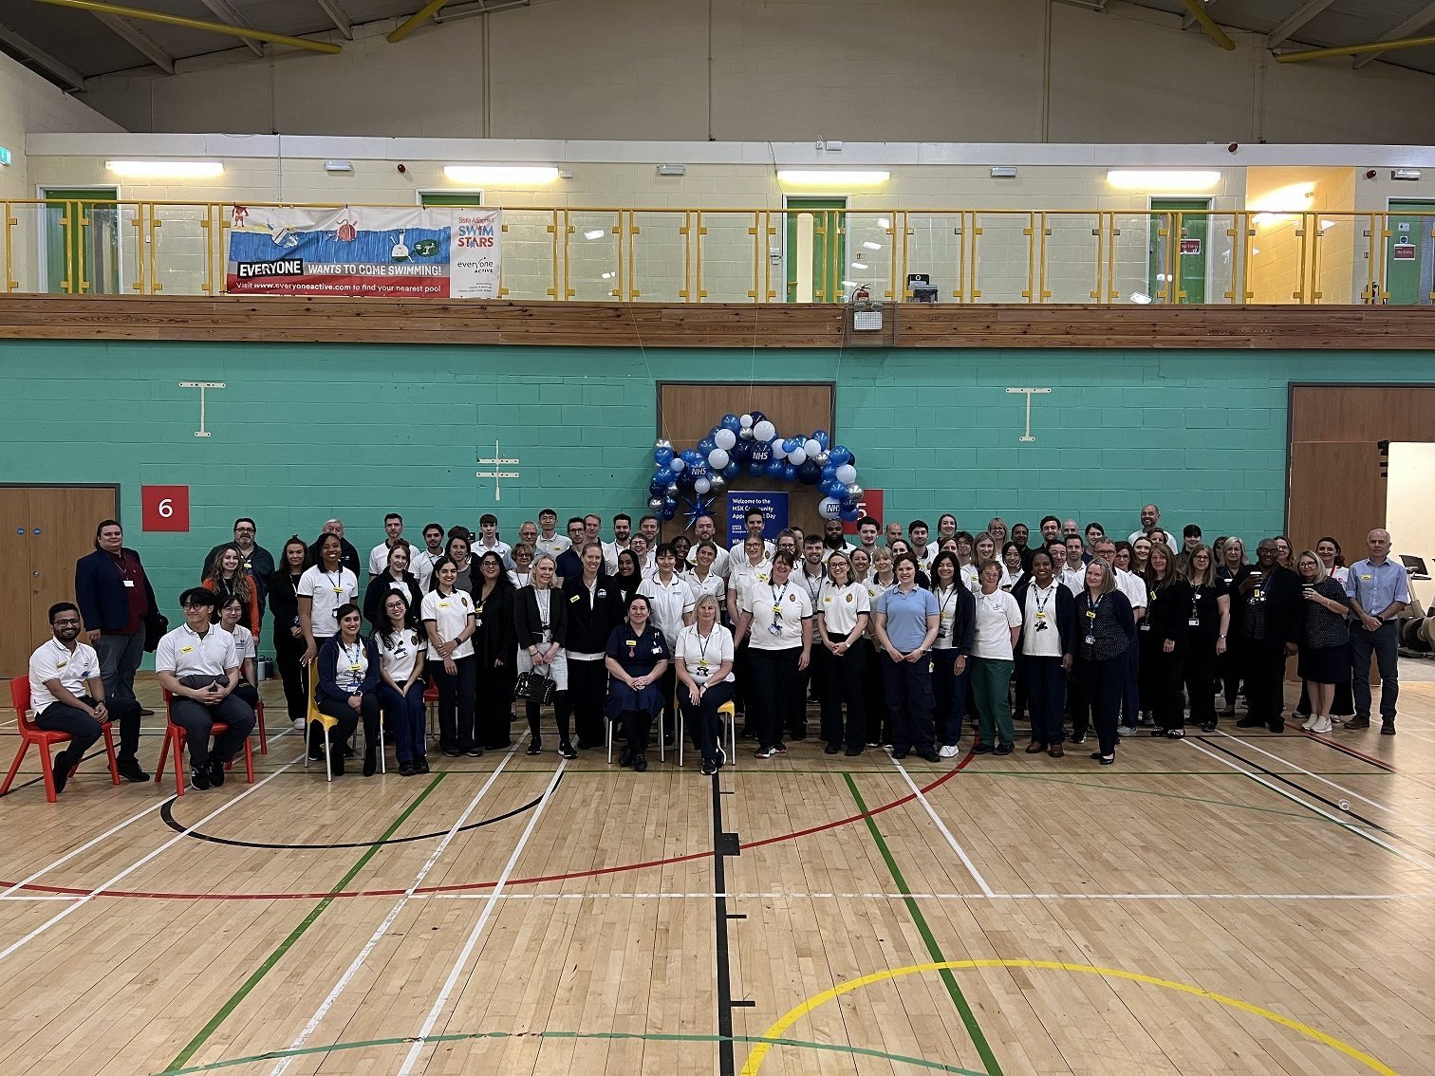
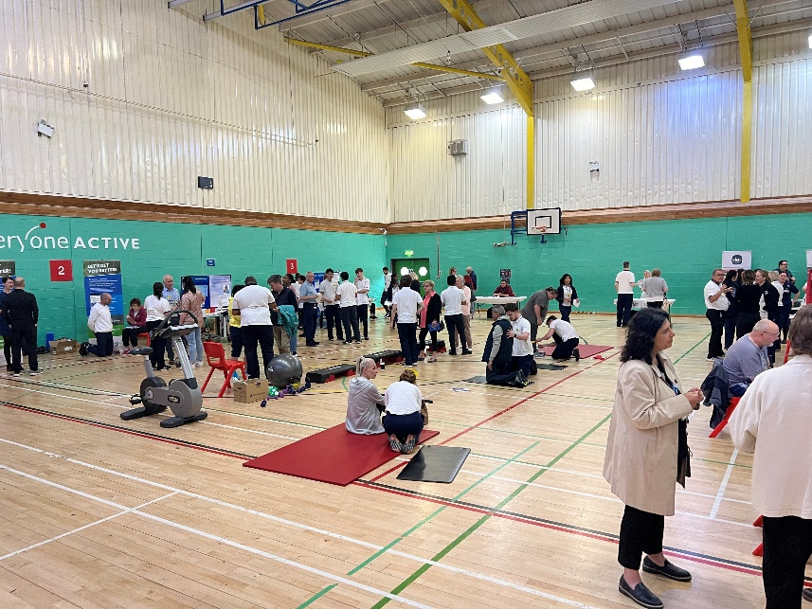
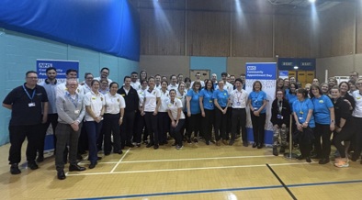
Outcomes
Notes:
? In summary, this was the first CAD in BSOL, achieving positive feedback from patients, peers and partners alike, which is an encouraging start.
?We have had some great learning outcomes to improve on this, which are currently being shared with both the QE/ROH collaboration and the Frailty & Respiratory team in Solihull, already demonstrating this model can be replicated (albeit tailored) to other community services.
? We have already gained so much knowledge and learning from this single collaboration, which is helping shape the future of further Community Appointment Days, including the expert patient inclusion, using both UHB Patient forums and the patient feedback on the day, with plans to approach the patients for further information of how well they feel this has helped 3 & 6 months down the line.
By delivering and promoting such a service, this not only provides a new and exciting method of service delivery and continued professional development for our clinicians and community partners, but ultimately could change the shift in patient care, moving to a more preventative, supported self management, as well as our traditional rehabilitation approach.

Slide 17
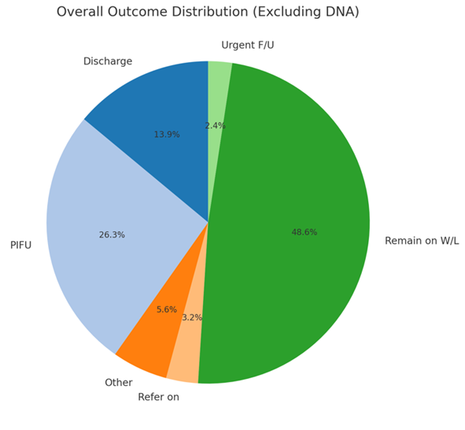
BSol & South Birmingham CAD in numbers
 | Total | % of Accepted
Invited | 779
Accepted | 298 | 38%
Declined | 458 | 59%
Attended | 258 | 86%
DNA | 40 | 13.5%
Walk ins | 5 | 0.006%
PIFU | 137 | 53%
FU Booked | 77 | 30%
Discharged | 16 | 0.06%
Notes:
Priliminary results from the spinal mini CAD are showing very similar percentages, and if we continue to analyse the data from the collaborative CADS, we can demonstrate trends of success and appreication from the patients, plus the confidence growth of the clinicians:
Just to give you a rough idea of the success of 113 patients invited to mini CAD:
48% acceptance (slightly higher that the main days)
our DNA rate was 14.5%, so around a normal day
PIFU was 40% (similar to the main CAD)
Data cleanse 13% (of patients invited and stated no longer required Physio)
FU 45% of which 20% was for an Ax to go into the groups (and again like the main CAD)

Slide 18
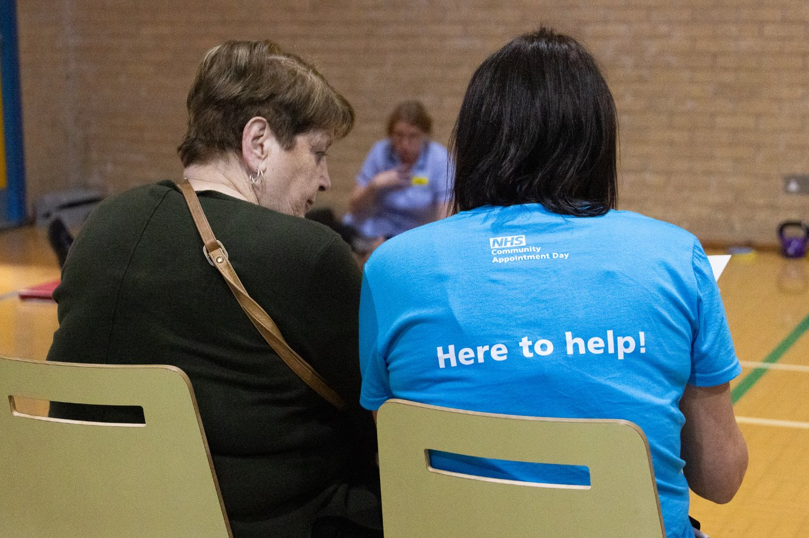
Patient Testimonies
Extremely satisfied with how my visit to the appointment day has helped – Especially with the guidance from the senior Physio
Excellent idea to run days like this to help a lot of people without feeling rushed
Great event, I found it really reassuring and helpful
They were helpful and gave some great advice and information. They gave me the right exercises to do. A really good day.​
Sarah who discuss my issues was extremely helpful and very friendly. Peter in the Brace section was also extremely helpful and knowledgeable
I feel when people get together you realise you’re not on your own, sometimes I feel isolated
Very knowledgeable and all different types of help
The staff seemed to have more time to discuss the issues I was having.
Time was given and every concern was taken into consideration
So understanding. Explained things clearly. Took time to listen and assess

Slide 19
Community Partner Testimonies
Age UK – A worthwhile event, organisers very communicative, great to speak to patients
SIAS – impressed by the number of attendees and felt had been successful in reaching out to the public in generally
Time to have conversations with patients. Multiple services to input
Versus Arthritis – Saw around 60 patients, giving valuable advice and raising the profile of the charity.
Felt involved and supported by the team.
OSSUR – Great working alongside the Knee Brace Team, and having direct impact with patients
Lovely feedback at the end from the team lead about contribution to the day and how appreciated work during the day was
Huge organizational task but very well led and posture collaboration with partners

Slide 20
Staff & Partners Feedback
57 Responses
How well prepared did you feel in advance of the CAD?
How well did you understand your role and responsibilities on the day?
Notes:
KIRSTIE The staff & partner feedback was also requested on the day and emailed out to staff and partners post CAD, with 13 questions, to include what role they played on the day, if they attended the training day, and any improvement suggestions
The evaluation for this information is currently being coded for trends and allowing qualitative data, but the raw data we can see today around the training and the staff feeling prepared is positive in the main part.
In the training day, ROH & BCHC were invited to attend, and where they were able they did. They have also seen the value in the training day, to allow the clinicians and admin to come together as one team, and had a safe platform to have their opinions, ideas and concerns listened to.

Slide 21
Notes:
KIRSTIE’s staff and patient feedback slide and or a coproduction slide with the community partner comments –
Reflect how the staff, patient and partner feedback parallels that of the Sussex Interim Report re: CAD. *** Very similar comments as mentioned in my email to you both!! ;)
I've used this as a quick comparison – the one on the left is Patients, and the one on the right is staff – it shows a similar result to the outcome!

Slide 22
Staff & Partners Feedback – cont…
57 Responses
How much did you enjoy taking part on the day?
To what extent did you feel valued and appreciated for your contribution to the CAD?
Notes:
KIRSTIE Here we can see that the staff and partners not only enjoyed the day, but felt valued in their contribution to the day – in the qualitative data being analysed this is coming out as being valued in both their patient input and their overall contribution

Slide 23
Staff & Partners Feedback – cont…
57 Responses
How did the care offered at this cad compare to standard NHS MSK Physio care?
How well do you think the format of the CAD facilitated the delivery of MSK Care?
Notes:
The same question was asked of the staff and partners as the patient question of a comparative to ‘normal’ NHS care, and interestingly, the percentage split is roughly the same as the patient split, with minimal of both patients and staff considering this a worse way to deliver care to the community.

Slide 24
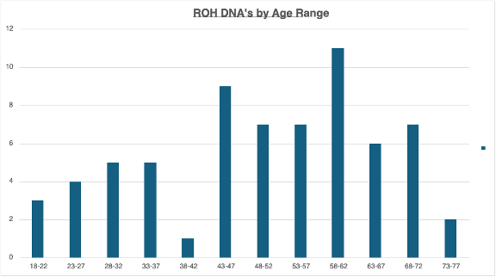
DNA's
Notes:
68 DNA's from ROH patients

Slide 25

Next Steps...
Mini CADs – specialty specific and non MSK​
BHH/GHH/BCHC​
Analysis Social Justice ​
Business as Usual?​
Collect & Analyse Feedback
Evaluate Impact of the CAD
Explore Future Utilisation of CADs to Improve MSK Health

Slide 26
Notes:
Project Aim
To pilot the running of a Community Appointment Day, in collaboration with UHB MSK Community Services and UHB MSK Acute Services. If successful, the plan is to roll out further events across BSOL in collaboration with UHB, ROH and BCHC. The future aim would be to continue to hold several events a year, at different locations yet to be agreed, across the Solihull Borough for the Solihull Community and Acute services.
Rationale
A Musculoskeletal (MSK) Community Appointment Day (CAD) is an innovative approach to providing support to patients on waiting lists for physiotherapy and other MSK services. It involves inviting patients on the waiting lists to a central location in the community, often a leisure centre, for an opportunity to connect with a variety of clinical and voluntary sector support services.
Whilst this is not specifically a waiting list initiative, the end outcome is expected to have a positive impact on waiting list size and waiting times for patients who remain on the list. The focus is on preventative care and overall well-being, rather than just treating the specific MSK issue and uses a “What Matters To You” approach.

Slide 27
References
Sussex MSK Partnership Central. Community Appointment Days Evidence Review and Evaluation Interim Report August 2024
Stronger Things Live Lounge: How Community Appointment Days cut health and social care waiting lists - New Local
Department of Health and Social Care. (2019) The NHS Long Term Plan. https://www.longtermplan.nhs.uk/
Department of Health and Social Care. (2018) Prevention is Better than Cure. https://www.gov.uk/government/publications/prevention-is-better-than-cure-our-vision-to-help-you-live-well-for-longer
Allied Health Professionals (AHP) Strategy for England: AHPS Deliver (2022) NHS Englandhttps://www.england.nhs.uk/ahp/allied-health-professions-strategy-for-england/
Birmingham and Solihull Integrated Care System. (2023) A Bolder, Healthier future for the People of Birmingham and Solihull. https://www.birminghamsolihullics.org.uk/about-us/our-integrated-care-partnership/our-integrated-care-strategy-2023-2033

