Slide 1
Vijay Selvaraj
Therapy Manager
Supporting Internationally Recruited staff
Thanks to Matt, Amy and rest of the WEB Therapy Team.
Royal Devon University Healthcare NHS Foundation Trust

Slide 2
What support We offered
Clinical Leads
Peer Support
Network( Ethnic Minority, Special Interest, Clinical Champions)
Practice Education Team
Pastoral Support
Occu-Health-Offered
Employee Support Officer
HR
CSM

Slide 3
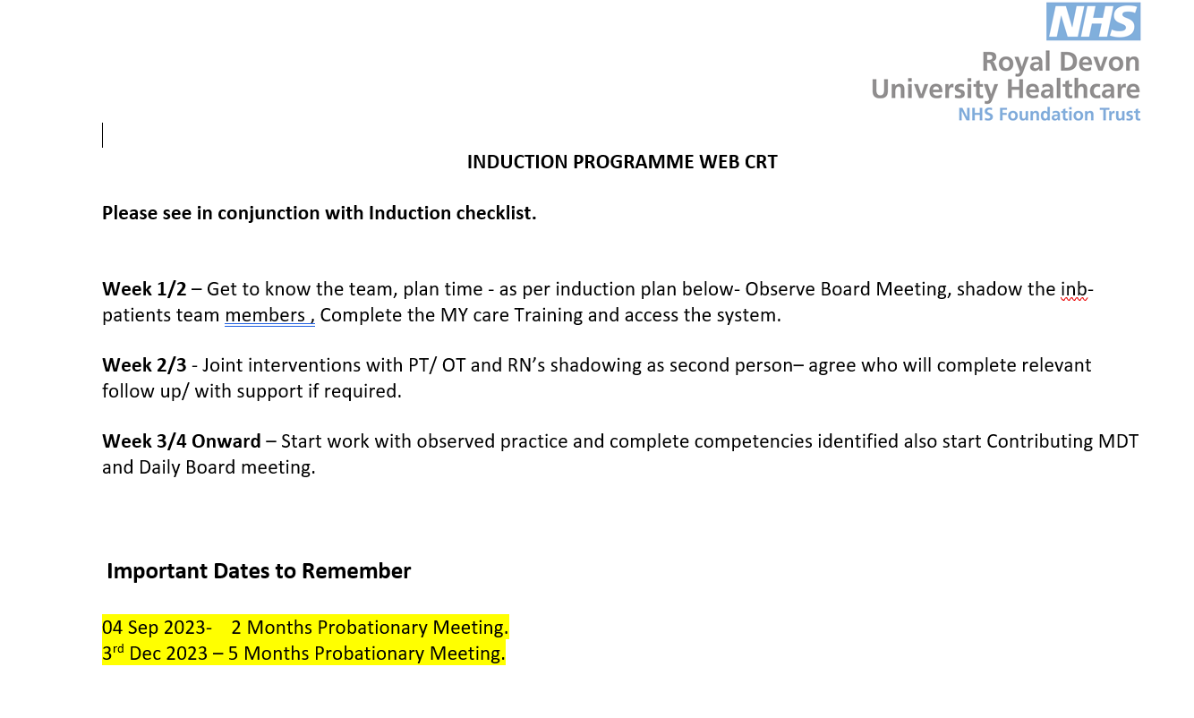

Slide 4
10 point Scale from Job Descriptions
Self- rating TM+ CL rating Evidence
Communication and relationship skills 8 3 Supervision discussions, observed px, team feedback
Analytical and Judgement skills 7 2 Observed px, notes, team feedback, clinical discussion.
Planning and Organisational skills 7 2 Caseload completed w/c 04/09.
Physical skills 7 3* Not enough evidence – a/w Moving and Handling risk Ax. Training.
Responsibility for pt and client care 6 1 Observed px, feedback from team, notes, Rx plans, clinical discussions
Responsibility for financial & physical resources 6 N/A* Not yet completed M&H training, but issues around wzf / Return advice to pts.
Responsibility for human resources 5 N/A* Not enough evidence to rate - not demonstrating so far.
Responsibility for information resources – 2 Inaccurate notes, struggling with small caseload.
Responsibility for research and development – 1 No evidence indep reflective activity, poor awareness skills / knowledge gaps.
Decision making 6 2 Not managing 5 pts, poor feedback board meetings. CPD evidenc submitted HCPC?
Physical effort 7 N/A* A/w risk Ax training. Needing prompts to prep treatment area.
Mental effort 8 2 Lacks dynamic Ax skills, limited awareness of feedback from MDT and changes to presentation, notes interpretation not thorough and requiring to make notes to discuss histories.
Emotional effort – N/A* Not enough exposure.
Working conditions 8 N/A* Ward-based currently but min feedback from shadowing UCR/CRT.

Slide 5
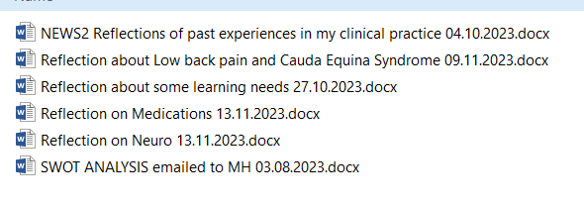

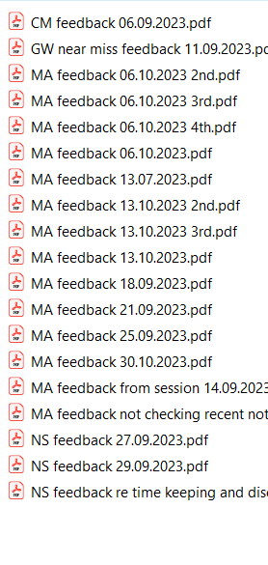
SMART Goals- Agreed time frame- Reflective practice- Evidence of support

Slide 6





Additional Support

Slide 7

ANY Questions?

