Slide 1
Vijay Selvaraj
My Journey in NHS since 2008

Slide 2
My First ever Job in NHS
Jan 2008
Locum Job as B5
Community Hospital Stroke Rehab…
Communication barriers
Struggle to navigate
Cultural shock with care arrangement
Driving on motorway, other road users beeping at me

Slide 3



Slide 4
Communication
Inhaler Fail | House M.D. (youtube.com)
iMedia l Short Film ' The Wait ' (youtube.com)

Slide 5

How to get back to my passion
Change in Career path 2016
Special Interest
Travelled all over for Interviews
44 interviews
2009 Start as B3

Slide 6


Slide 7

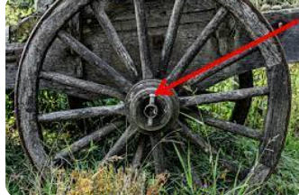
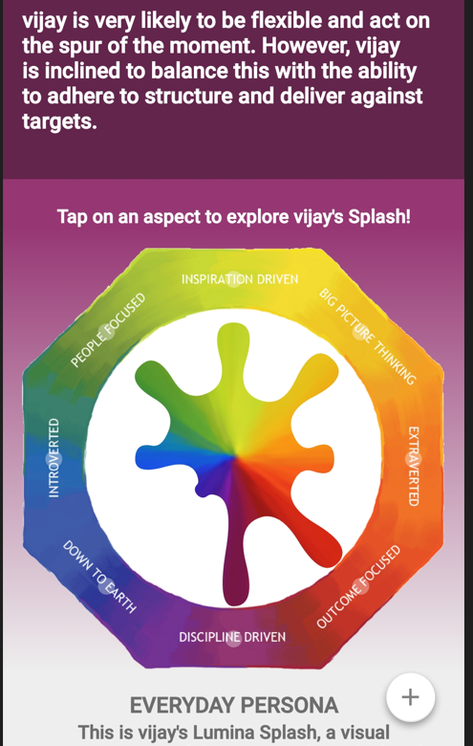
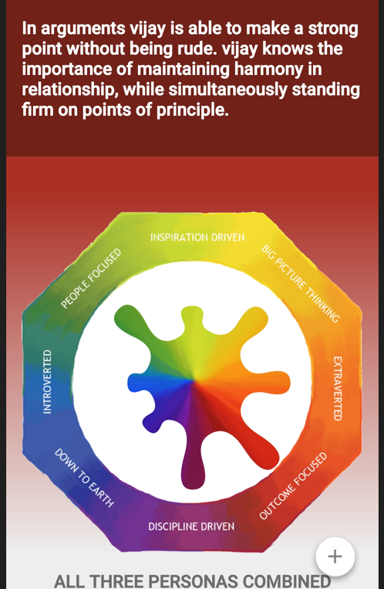

Legacy- Lynchpin-Empathetic Leader
ELHT
CMFT
HFT
RDUH

Slide 8

Moving forwards
“The secret of change is to focus all of your energy, not on fighting the old, but on building the new.”
Socrates

Slide 9
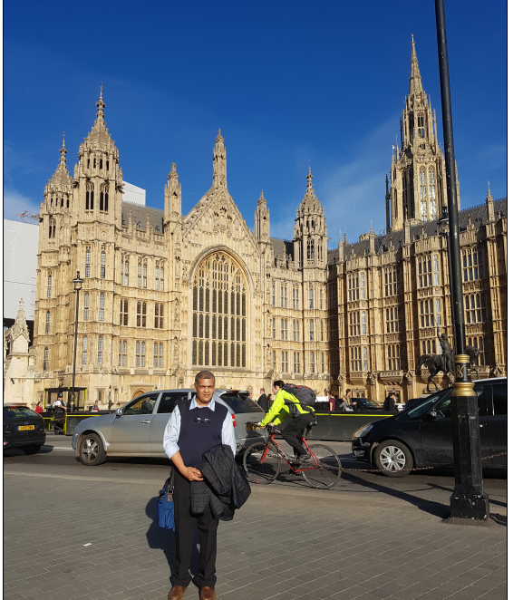

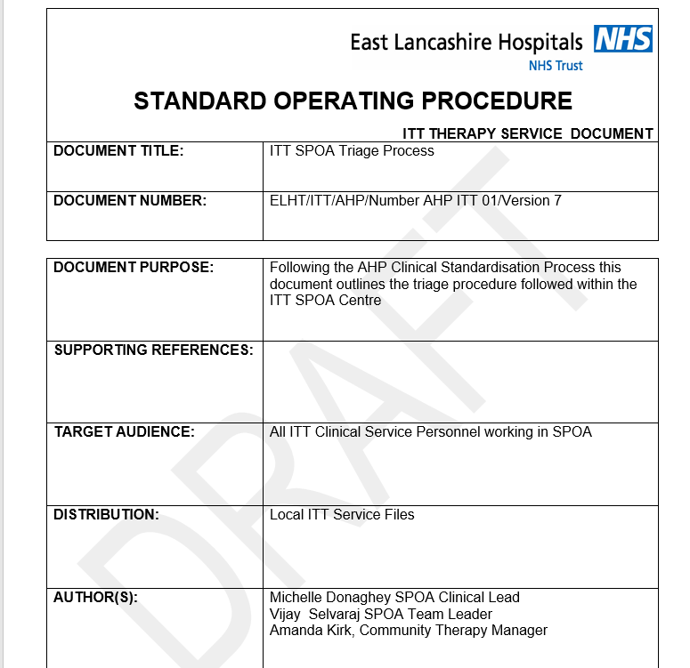

Rehab Matters
SPOA

Slide 10
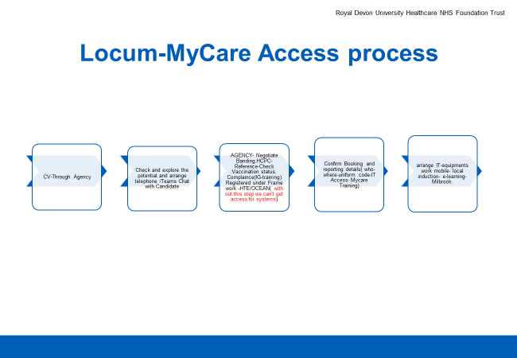


My Contributions

Slide 11
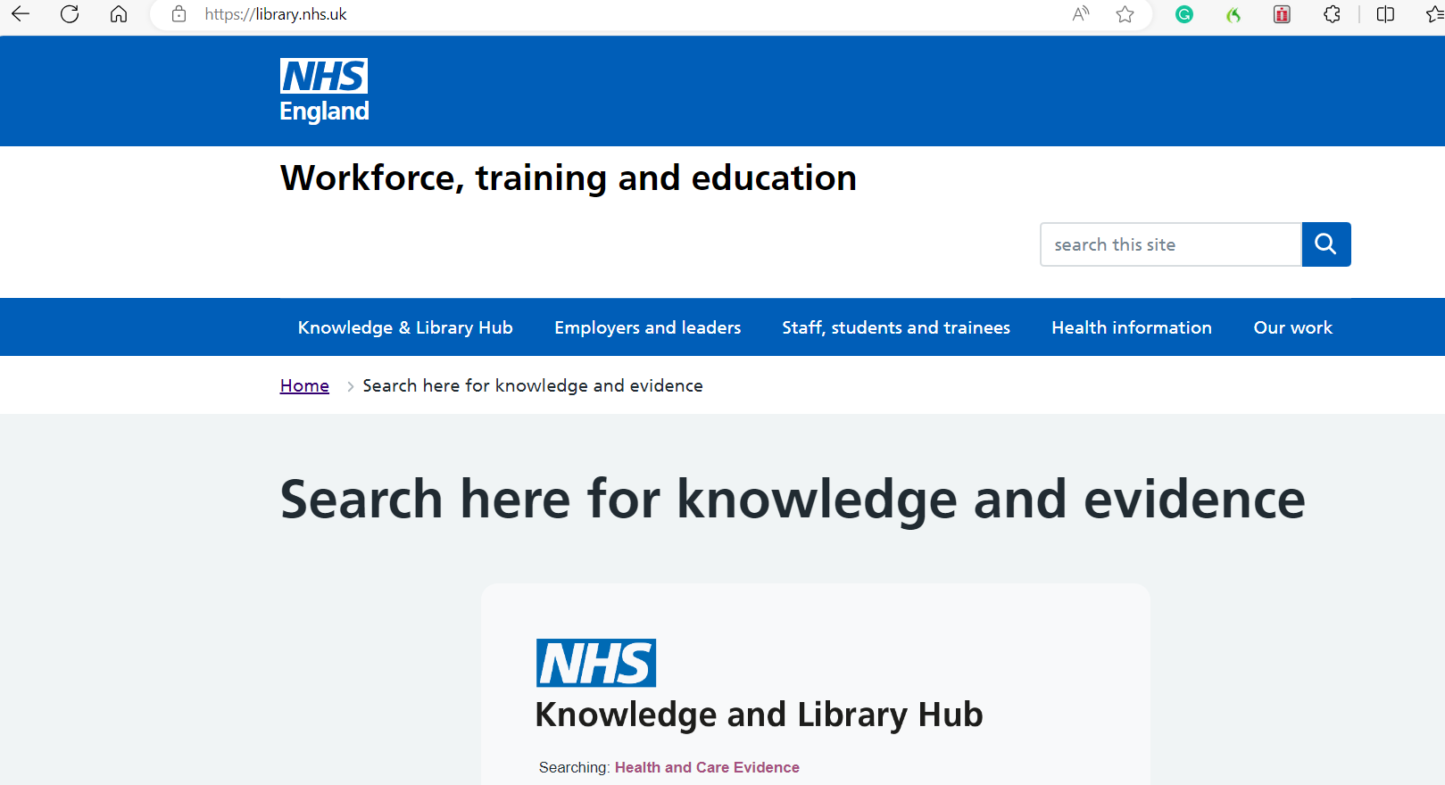
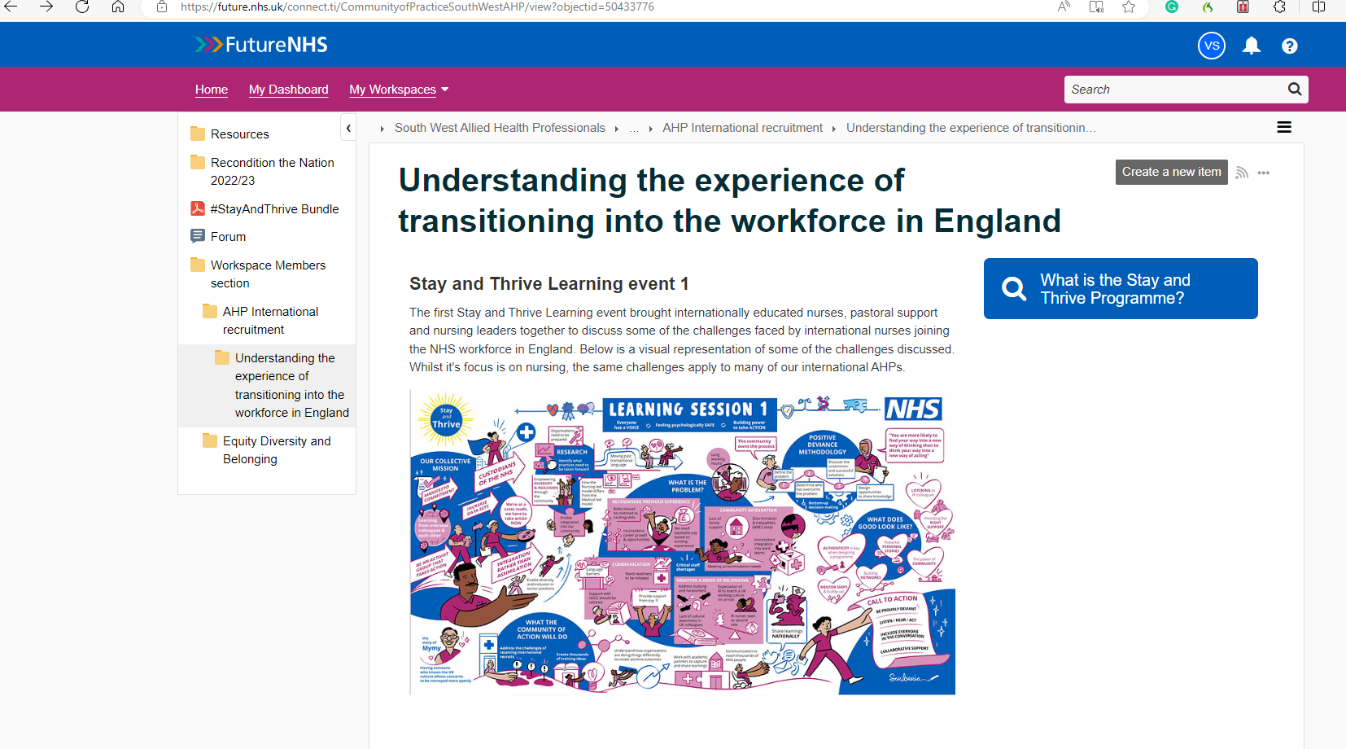

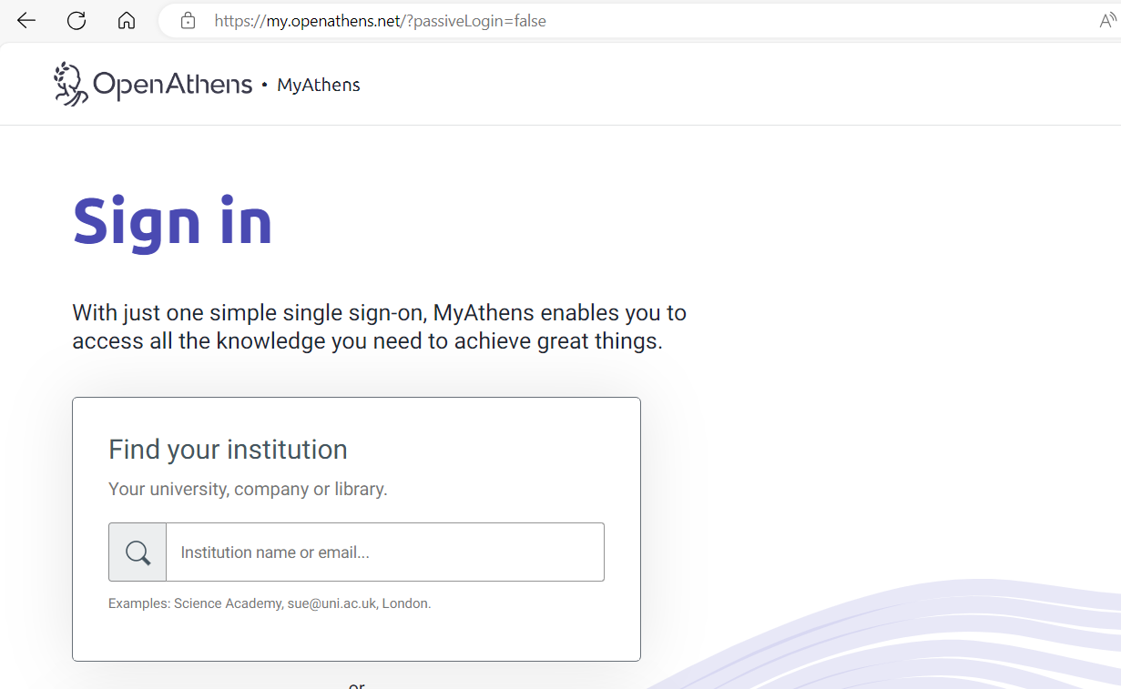
Additional Resources

Slide 12
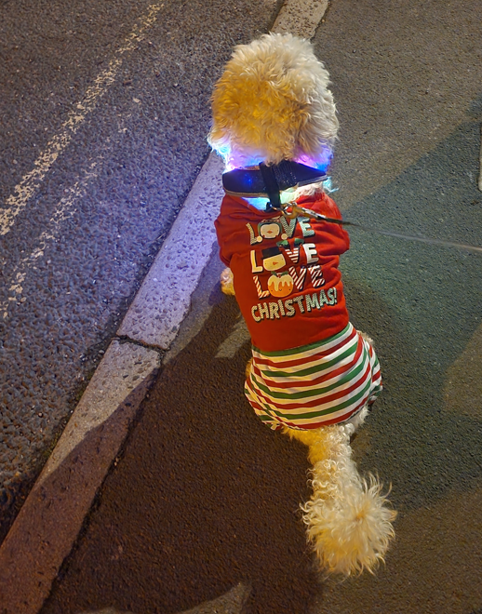
ANY Questions?
vijay.selvaraj2@nhs.net

